Slide 1
Binary Analysis Tools:
Debuggers, Reversers, and more

Slide 2
Tools
Debuggers
  GDB, LLDB
  GDB plug-ins: PEDA, pwndbg, GEF
Disassembler / De-compiler
  IDA Pro
  Ghidra
  Radare2
Command Line Tools
  readelf, objdump,
  bash/zsh, tmux, vim …
  ltrace, strace, lsof
  xxd
Python pwntools
  Swiss army knife for hacking

Slide 3
GDB Debugger
GDB (Vanilla)
  De facto standard
  Run on binary, process, coredump
  Expose extensible API (Python)
GDB + PEDA
  Old school
GDB + pwndbg
  Comprehensive and heavy weighted, ARM and x86
GDB + GEF
  Light-weighted but powerful
  ARM and x86
Notes:
animation

Slide 4
Running GDB
$HOME/.gdbinit
  Pre-loaded every time you run gdb (to save your typing)
Three modes: (1) run a program, (2) attach to a running process, (3) *coredump analysis
  $ gdb level0
  $ gdb –p <process id>
  $ gdb level0 core
*coredump : consists of the recorded state of the working memory of a computer program at a specific time, generally when the program has crashed or otherwise terminated abnormally
Notes:
consists of the recorded state of the working memory of a computer program at a specific time, generally when the program has crashed or otherwise terminated abnormally

Slide 5
GDB: Basic Commands
info <subcommand>
  showing various w.r.t. debugged program / context
apropos < REGEX >
  Search for commands matching a REGEX (~ man –k )
set <VAR> <EXPR>
  Assign EXPR (expression) to VAR (Variable)
disas function | *addr
  disassemble
⏎ (enter)
  Repeat previous command
telescope <subcommand>
  a.k.a `dereference`
  simplifies dereferencing memory aliases

Slide 6
GDB: Basic Commands
b (reakpiont) main | *0x80808080
  Set a breakpoint at the main function (or address *0x80808080)
r(un)
  Run the program up to the break points
  You can add arguments or pipe stdin
    pwndbg> r < /tmp/input
c(ontinue)
  Continue (resume) after break point

Slide 7
GDB Stepping comands
n (next)
  Execute next statement, does not follow function calls
ni (nexti)
  Execute next instruction, does not follow function calls
s (step)
  Execute next statement, follows function calls
si (stepi)
  Execute next instruction, follows function calls
f (finish)
  return from the stack frame

Slide 8
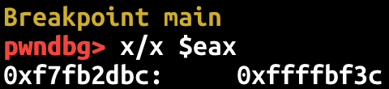
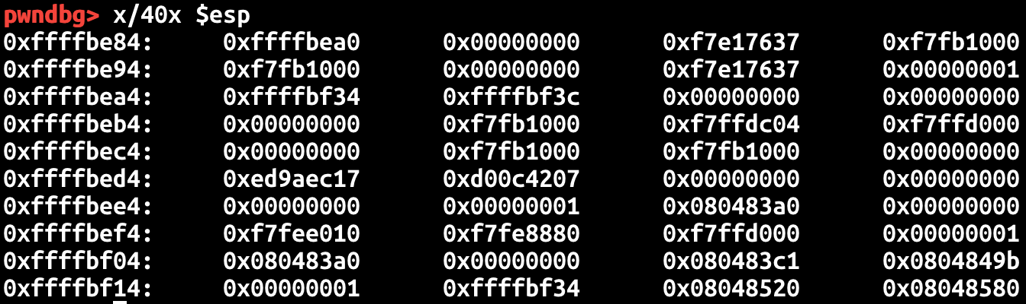
GDB: eXamine
x/x $eax
  Get the value of eax register
x/40x $esp
  Get the 40 integer values stored at the address pointed by esp

Slide 9
Stack
MY_ARG2
Grow
MY_ARG1
Return IP
CPU Stack (grows downward)
  Starts with %ebp
  Ends with %esp
Negative indexing over %esp
  Local variables
Positive indexing over %ebp
  Function arguments from caller
Positive indexing over %esp
  Function arguments to callee
Saved EBP
%ebp
Local A
ebp-8
Local B
ebp-c
Local C
ebp-10
ARG 2
esp+4
ARG 1
esp
%esp

Slide 10
Stack Usage Example
MY_ARG2
MY_ARG1
Return Addr
Saved EBP
%ebp
pushl $0x80485a0
  Push means adding an item to the stack top
Local A
ebp-8
Local B
ebp-c
Local C
ebp-10
%esp

Slide 11
Stack Usage Example
MY_ARG2
MY_ARG1
Return Addr
Saved EBP
%ebp
pushl $0x80485a0
  Push means adding an item to the stack top
Local A
ebp-8
Local B
ebp-c
Local C
ebp-10
0x80485a0
%esp

Slide 12
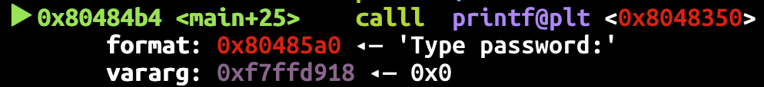
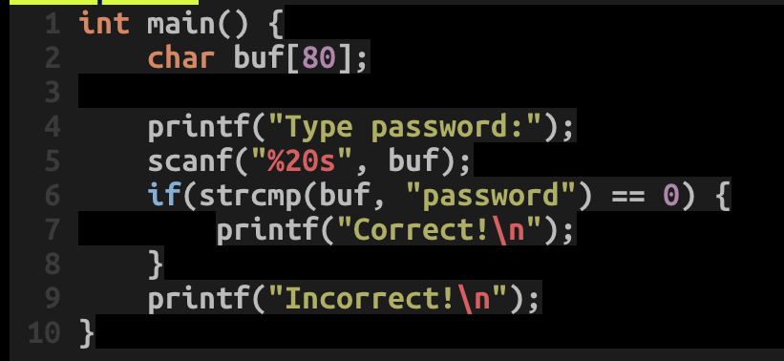
GDB: shows func arguments
Shows arguments when calling a function
So it’s
  printf(“Type password:”);

Slide 13
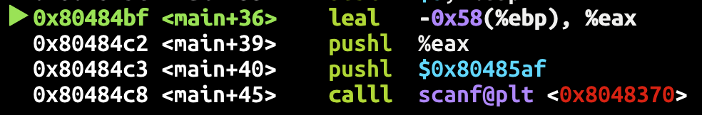
Local Buffer Variable
scanf(“%20s”, buf)

Slide 14
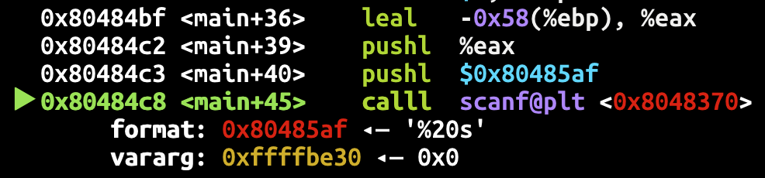
Local Buffer Variable
MY_ARG2
MY_ARG1
Return Addr
Saved EBP
%ebp
scanf(“%20s”, buf)
-0x58(%ebp), negative indexing over %ebp
  A local variable
buf
ebp-0x58
lea –0x58(%ebp)
0x80485af
%esp

Slide 15
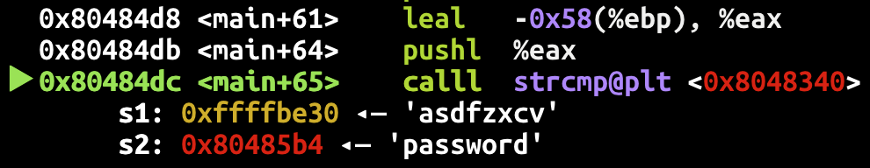
Handing Conditional Branch (if)
strcmp(buf, “password”)
-0x58(%ebp) stores our input, and it is compared to ‘password’

Slide 16
Handing Conditional Branch (if)
if (strcmp(buf, “password”) == 0)
testl: performs logical comparison (and, or, etc),
cmp: performs arithmetic comparison (above, below, greater, less..)
jne: jump if not equal, equal here means zero
The green checkmark indicates it’s taken!
  Meaning that testl return value is non-zero

Slide 17
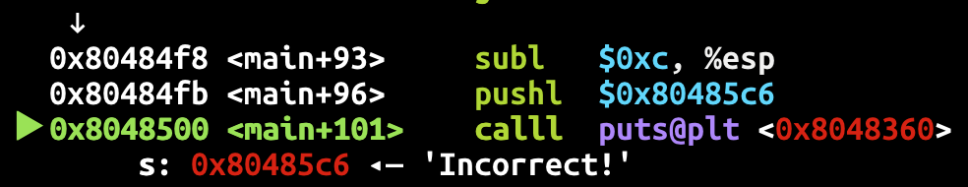
After jump..
Incorrect…

Slide 18
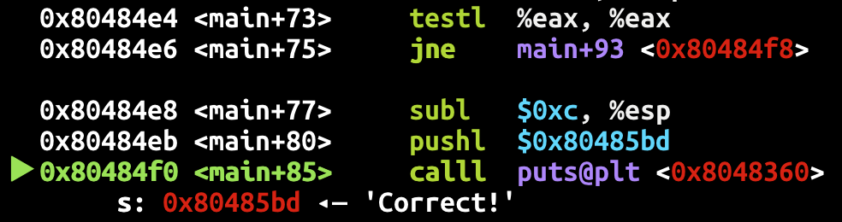
If "jne" fails (strings are equal)
Correct!

Slide 19
TMUX tips
CTRL +c : create a new window
CTRL +[0-9] (a number) : select the window with that number
CTRL + → ←↓↑ (arrows) : move to the pane
CTRL + % : split the pane vertically
CTRL + “ : split the pane horizontally

Slide 20
pwntools

Slide 21
pwntools: process tube
process invoke + interactions
Batch
GDB attach
Interactive
from pwn import *
context(arch='i386') # or arch='amd64'
p = process('./7-stack-cookie', )
p.recvuntil(b"How many bytes do you want to read?")
p.sendline("1")
p.recvuntil(b"bytes: \n")
p.sendline(b"A")
p.interactive()

Slide 22
pwntools: remote
nc (netcat)
  ’cat’ for network, establish a pipe between server and client
pwntools remote class
# It works with ipv4 by default
l = listen(1234)
l.spawn_process('/bin/sh’)
r = remote('127.0.0.1', l.lport)
r.sendline(b'echo Goodbye’)
r.recvline() b'Goodbye\n'

Slide 23
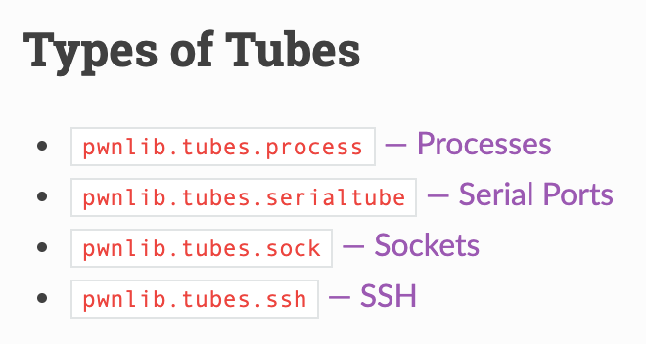
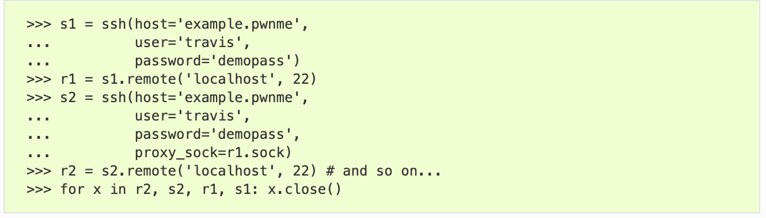
pwntools: pwnlib.tubes
Communication interface for process, network, socket, serial, tty …
  send(), sendline(), ….
  recv(), recvline(), recvuntil() ….
  interactive()

Slide 24
pwnlib.util.packing
Simplifies access to the standard struct.pack and struct.unpack
>>> a = p32(-5, sign='signed', endian='big')
>>> a
b'\xff\xff\xff\xfb'
>>> u = make_unpacker(32, signed='unsigned')
>>> u(a)
4227858431

Slide 25
pwntools: Tips
logging support for tubes
>>> p = process('./7-stack-cookie', level='debug')
Set the right context
  arch: i386, amd64, arm, aarch64
  terminal: x-terminal-emulator, tmux
>>> context(arch='i386', terminal='tmux')

Slide 26
bytes, int, int[], str …
python3 is picky on its data types.
bytes ←→ str
bytes ←→ int
Error
>>> open("flag.txt", "rb").read() + "hello, world!"
>>> b = open("flag.txt", "rb").read()
>>> s = b.decode('ascii')
>>> bytes(s, 'ascii')
>>> bytes(s, 'utf-8')
>>> int.from_bytes(b'\x01\x02\x03\x04', "little")
>>> list(b'\x01\x02\x03\x04')
>>> bytes([1,2,3,4])
>>> bytes(bytearray(b'\x01\x02\x03\x04'))

Slide 27
pwntools: Resources
Official document
  https://github.com/Gallopsled/pwntools#readme
Tutorial
  https://github.com/Gallopsled/pwntools-tutorial/blob/master/utility.md
And many more …

Slide 28
Pwntools
p = process(‘./program_name’) # execute a program named as arg
p.send(“asdf”) # send ‘asdf’ as an input
p.sendline(“asdf”) # send ‘asdf\n’ as an input (newline!)
p.recv(0x100) # recv upto 100 bytes
p.recv(timeout=0.1) # recv for 0.1 second
p.recvline() # recv a line
p.recvuntil(‘:’) # recv until output meets ‘:’
p.interactive() # connect input/output to keyboard/console…

Slide 29
Pwntools
e = ELF(‘./program_name’) # open an ELF program named as arg
e.symbol[‘get_a_shell’] # get the address of get_a_shell()
gdb.attach(p) # spawn a gdb server attached to p
  --> you may attach your gdb by running the command shown on the screen
c = Core(‘./core’) # open a core file
c.stack.find(buf) # find the address of buffer in stack

Slide 30
’xxd’: HEX Dump from a File
HEX output
  xxd <file>
Skip first n entries
  xxd –s <n> <file>
Limit output to n entries
  xxd –l <n> <file>
Reverse HEX dump into binary
  xxd –r

Slide 31
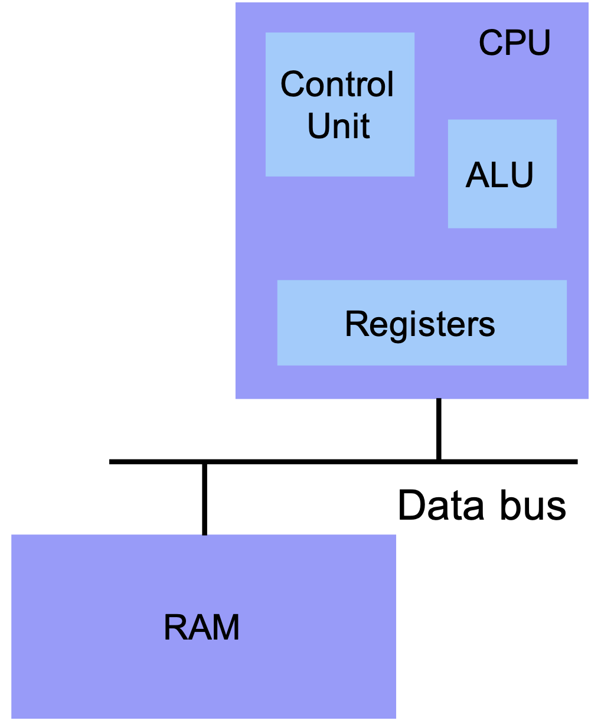
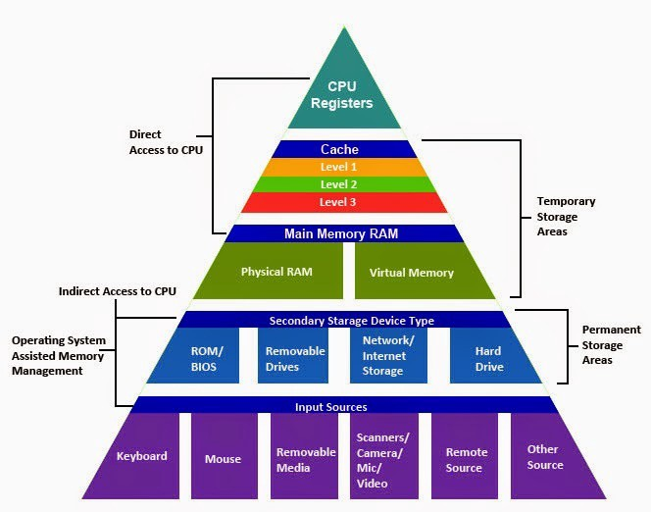
Von Neumann Architecture
Registers
Small amount of storage on the CPU
  Much faster than RAM
  Top of the storage hierarchy
    How about CPU caches?
Above RAM, disk, ...

Slide 32
Data Encoding
Endianness
Two’s complement encoding
Primitive Types
ASCII
String
Notes:
Refer to other resource

Slide 33
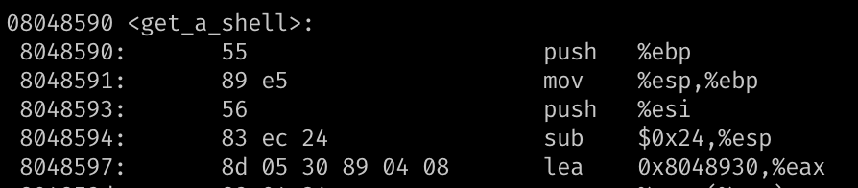
Integer Representations
Unsigned representation (%u)
  8-bit → A byte -> char
Signed
  2’s complement → 1 bit for signedness (%d)
Hexadecimal representation
  0x0 ~ 0xF → 4-bits
  0xB5 → 8-bits (int8_t) → a char
= 214
= 0xD6
Notes:
https://www.electronics-tutorials.ws/binary/signed-binary-numbers.html

Slide 34
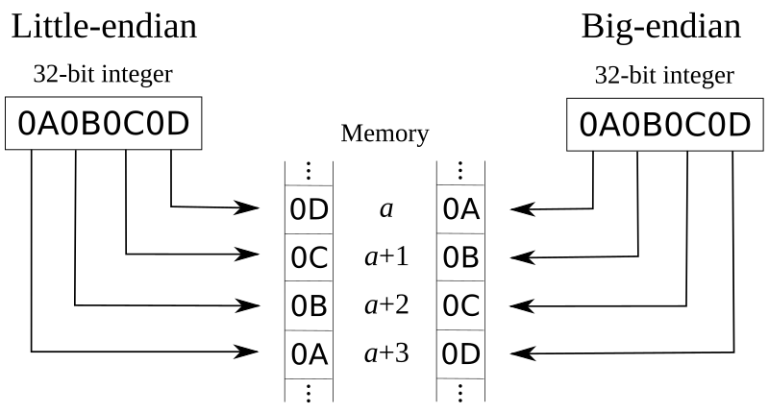
Endianness: Little vs. Big
How the hardware architecture layouts array of bytes
Intel → Big endian
ARM → Little endian

Slide 35
Bitwise Operations – Truth Table
& (AND)
1 if both are 1
| (OR)
1 if either of one is 1
^ (XOR)
1 if two values are different
AND | 0 | 1
0 | 0 | 0
1 | 0 | 1
OR | 0 | 1
0 | 0 | 1
1 | 1 | 1
XOR | 0 | 1
0 | 0 | 1
1 | 1 | 0
Do not confuse with Logical operators: || , &&

Slide 36
Bitwise Operations - Examples
AND
  1 & 2 = ?
    00000001
    00000010
    = 00000000 = 0
  0x32 & 0x47 = ?
    00110010
    01000111
    = 00000010 = 2
OR
  1 | 2 = ?
    00000001
    00000010
    = 00000011 = 3
  0x32 & 0x47 = ?
    00110010
    01000111
    = 01110111 = 0x77
XOR
  1 ^ 2 = ?
    00000001
    00000010
    = 00000011 = 3
  0x32 ^ 0x47 = ?
    00110010
    01000111
    = 01110101 = 0x75

Slide 37
Bitwise Operations – Reversible XOR
XOR is a reversible operator
  A ^ B = C
  C ^ B = ?
    C = (A^B)
    C ^ B = (A ^ B) ^ B = A ^ (B ^ B)
  # XOR-ing the same value, zero
  B^B = 0
  # A’s 0s will be zero
  # A’s 1s will be one
  A ^ 0 = A
XOR and SWAP
Suppose you have
int a,b;
Swap – temp variable
  int t = a;
  a = b;
  b = t;
Swap – XOR
  a = a^b
  b = a^b ⬄ (a^b)^b => a
  a = a^b ⬄ (a^b)^a => b

Slide 38
Bitwise Operations - AND
Use it to get the least significant bits (byte)
  0x0804868c <+44>: movsbl (%eax,%ecx,1),%eax
  0x08048690 <+48>: add $0x20,%eax
  0x08048693 <+51>: and $0xff,%eax
  %eax = [%eax + %ecx * 1]; // read 1 byte (movsbl)
  %eax += 0x20;
  %eax &= 0xff
  int a;
  a += 0x20;
  a &= 0xff; // retain only a byte
movsbl: move int8_t (char) → int (integer)
Notes:
todo: update example

Slide 39
Bitwise Operations - AND
  int a; a += 0x20; a &= 0xff;
  An unsigned character value could be in the range from 0 to 255
  The code adds 32 (0x20) to the character value.
  What if the original value is 255?
    255 + 32 = 287 = 0x11f ← not a character
  287 & 0xff?
    0x11f & 0xff
    0x1f!
0x011f = 00000001 00011111
0x00ff = 00000000 11111111
------------------
> 00000000 00011111
& (AND)

Slide 40
<stdint.h>
Be explicit on
  Data types
    Value or pointer
  Data width: a byte (8-bit), four bytes (32-bit), eight bytes (64-bit)
    2^4 = 16, 2^5 = 32 ….
    2^10 = 1024 ≈ 1K, 2 ^ 20 = 1024 X 1024 ≈ 1M …
      Q: 2^32 ?
  Signedness
Beware of side effects
  overflow, underflow …
Use <stdint.h>
#include <stdint.h>
int32_t a; // 4 bytes
uint8_t b; // 1 byte
…
int8ptr_t c; // 4 bytes
int32ptr_t d; // 4 bytes
…

Slide 41
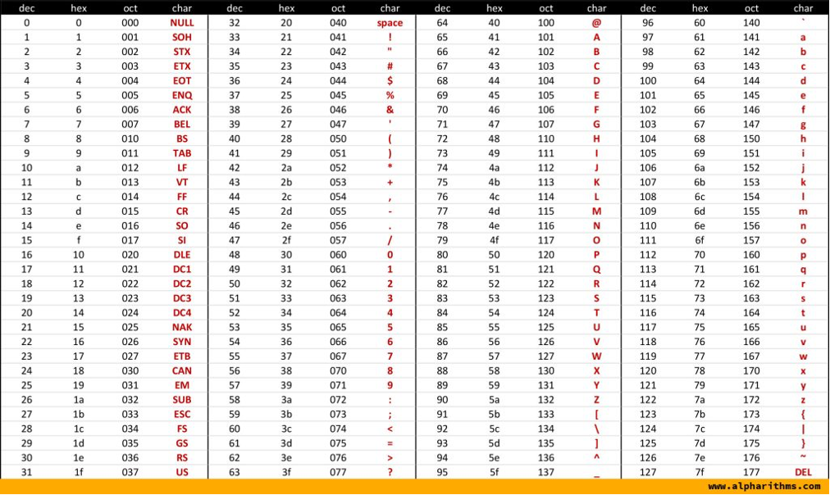
ASCII Table
A byte to represent a character
0 ~ 255 (0x0 ~ 0xFF) (unsigned) characters
  Limited → Unicode
String terminated by 0x0 (NUL)
Alpha + Digit region starts from 0x30 (48)

Slide 42
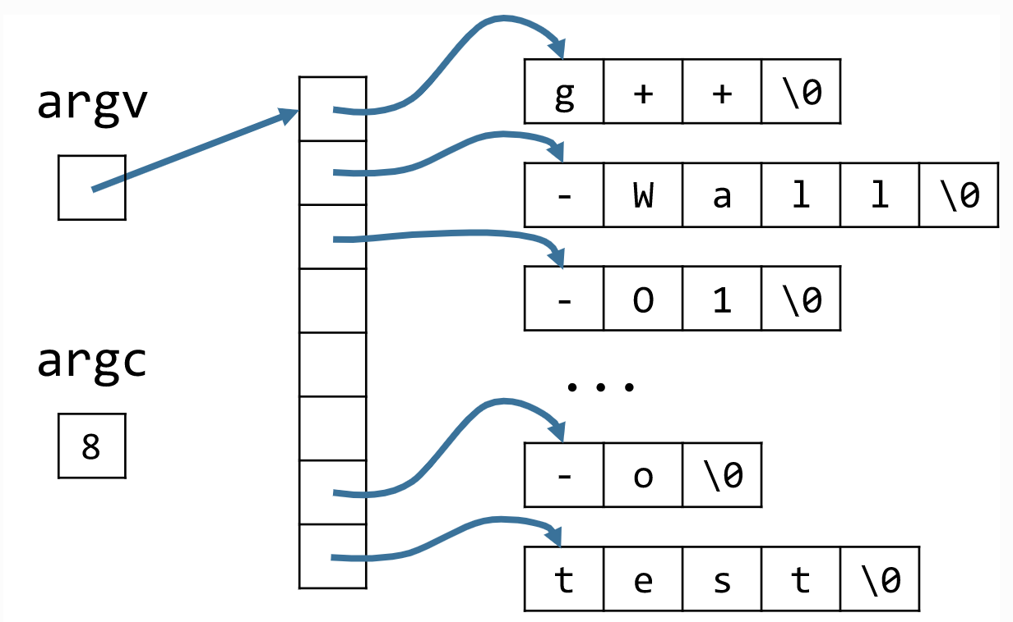
C-Style Strings
String is ‘NULL’ (\0) terminated
char str[6] = { 'h', 'e', 'l', 'l', 'o', '\0' };
Command line arguments
g++ -wall –O1 …. –o test

Slide 43
(Naïve) string functions
int strlen(char* str);
int strcpy(char* dst, char* src);
int strlen (char* str) {
  int l= 0;
  while (str(l) != ‘\0’) {
  l++;
  }
  return l;
}
int strcpy (char* dst, char* src) {
  int l= 0;
  do {
  dst[l] = src[l];
  l++;
  } while (src(l) != ‘\0’)
  return l;
}
How about ‘strcmp’?
Notes:
strcmp return value man strcmp

Slide 44
Next Class
Unit2 will be out
  ~8 problems on basic reversing and BOF (Buffer Overflow) Attacks
More on X86 + ARM assembly
Debugging and reversing tools

Slide 45
Reverse-Engineering Tools
Disassembly vs. Decompilation
Popular tools
  IDA Pro
  Ghidra
  Radare 2 (Cutter)
Image from: https://www.hex-rays.com/products/ida/tech/graphing.shtml

Slide 46
Binary Ninja
  https://binary.ninja/
Image from: https://0x00sec.org/t/re-guide-for-beginners-methodology-and-tools/2242

Slide 47
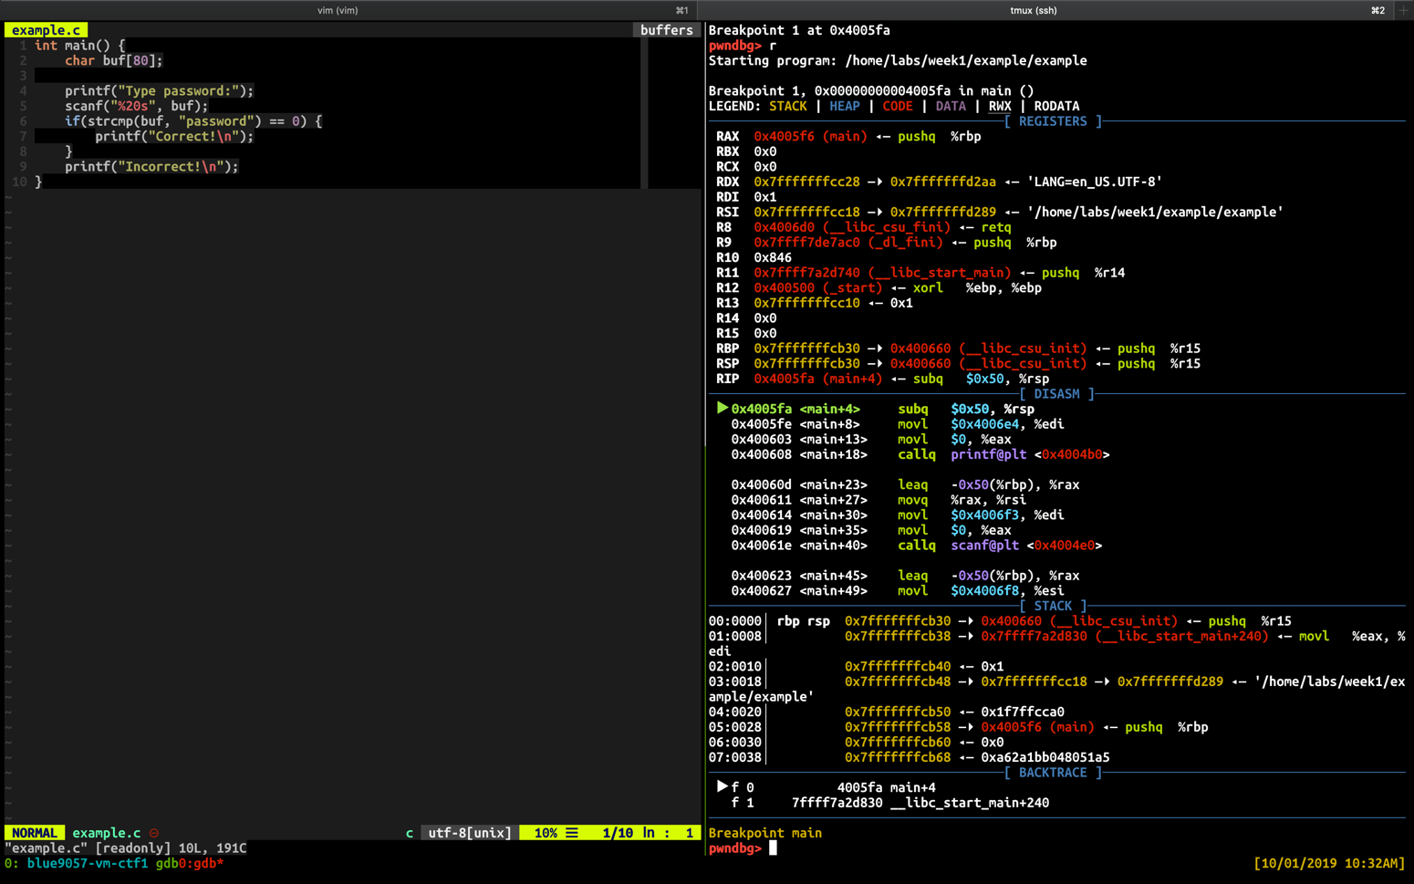
Console Debugging Example
Use tmux to split the window
  Left: vim
  Right: gdb

