Slide 1

CS 6332.001: Systems Security and Binary Code Analysis
Lecture 01
Kangkook Jee
Aug 26, 2025

Slide 2
Course Title
Systems Security and Malware Code Analysis
Binary
Systems Security and Malware Code Analysis
We do 'malware' but that is not all
'Binary' would encompass broader topics

Slide 3
Course Objective
Understand the software execution stack in a modern computing systems
Learn, experience, and comprehend available attacker TTPs*
Learn system security measures to defend/protect computing systems
  TTP*: Tactics, Techniques, and Procedures
Notes:
What is modern? not only computers

Slide 4
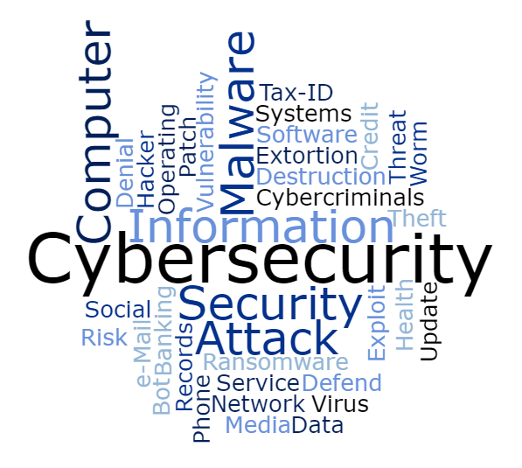
What the Course will NOT Cover
(But Still Important)
Hardware Security
Network Security
Usable Security
Cryptography
Privacy

Slide 5

Instructor – Who Am I?
System security researcher for 10+ years
  Industry + academia
5th year in Dallas, TX
Likes to play many different sports
  Skiing, running, biking, basketball …
Research focus
  Security problems in general
    System and software security …
  Graph learning for system security
Enjoy student interactions
Used to play Capture-The-Flag (CTF)
Notes:
Find me.

Slide 6
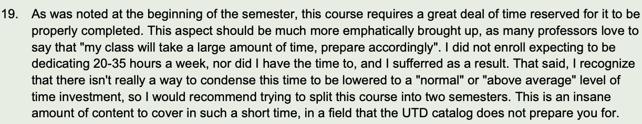
Beware What You Are Getting Into
System-heavy, many low-level struggles
  Intel + ARM (?) assembly, many assignments
  Virtualization, static and binary code analysis
  HDL decompilation, AI for Hacking/Reversing
  …
The course will be challenging, heavily hands-on

Slide 7
Pre-requisites and Expectations
Fluent in C/C++
Familiar with Linux
  Shell scripting, commands, tmux, etc.
Python
  Swiss Army knifes
Editors
  vim, neovim
And more …
  Git + CI/CD, markdown
Willingness to
  Deal with binaries, hex decimal, and assembly codes
  Put many hours

Slide 8
UTD System Security Courses
Hard pre-requisites
  C programming ( intermediate or higher)
  Computer architecture + assembly
  Kernel and program loading procedures
  Handy with Linux systems
  Handy with Hexadecimal
Optional requirements
  CANDL (CS4301)
  Compiler Design (CS4386)
  Virtualization (CS6348)
Another system security topics
  Compiler instrumentation
  Dynamic language analysis
  Graph representation for system and program behaviors
  ML-based security modeling
C programming language & Linux
(CS3377)
Computer Architecture (CS3340)
Operating System (CS4348)
System Security and Binary Code Analysis
(CS6332)

Slide 9
UTD System Security Courses
Hard pre-requisites
  C programming ( intermediate or higher)
  Computer architecture + assembly
  Kernel and program loading procedures
  Handy with Linux systems
  Handy with Hexadecimal
Optional requirements
  CANDL (CS4459)
  Compiler Design (CS4386)
  Virtualization (CS6348)
Another system security topics
  Compiler instrumentation
  Dynamic language analysis
  Graph representation for system and program behaviors
  ML-based security modeling
C programming language & Linux
(CS3377)
Computer Architecture (CS3340)
Operating System (CS4348)
Cybersecurity Attack Defense Lab
(CS4459)
Compiler Design
(CS4386)
System Security and Binary Code Analysis
(CS6332)

Slide 10
UTD System Security Courses
Hard pre-requisites
  C programming ( intermediate or higher)
  Computer architecture + assembly
  Kernel and program loading procedures
  Handy with Linux systems
  Handy with Hexadecimal
Optional requirements
  CANDL (CS4459)
  Compiler Design (CS4386)
  Virtualization (CS6348)
Another system security topics
  Compiler instrumentation
  Dynamic language analysis
  Graph representation for system and program behaviors
  ML-based security modeling
C programming language & Linux
(CS3377)
Computer Architecture (CS3340)
Operating System (CS4348)
Cybersecurity Attack Defense Lab
(CS4459)
Compiler Design
(CS4386)
System Security and Binary Code Analysis
(CS6332)
Program Analysis for Data Driven Security
(CS6????)

Slide 11
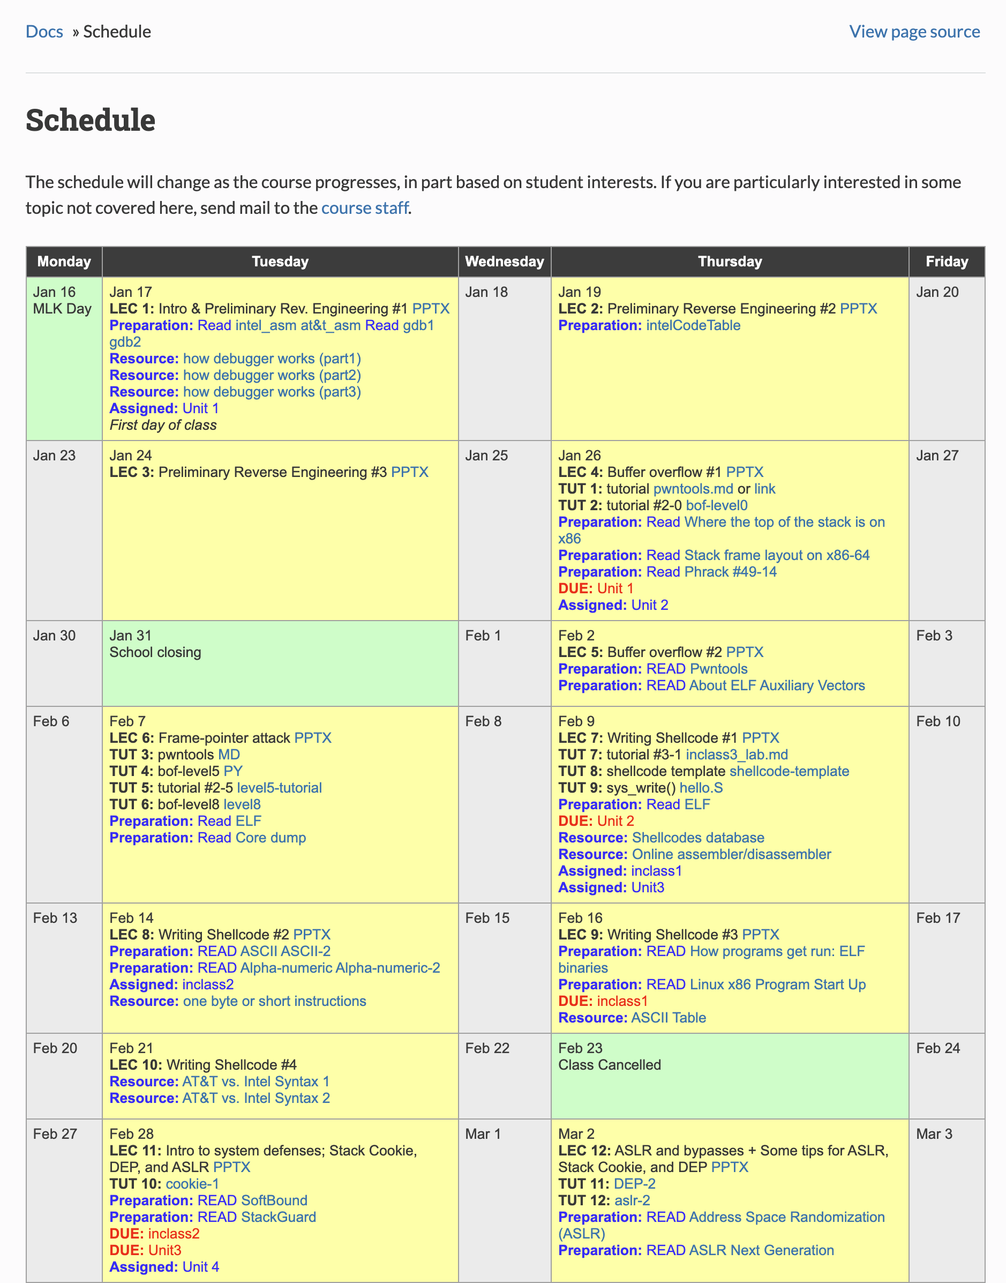
CANDL vs. CS6332
Graduate vs. Undergraduate
X86 (Intel) vs. ARM
Attack vs. Defenses
Solved problems vs. Open problems

Slide 12
CS6332-F25*
Advance topics candidate
  Python interpreter internals
  Solidity* compiler internals
  Bytecode (PYC, EVM) decompilation
  Space systems; LEO satellites

Slide 13
Course Agenda
Intel (i386, x86_64)
  How a program runs
  Binary loading and dynamic linking
Hacking and defending binaries
  CTF-like challenges
Binary binary analysis and instrumentation
  Virtualization technology

Slide 14
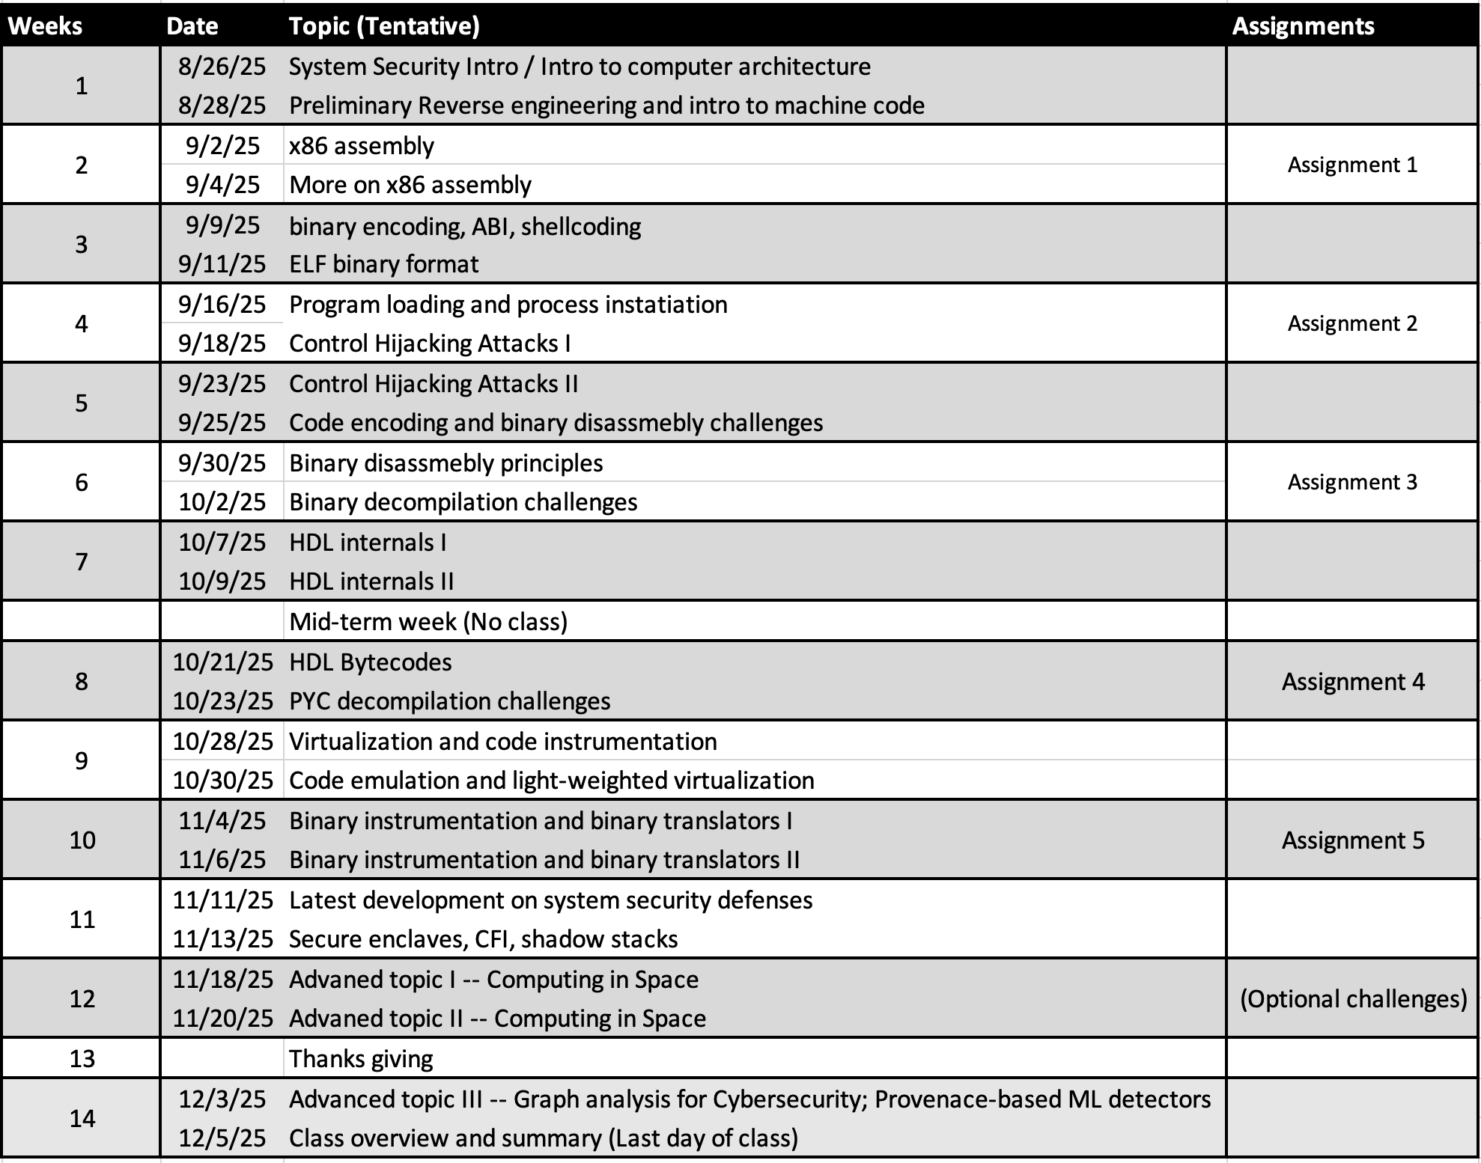
Course Agenda
Intel (i386, x86_64)
  How a program runs
  Binary loading and dynamic linking
Hacking and defending binaries
  CTF-like challenges
Binary binary analysis and instrumentation
  Virtualization technology

Slide 15
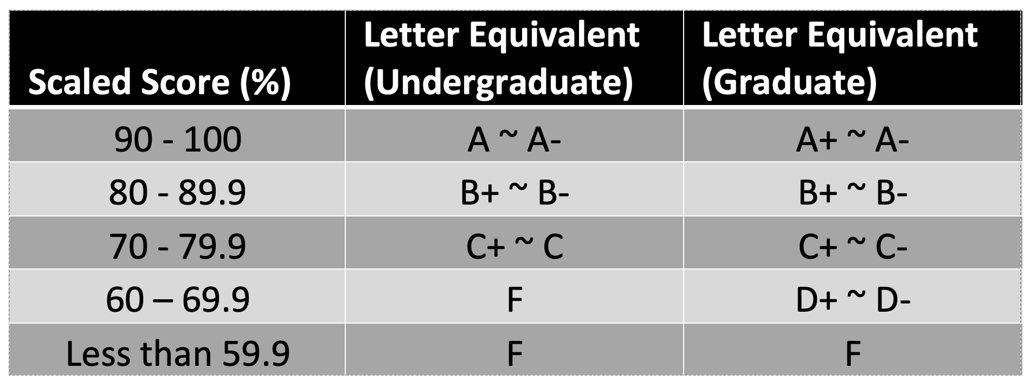
Course Agenda
I DO care about class attendance
  (Pop) Quizzes
  Random attendance check
  For exceptions, students need to communicate a day prior
Four major assignments
  Make-up assignment (not for everyone)
  Will talk more on it later
 | Evaluation
Assignment 1 | Intel (x86) binary hacking challenges | 10%
Assignment 2 | Intel (x86) binary hacking challenges II | 15%
Assignment 3 | Binary defense with PINTOOL | 15%
Assignment 4 | Dynamic Binary Translator | 30%
Assignment 5 | Static Binary Instrumentation | 20%
 | Class participations and quizzes | 10%

Slide 16
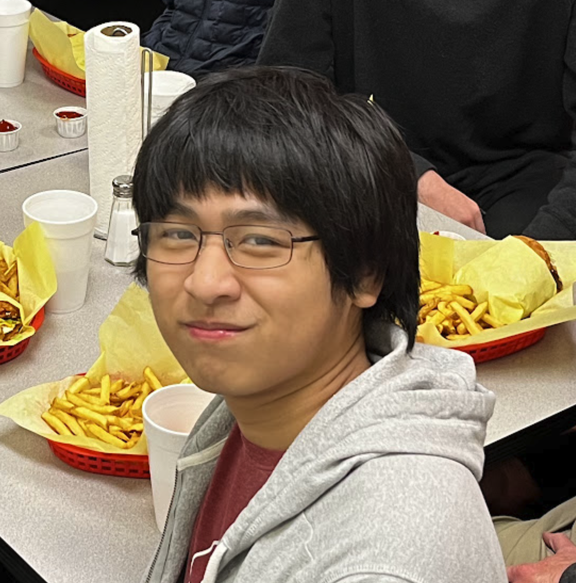
Class Meetings and Communications
Class website https://cs6332.syssec.org/
CTF scoring server – https://ctf.syssec.org
Intel CTF challenge host – ssh://ctf-vm1.utdallas.edu
  Need ssh public key
Class Discord
  ?????
  Change your nickname to be 'Firstname Lastname (netid)'
Instructor office hour
  TBD @ ECSS 3.226
Max Zheng
  TA office hour: TBD @ ECSS 3.221
Max Zheng

Slide 17

Class Participation
Current plan
  Primarily in-person
  No Teams recording
If you need remote access / support, please talk to the instructor
  In case you need to be absent
  Email instructor a day before

Slide 18
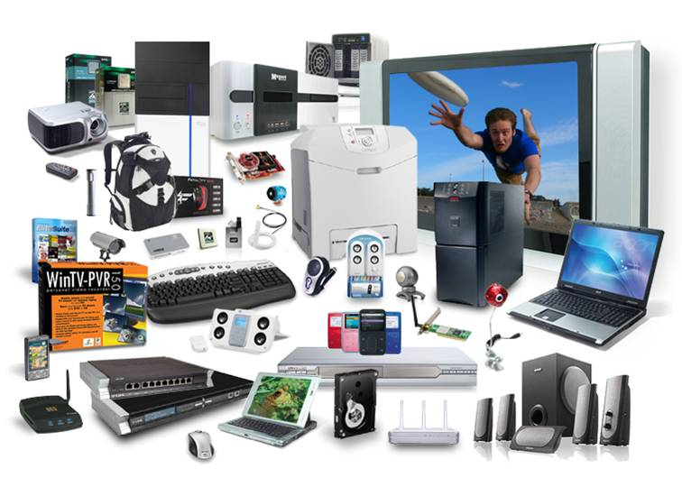
System Security and Binary Code Analysis
What is the Course is about?
System
Security
Binary
Code
Analysis
Can you count how many CPUs do you own?
Notes:
We no longer count cores..

Slide 19
What Would Define "System"?
Run `uname –a`
Hardware ISA (Instruction Set Architecture)
  Intel, MIPS, ARM, RISC-V, PowerPC …
Architecture
  8bit, 16bit, 32bit … 64bit
OS + Kernel
  Linux, Windows, OSX …
System Library
  GLIBC, WIN32.dll, busybox

Slide 20
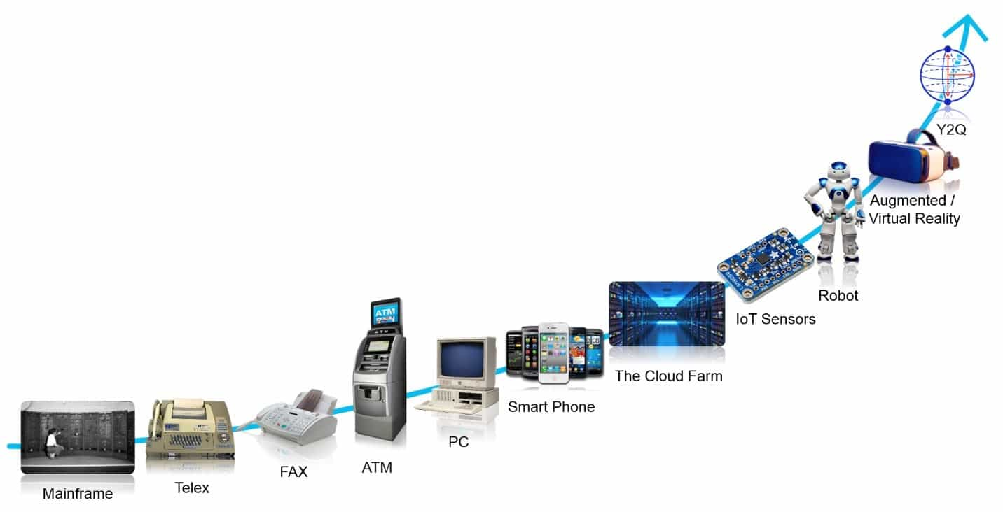

System Evolution
Now becoming more and more ubiquitous
  Desktops, Servers, Cell phones, IoT, Industrial PLCs, home automation ..
  Can you count how many CPUs do you own?
Formerly, homogenous system security landscape
  System == Windows + Intel X86
    > ~90 % market share, main playground for malware / attackers
  ~80 % > Malware are written for Windows based systems
  Once written, wide infection
    NIMDA (2001), Code Red (2001), SQL Slammer (2003)
  Noisy attacks, targeting unspecified mass

Slide 21


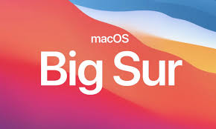
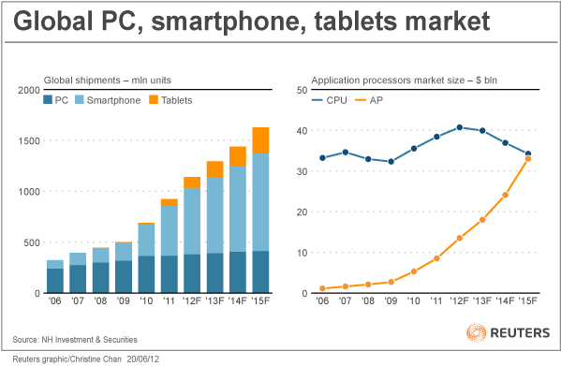
System Diversified Architectures + OSes
IoT evolutions: RISC + Linux or MCU + RTOS
Mobile frameworks: ARM + Android (Java + Linux)
Industrial Control Automations
  ICS / CPS systems: highly fragmented & proprietary
Unmanned Aerial Vehicle (UAV), Autonomous Cars
GPU computations
Q: Do we still need to study x86?
  Yes, but we now have more to learn
  While the relative portion has shrunk,
  total size has increased

Slide 22
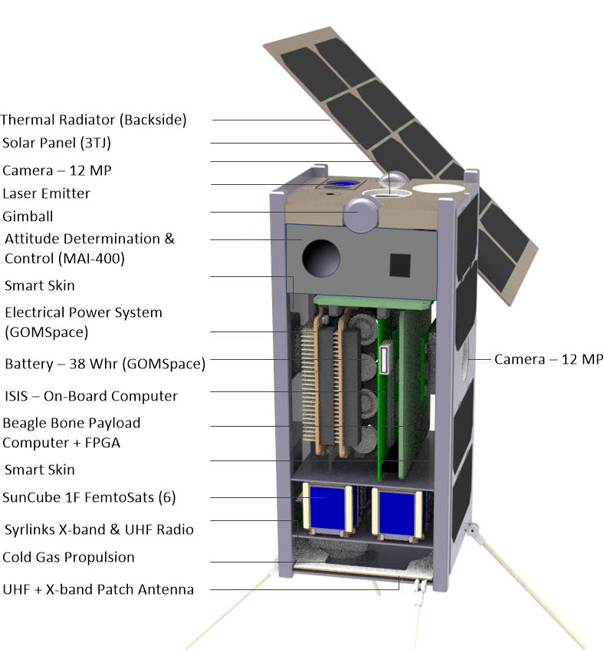
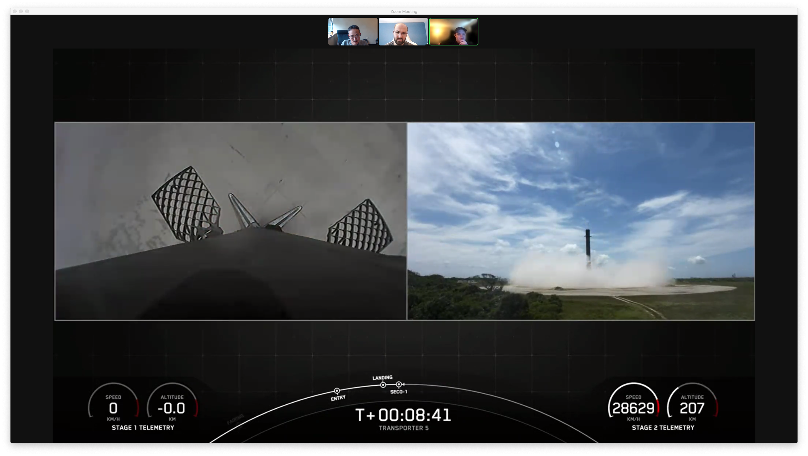
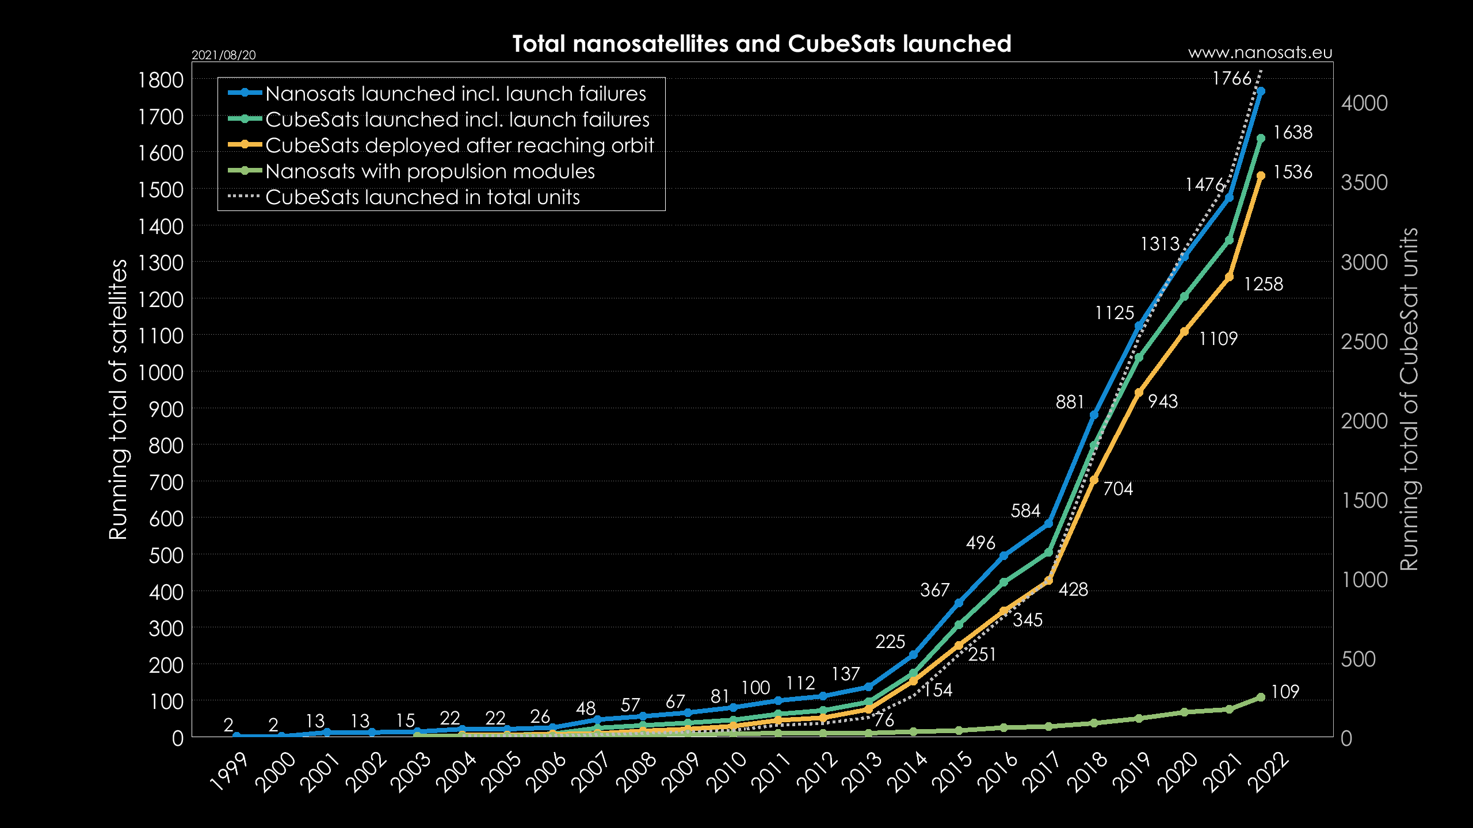
New Space Era
Two Enablers
  Re-usable booter technologies
  Ever-shrinking size of techonologies
Standard 2U CubeSat
(1U: 10 cm × 10 cm × 11.35 cm)
Total count of CubeSats launched as of August 2021

Slide 23
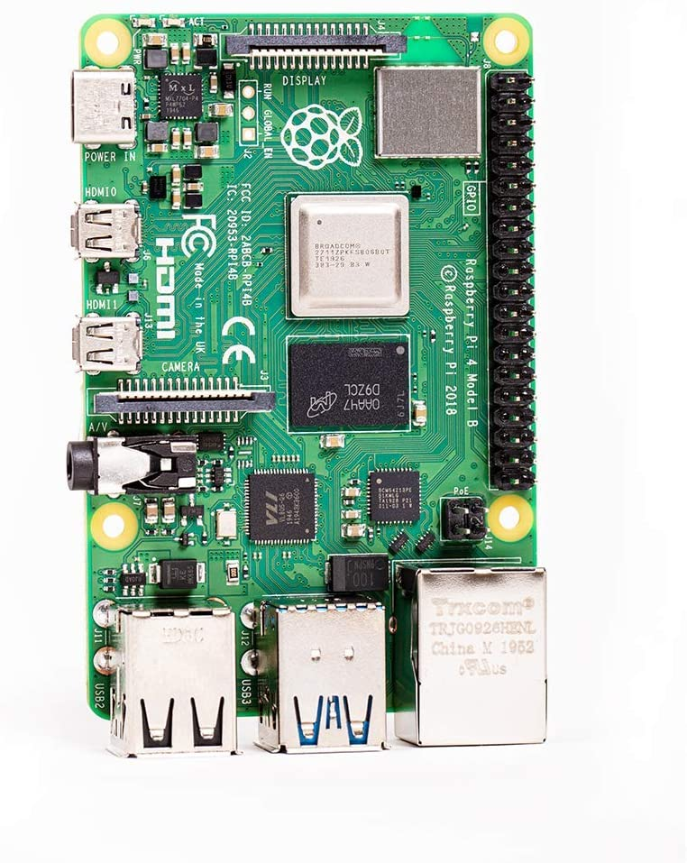
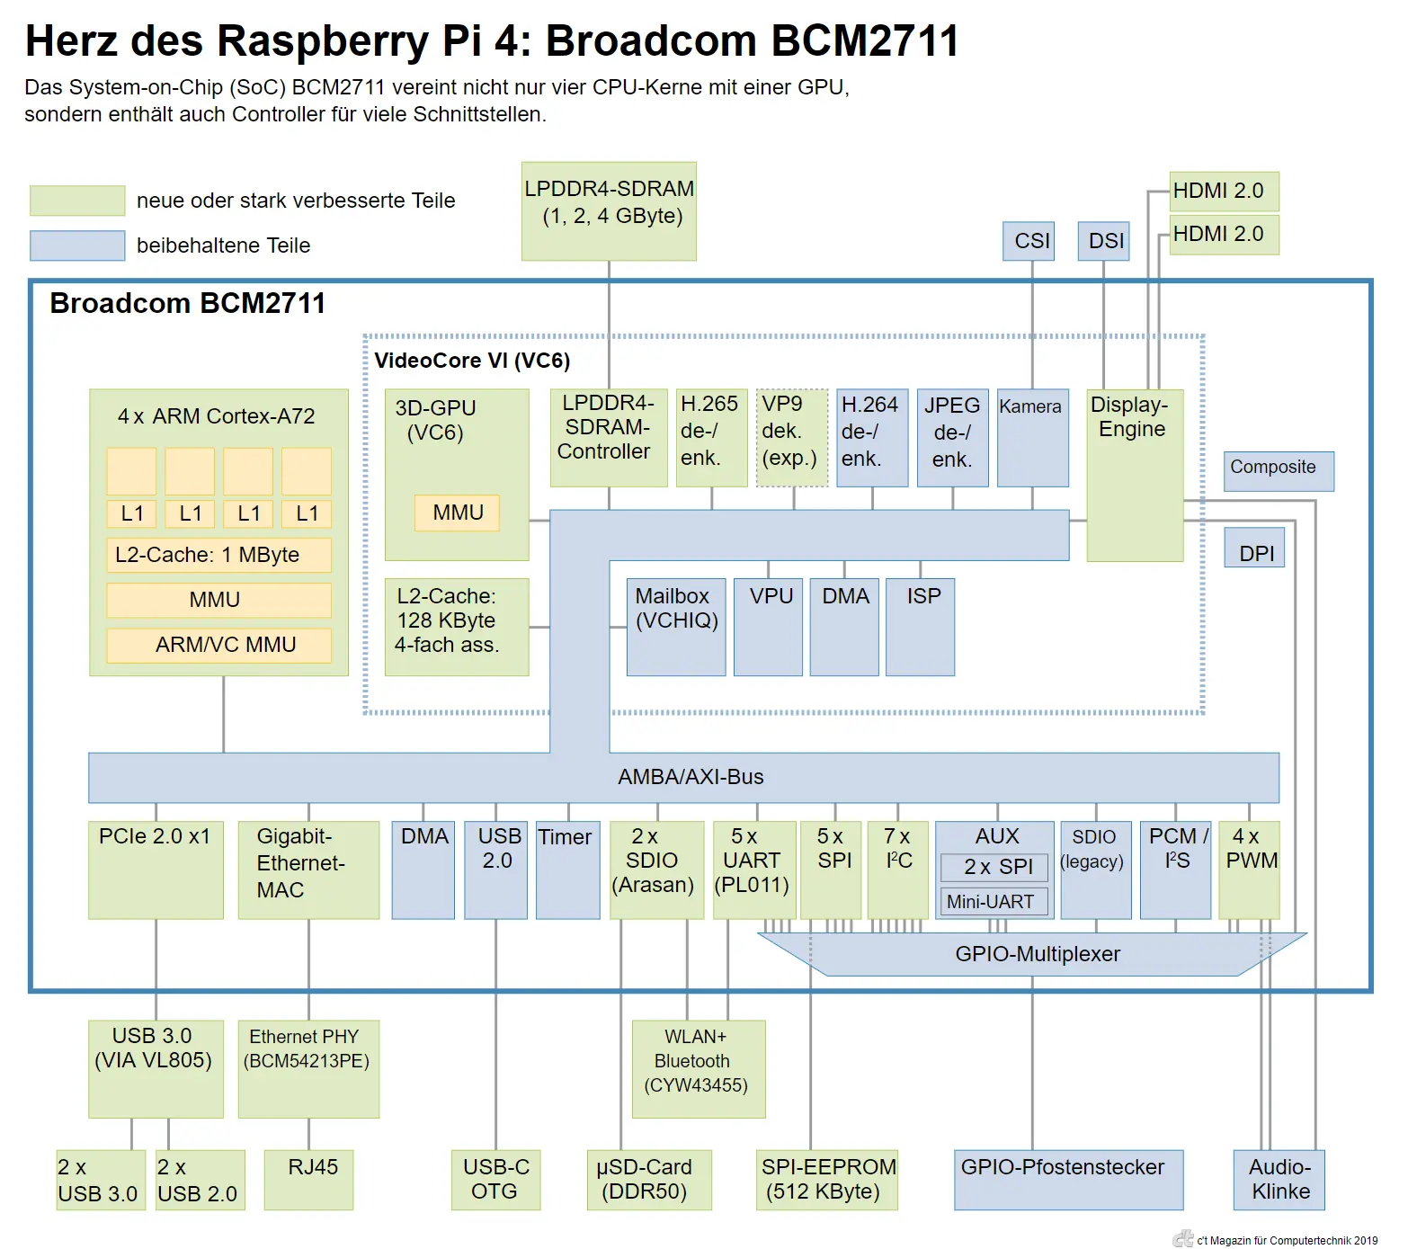
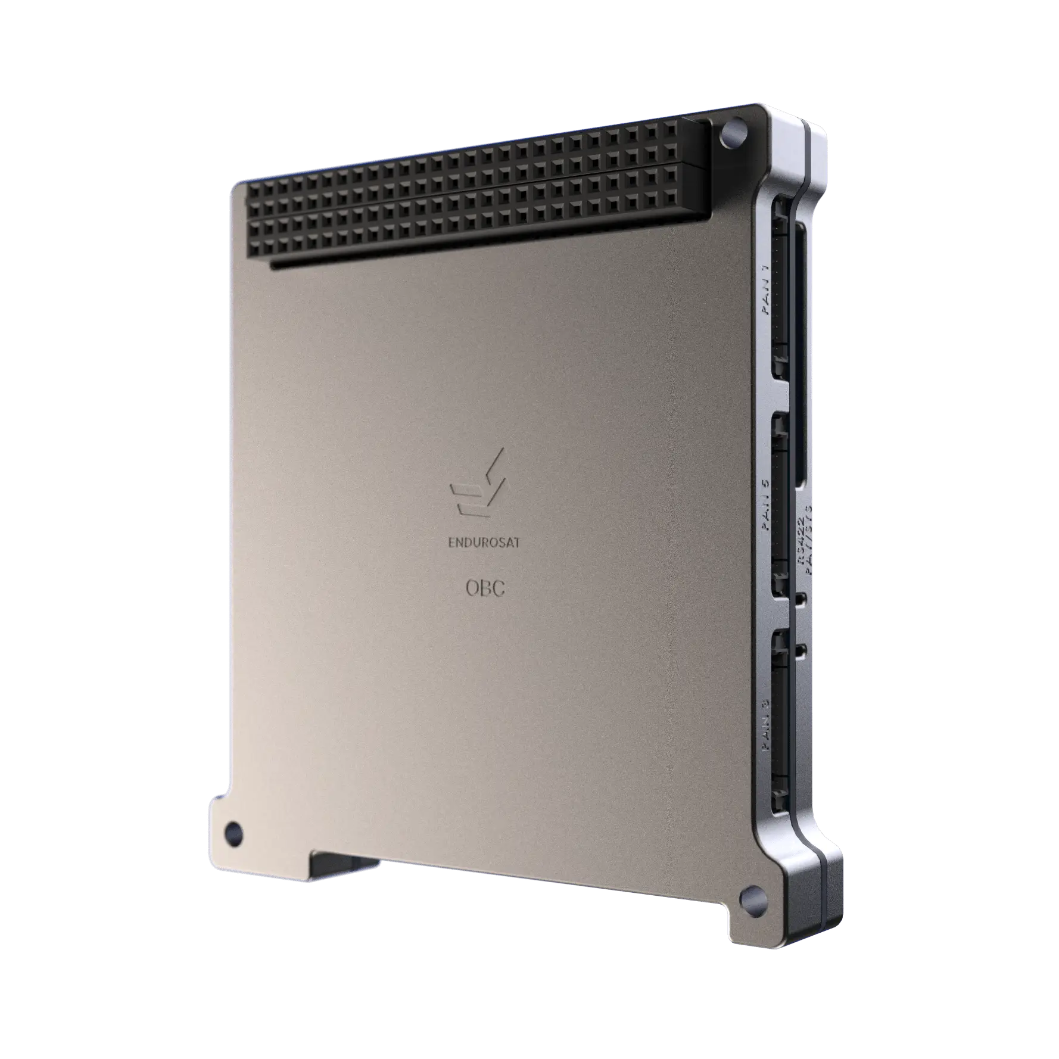
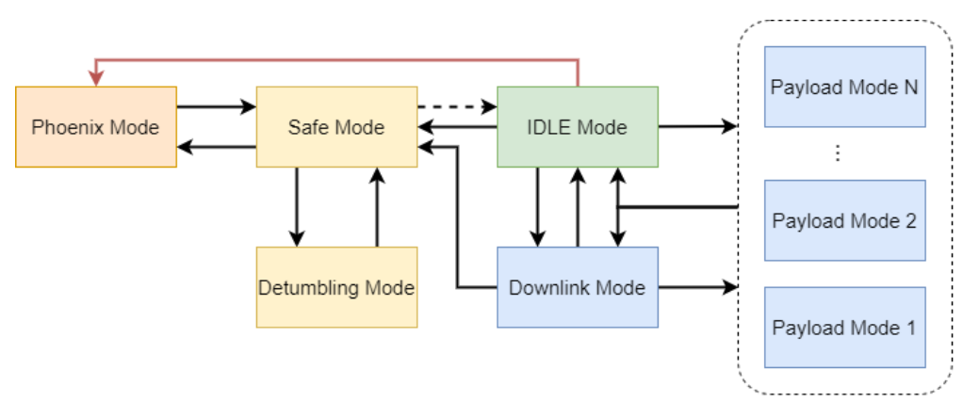
IBM Endurance
Raspberry Pi 4 (BCM 2711)
  Yoko Linux image customized for satellite operation
  Minimal power consumption
  Fast / seamless recovery
  Container env support
CubeSat Onboard Computer (OBC)
  Controls Payload operation
  Monitors and administers CubeSat operation
Payload (Rpi4)
CubeSat OBC
Notes:
https://www.endurosat.com/cubesat-store/cubesat-obc/onboard-computer-obc/

Slide 24
System Security and Malware Code Analysis
What is the Course is about?
System
Security
Binary
Code
Analysis
Can you count how many CPUs do you own?
Notes:
We no longer count cores..

Slide 25

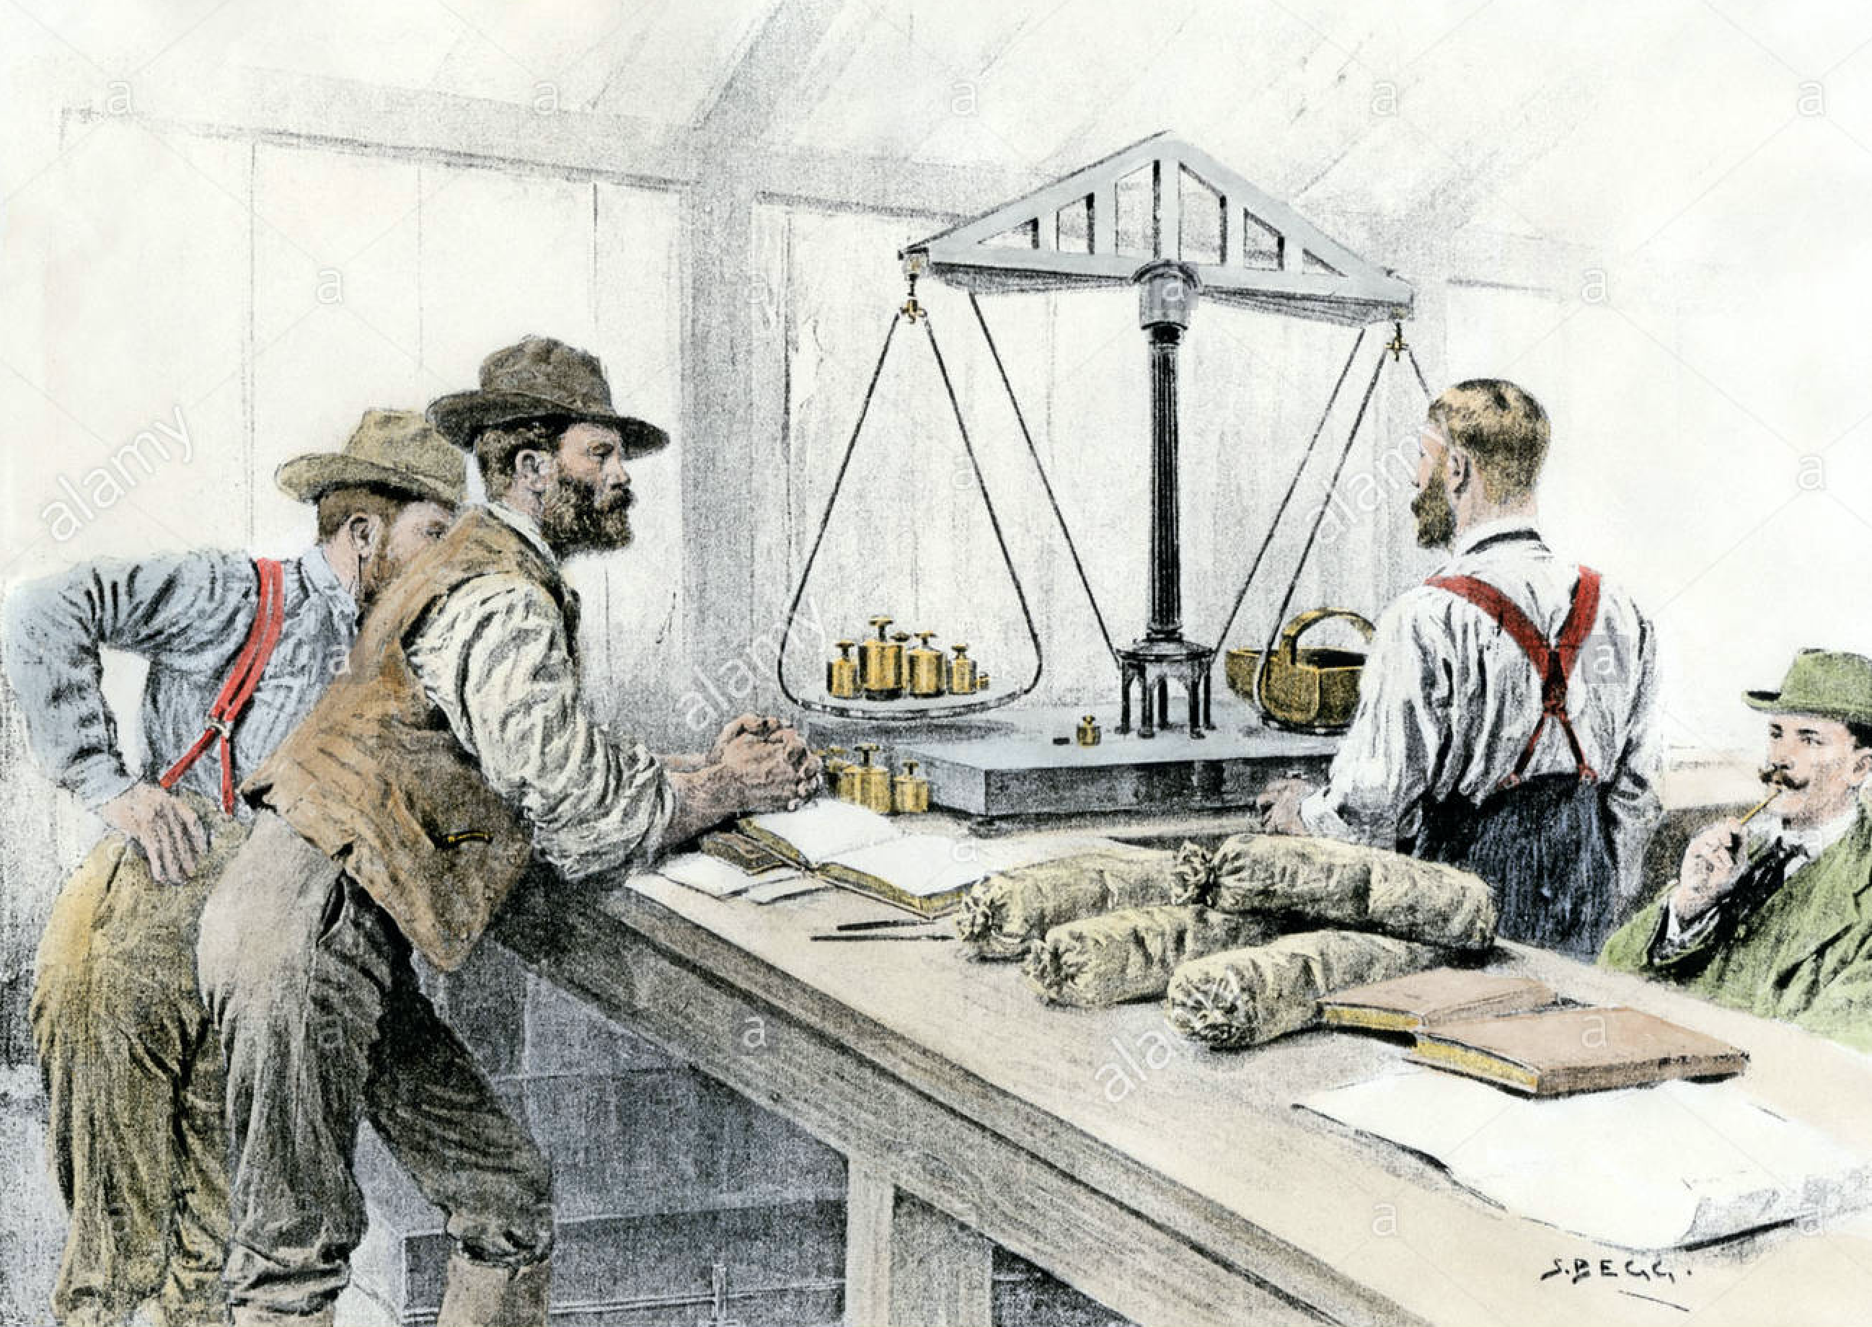
What is Security? Security against what?
Why security matters?
  Rest of CS discipline mainly focuses on efficiency, scalability, optimization etc.
Basic security principles:
Confidentiality, Integrity, and Availability
Data is new gold for our generation
  Exponential growth in its amount and applications
Notes:
Security is a totalistic and comprehensive art
which cannot exist in isolation

Slide 26
What about Privacy?
Security provides mechanisms to safeguard data
  Access control, authentication, authorization ….
Privacy is associate a person with data
  Anonymization, randomization, censorship resistance
  Generally, more complex and subtle, cultural and context-dependent
    E.g., GDPR for EU
  ML model membership problem
    Does your model include my personal information?
  Differential privacy
    Perturb your data, preserving model accuracy

Slide 27
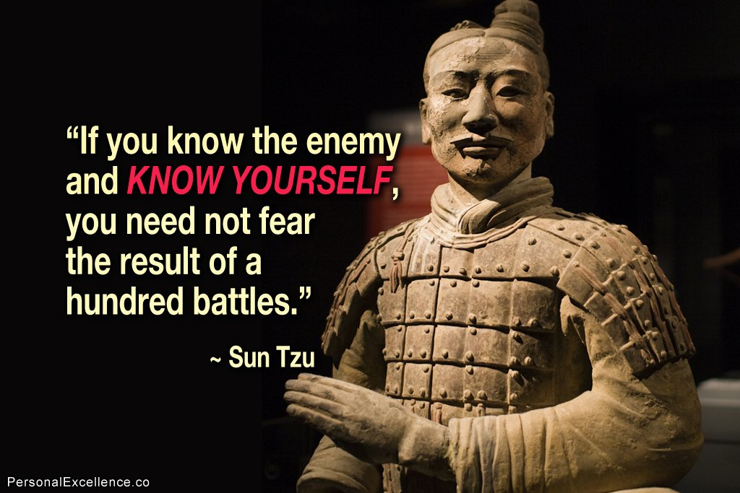
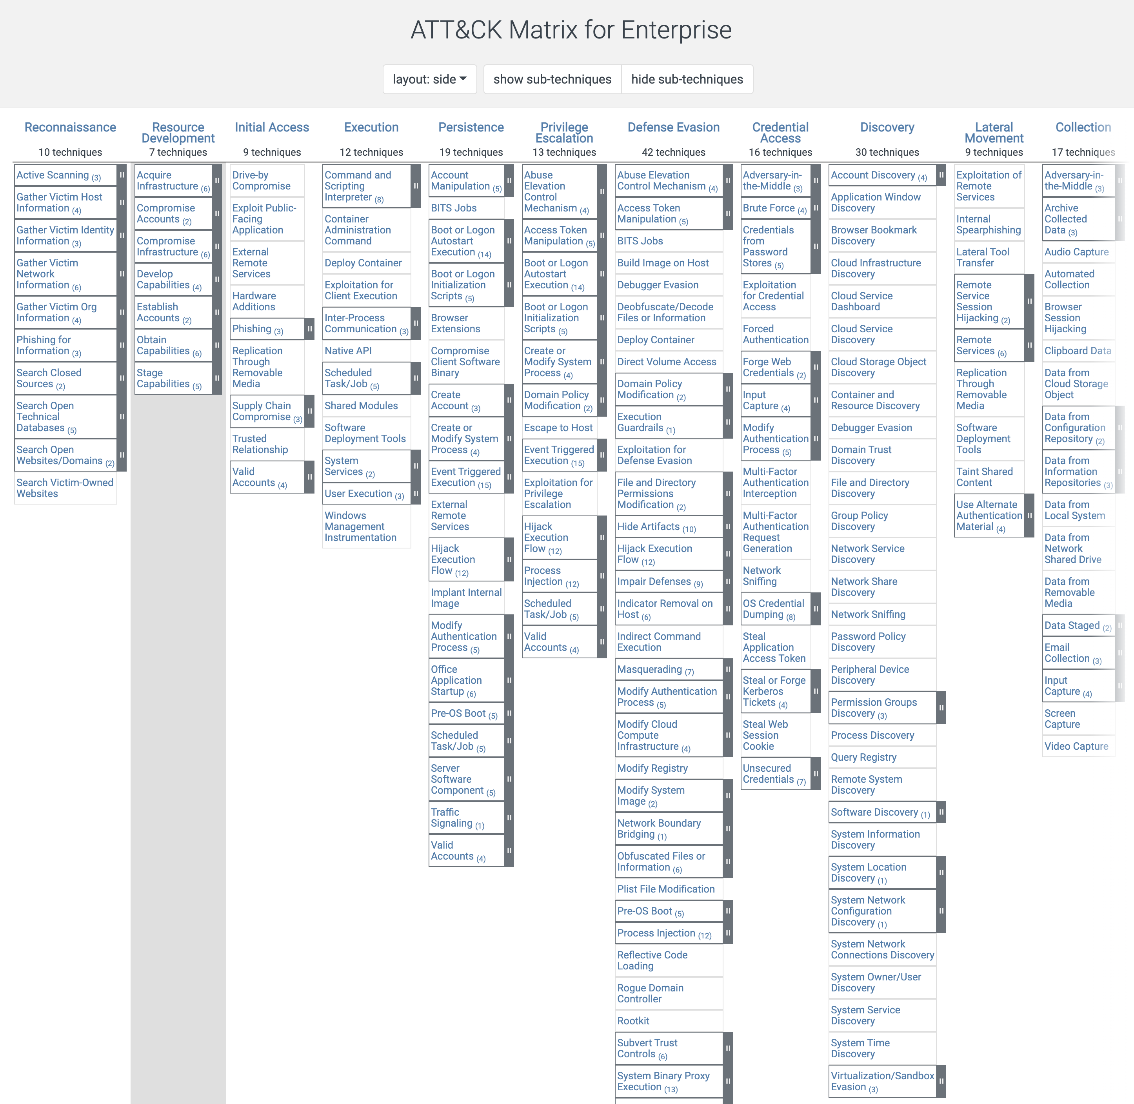
Threat Modeling
Cyber security is a modern-day battlefield
  Sun Tzu 's Art of War (孫子兵法)
Attack surface
Attacker knowledge
Attacker capability
  Tactics, Techniques, and Procedures (TTPs)
Notes:
PreviousWarfare vs. Battle
We cannot win every battle, nor aim to win every battle
We want to win a war, but not a battle

Slide 28
System Security and Malware Code Analysis
What is the Course is about?
System
Security
Binary
Analysis
Notes:
We no longer count cores..

Slide 29
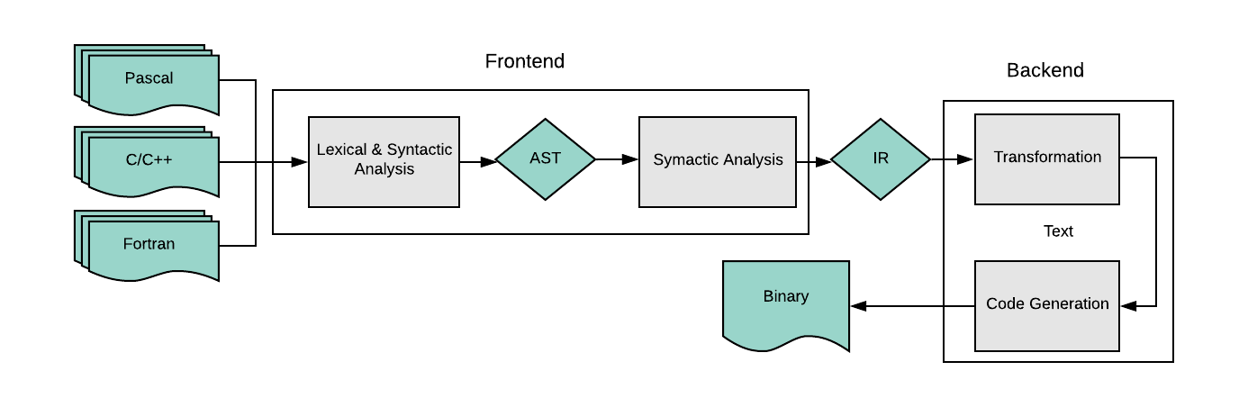
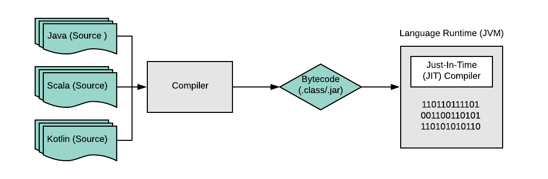
Binary and Malicious Code
Binary code
  No source code
  Machine instruction stream + headers
  Who generates the binary?
How do you know the binary is "malware"?
  Can we determine just by looking at it?
  Do we have to run it?
  Do we still need a que?

Slide 30
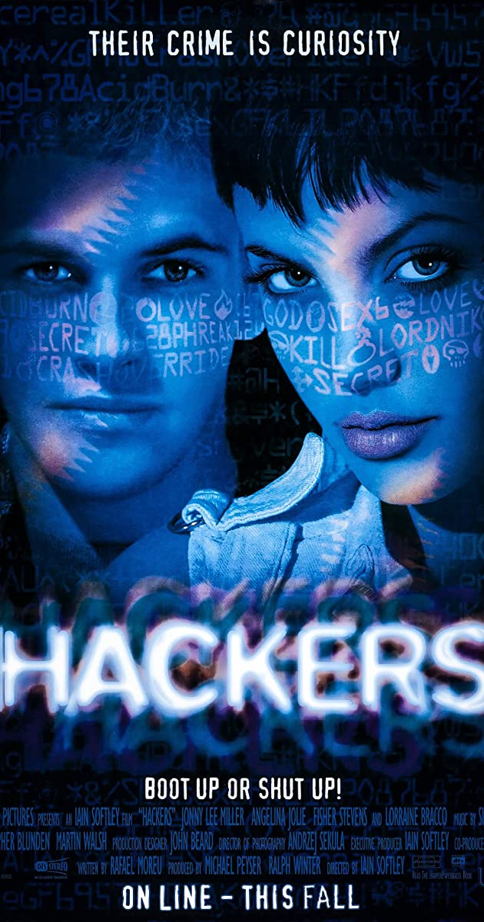
Cyberattack in 1990’s
Street kids seeking for a fame
Poorly designed software products
Targeting unspecified majority,
betting for a luck
Cyberattack as a business model
  Highly skilled resources, clear target, political and/or financial incentives
  Major battlefield for cyber-warfare at state-level
  Lots of $$$$$
Hackers – 1995 Film

Slide 31

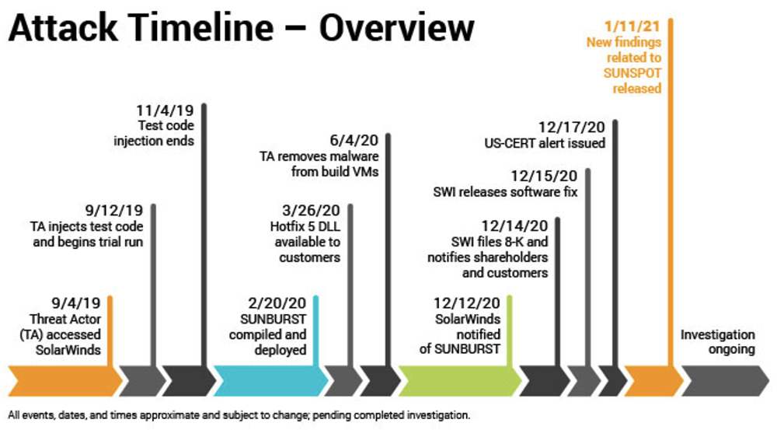
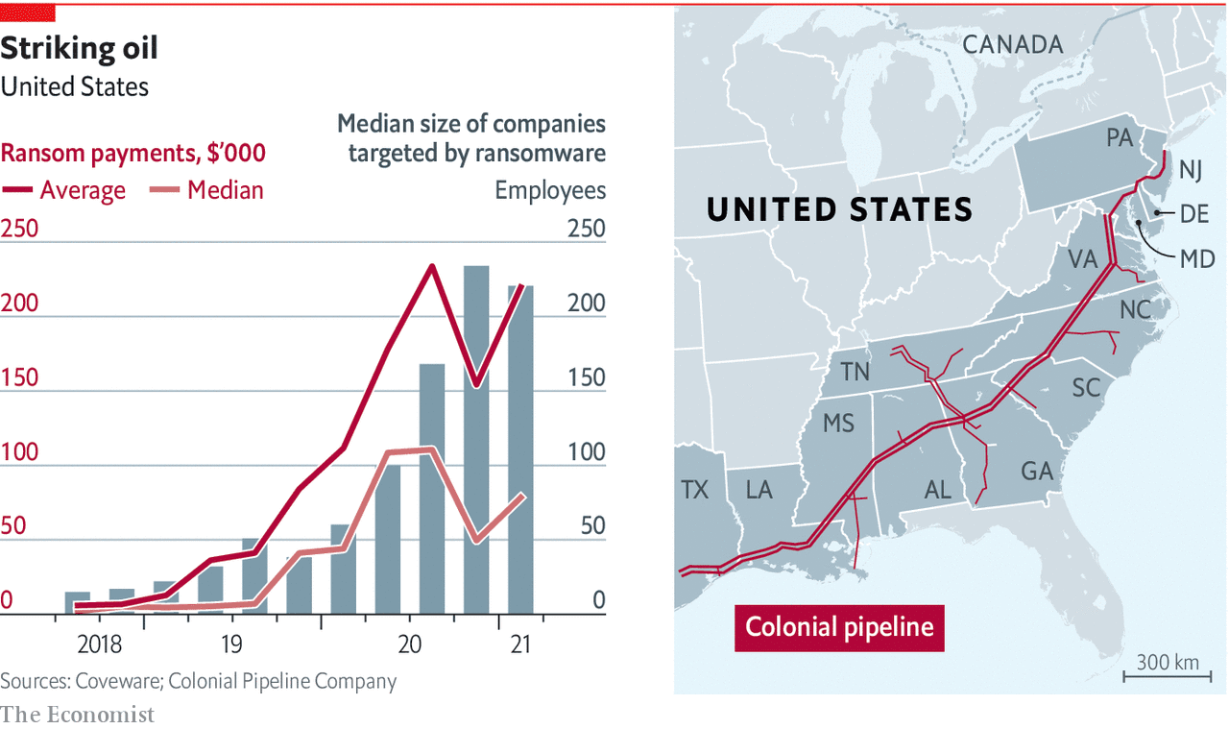
Cyberattack in 2020’s
Attack timeline
Cyberattack as a business model
  Lots of $$$$$
  Mature ecosystem
    RaaS: Ransomware As A Service
  Highly skilled resources, clear target,
  huge political and/or financial incentives
Major battlefield for cyber-warfare at state-level

Slide 32
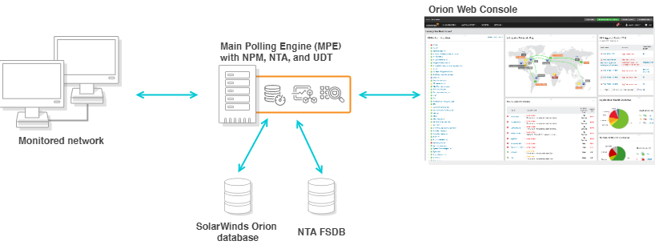
SolarWinds
The scariest supply chain attack
SolarWinds
  Austin-based network security tool vendor
  Orion: widely deployed network monitoring tool
Adversary planted (committed) backdoor code somewhere …
  A plugin built with compromised code (C#)
  Automatically deployed to thousands sites
Many government agencies + private companies
  Potential 18,000 customers including FireEye, NVIDA, Intel and many Government agencies
Notes:
https://www.cyberark.com/resources/blog/the-anatomy-of-the-solarwinds-attack-chain
https://www.datacenterknowledge.com/security/list-known-solarwinds-breach-victims-grows-do-attack-vectors

Slide 33
What is “Malware” and “Code”
Malware ∋ worms, virus, rootkits, ransomware, crypto-miner….
  Written and devised to meet the attacker demand with their own historic context
Term | Description
Worm | A standalone piece of malicious software that reproduces itself and spreads from computer to computer.
Virus | A piece of computer code that inserts itself within the code of another standalone program
Rootkits | Software tools open for remote access to and control over a system (root access)
Ransomware | A flavor of malware that encrypts your hard drive's files and demands a payment (e.g., Bitcoin)
cryptojacking / cryptominer | Secretively steals your CPU cycles
Notes:
https://www.csoonline.com/article/3295877/what-is-malware-viruses-worms-trojans-and-beyond.html

Slide 34
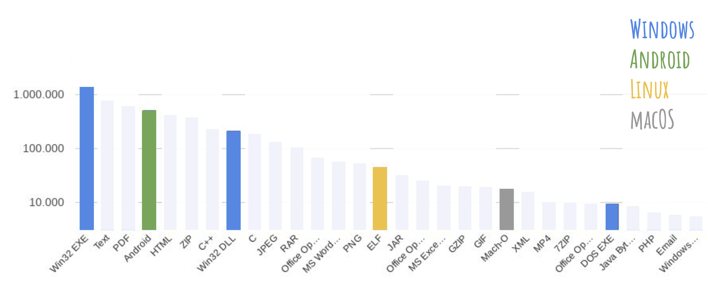
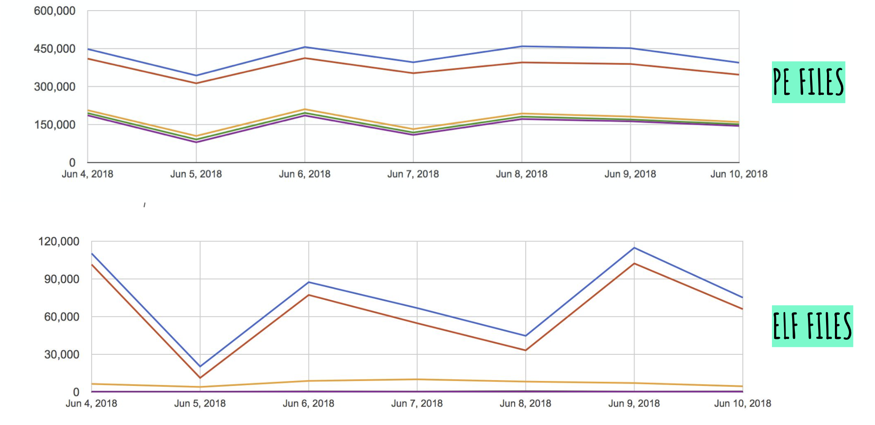
What is “Malware” and “Code”
What Code are we dealing with?
  X86 ? Intel?
  How about Java?
    Android
  How about .Net, Rust, Golang …?
    Powerful and quick to develop
    Once written run everywhere (Golang)
  How about Python? PowerShell?
    PowerShell is the MOST favored attack vector
  Attacker are expensive too! There time is money!
Notes:
VirusTotal is shared file repository for everyone
When you have a binary → Upload to see what people says

Slide 35
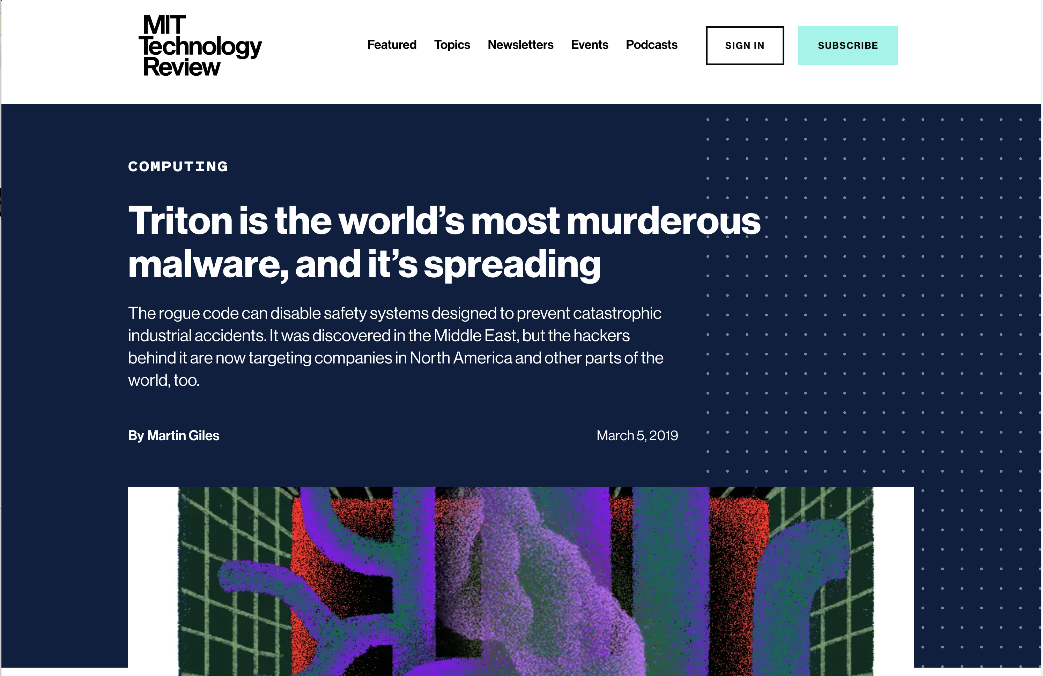
Python Binaries
Valid software deployment approach
  Dropbox / Google Drive
  Simula: Dassault Systems
Malware as well
  Trition/TriSys Malware
Try PyLingual!
  https://pylingual.io

Slide 36
Fileless Malware
Do not leave any evidence! Do not store anything
  AV scanners scan files. No files, No red flags
Fileless attack no longer leaves its footprints on file system
  Process injection, Living-off-the-land, PowerShell scripting ….
  E.g., svchost.exe injected by attack vs. normal svchost.exe
  E.g., certutil.exe making an C2 Internet connection

Slide 37
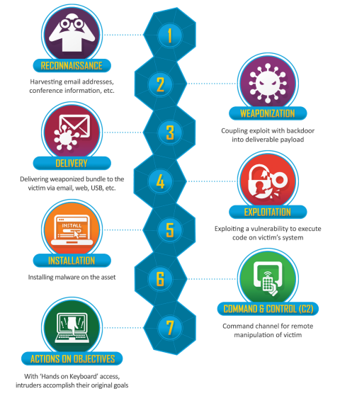
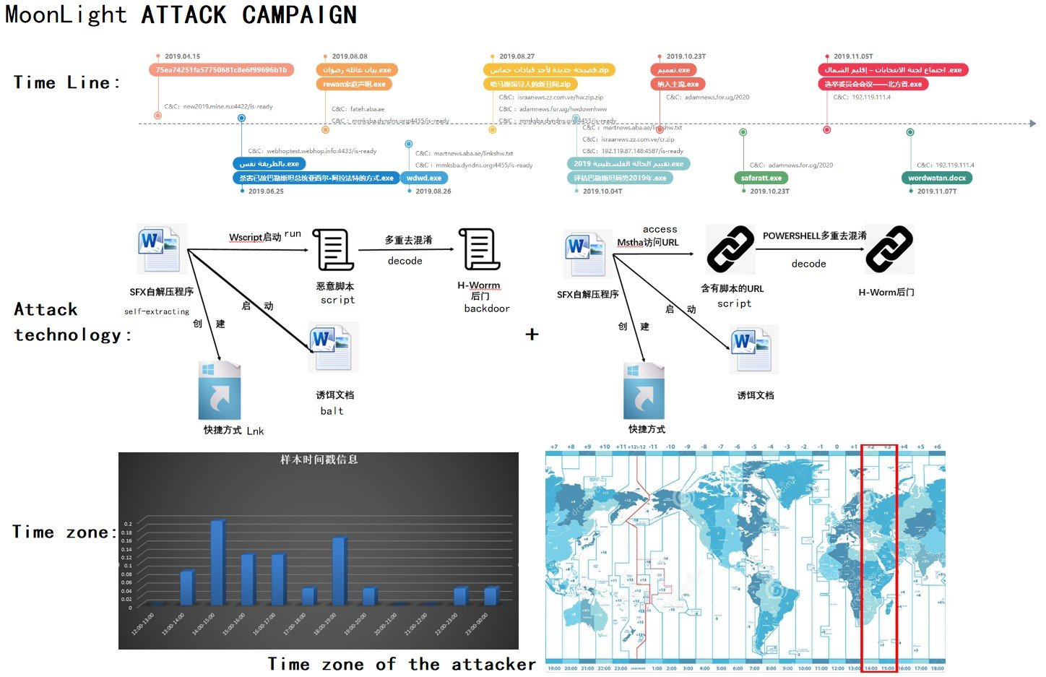
“Malware” and “Code”: A Puzzle In A Big Picture
Cyber-Kill Chain Analysis
Cyberattack Campaign Attribution
Notes:
https://www.lockheedmartin.com/en-us/capabilities/cyber/cyber-kill-chain.html
https://twitter.com/RedDrip7/status/1199985553929728000/photo/1

Slide 38
System Security and Malware Code Analysis
What is the Course is about?
System
Security
Malware Code
Analysis
Notes:
We no longer count cores..

Slide 39
Traditional Analysis
Program Analysis
  Source code vs. Binary only
  Static analysis vs. Dynamic instrumentation
  Code Disassembly, de-compilation
  Different architectures
    x86, ARM, MIPS …
Hybrid Analysis
  Binary lifting
Attacks
  Memory Corruption Attacks
    Stack and heap
  ROP gadgets
  Format string attack
  ...
Defenses
  Stack canaries
  DEP, NX
  ASLR

Slide 40
Emerging Challenges
Rapid Growth in Attack Surface
How can we scale our analysis?
Ecosystem fragmentation
  E.g., IoT, ICS systems
Systems run from different layers
  Language runtimes, Web assembly, Browser OS
More security education, more security professionals
  Still, we may be falling behind ….
  Labor intensive, highly dependent to individual capability
ML-based binary code analysis
  Can we automate binary and code analysis?
  What are the features with high security implications?
    Garbage in, garbage out
  ML is statistical measure
    We may scale, but we cannot be perfect…
Can we still win the war?
  Even when we lose a couple of battles?
  Human expert in the loop

Slide 41
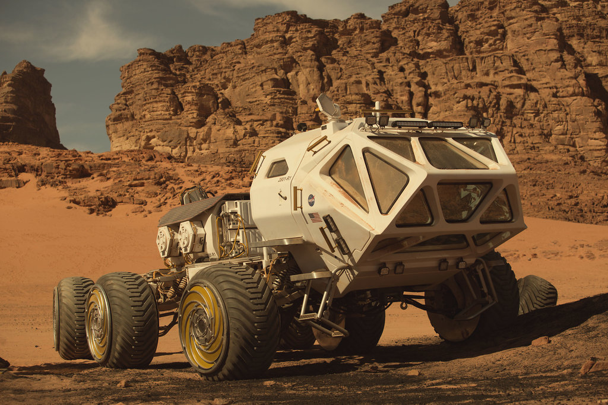
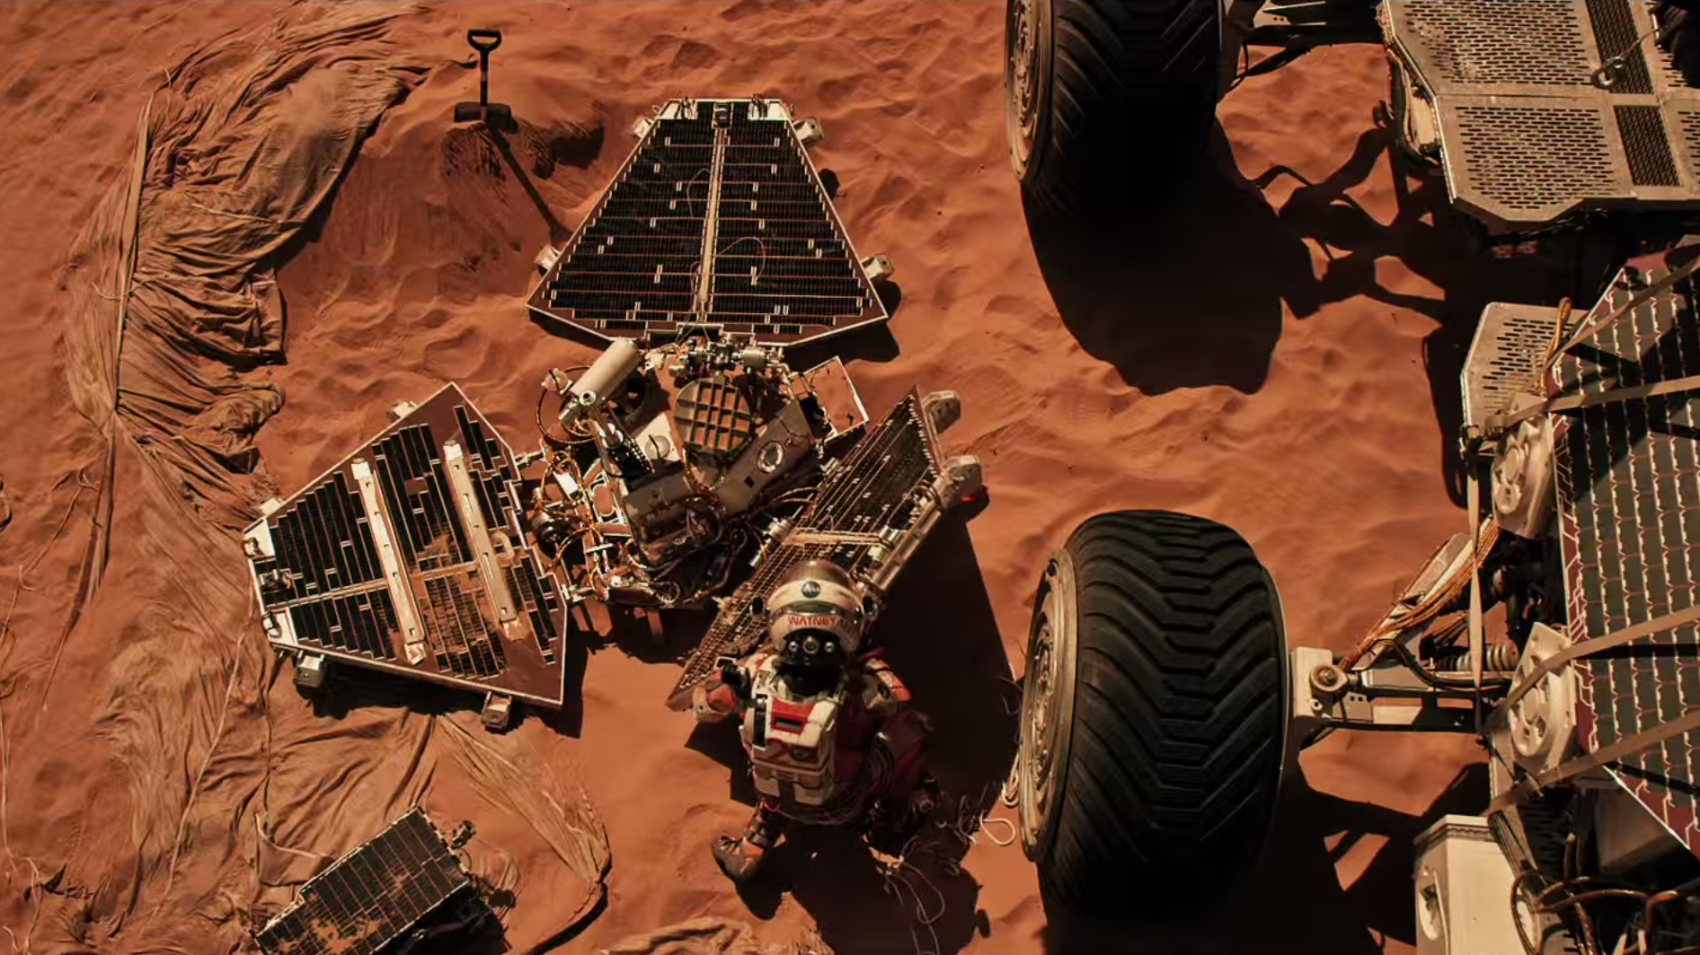
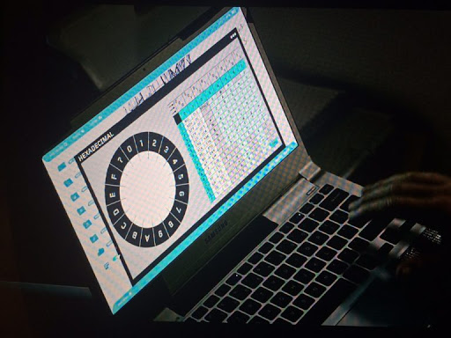
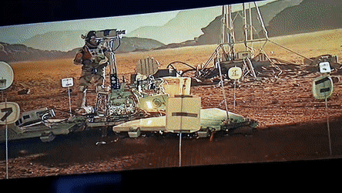
Case Study: How Did JPL Connect to Mark Watney?
At Sol 6: Mark Watney left alone in the Mars at due unexpected thunderstorm at Mars
Sol 10: Mark tried to revive long deactivated PathFinder lander to reconnect back the Earth
Revived Pathfinder lander could connect back to the earth but
  Limited bandwidth, lengthy communication delays,
  No support for proper I/O
Sol 83: Mark devised a protocol an ascii byte at a time (1 byte per 4 seconds)
*Sol : Day on Mars
Notes:
https://youtu.be/NttUBB98zg4?t=82

Slide 42
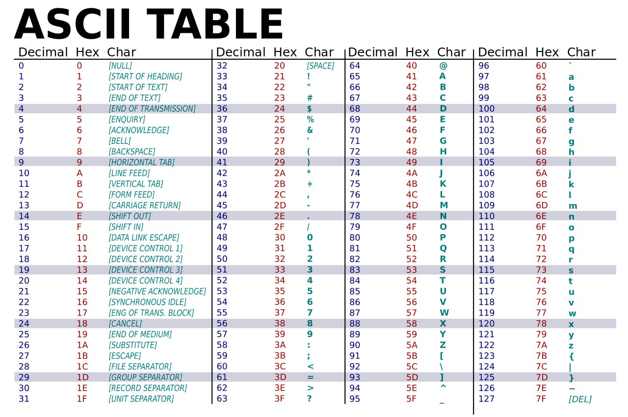
How to read a memory region?
  'CHAR' type (8 bit) => 2⁸ => 256
0 ~ 255 (0x0 ~ 0xFF) (unsigned) characters
  Limited → Unicode
String terminated by 0x0 (NUL)
Alpha + Digit region starts from 0x30 (48)

Slide 43
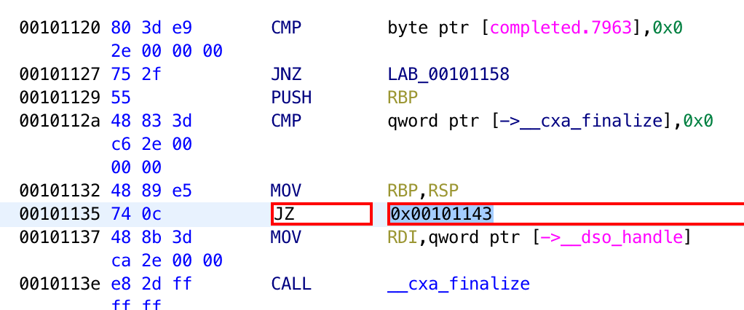
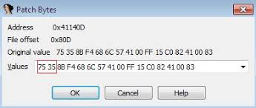
Binary Patching
Editing / modifying the binary program without accessing the source code
Many reversing tools exist but still not easy
  Ghidra, IDA Pro, Cutter …
In high demand
  Not many people understand …

Slide 44
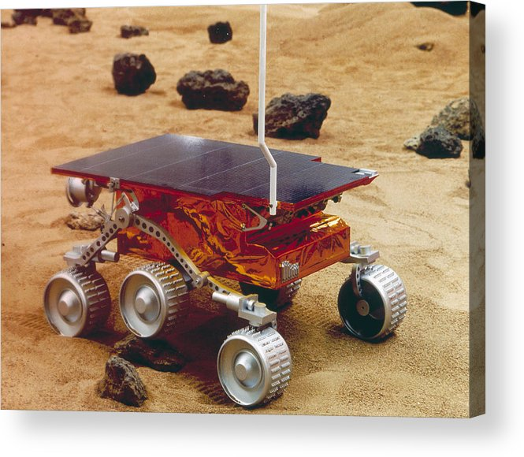
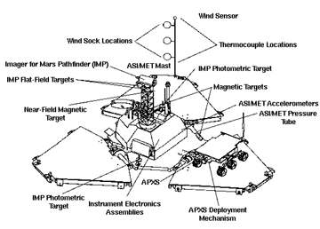
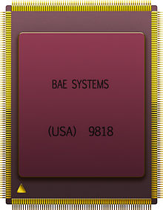
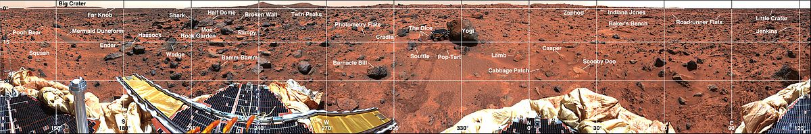
REAL Case Study: Mars PathFinder Bug fix
Launched on 1996 (Cost 175M)
Runs VxWorks 5.x (the latest version 7)
  Real Time OS
The computer of the Pathfinder lander was a Radiation Hardened IBM RISC 6000
  Single board computer (IBM RAD6000 SC) with 128 MB of RAM and 6 MB of EEPROM
Notes:
https://www.cs.cornell.edu/courses/cs614/1999sp/papers/pathfinder.html
https://mars.nasa.gov/MPF/mpf/fact_sheet.html

Slide 45
Until Next Class
Discord
CTF scoring server
Connect to CTF challenge host
  https://ctf-vm1.utdallas.edu

Slide 46
Backup

