Slide 1
CS 6332.001: Systems Security and Binary Code Analysis
Lecture 02
Kangkook Jee
Sep 10, 2026

Slide 2
Reminder: This is a graduate course
We cannot cover every details
You need to learn how to study and research by yourself

Slide 3
Agenda
Code generation process
X86 assembly
  32bit / 64bit
Functions calling conventions
Binary encoding / decoding
Binary reversing basics
  Disassembly, elf header information
Debugger vs. Reverser or both
  GDB + pwdbg
  objdump, ldd, tmux
  Ghidra, IDA Pro
  Misc tools: lstrace, ptrace
Scripting your exploits
  pwntools + python

Slide 4
Hands-on Activities
In class hands-on
  Under ctf-vm1.utdallas.edu:/home/labs/inclass1
Assignment (unit1) out
  Under ctf-vm1.utdallas.edu:/home/unit1
  Due in two weeks

Slide 5
Unit 1
Level0-crackme0 (64-bit): 5
Level1-crackme1 (32-bit): 5
Level2-length and sum (32-bit): 10
Level3-complex math (32-bit): 10
Level4-two's complement (32-bit): 20
Level5-BoF0-32 : 10
Level6-BoF1-32 : 10
Level7-BoF2-64 : 10
Level8-BoF3-32 : 20
Level9-BoF4-64 : 20
Reversing + Buffer overflow
  A quick start
Don’t use decompiler
  E.g., Ghidra
You have two weeks but
  Unit2 will be out back-to-back
  Start early
Go to ctf-vm1 and fetch!
  $ fetch unit1

Slide 6
welcome_quiz0

Slide 7
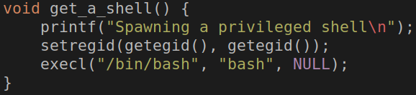
get_a_shell()
Inherit current privilege and then execute a shell
You can read the flag!
setregid(getegid(), getegid())
execl(“/bin/bash”, “bash”, 0);
Notes:
can we better format this?

Slide 8
get_a_shell(): setregid()
getegid()
  Get effective GID
setregid(gid_t rgid, gid_t egid)
  Set real and effective gid
setregid(getegid(), getegid())
  Set real and effective gid as current effective gid
  Privilege escalation!
  Set your gid to unit3-level0-…

Slide 9
Linux Access Control: Resource Ownership
Ownership for user and group
  Who (or which group) owns the file?
Permissions for User, Group, Other
  Write, Read, eXecution
Program with setuid, setguid bits
  Atop the privileges of the user, run with the privileges of the file owner instead

Slide 10
Data Encoding
Two’s complement encoding
Primitive Types
ASCII
String

Slide 11
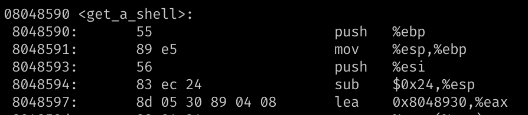
Integer Representations
Unsigned representation (%u)
  8-bit → A byte -> char
Signed
  2’s complement → 1 bit for signedness (%d)
Hexadecimal representation
  0x0 ~ 0xF → 4-bits
  0xB5 → 8-bits (int8_t) → a char
= 214
= 0xD6
Notes:
https://www.electronics-tutorials.ws/binary/signed-binary-numbers.html

Slide 12
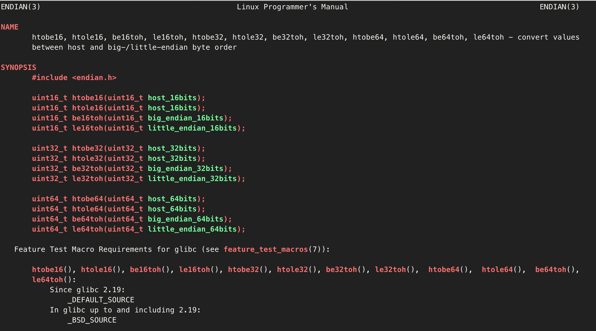
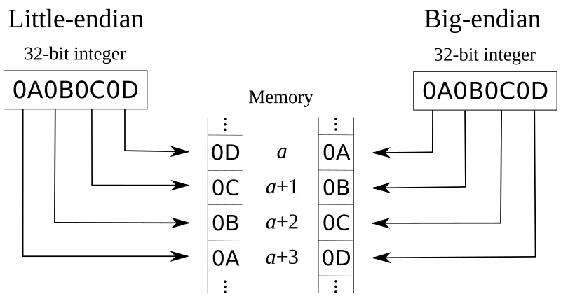
Endianness: Little vs. Big
How the hardware architecture layouts array of bytes
Intel,ARM → Little endian
Network
→ Big endian
"man endian"
Notes:
example needed

Slide 13
Bitwise Operations – Truth Table
& (AND)
1 if both are 1
| (OR)
1 if either of one is 1
^ (XOR)
1 if two values are different
AND | 0 | 1
0 | 0 | 0
1 | 0 | 1
OR | 0 | 1
0 | 0 | 1
1 | 1 | 1
XOR | 0 | 1
0 | 0 | 1
1 | 1 | 0
Do not confuse with Logical operators: "||" , "&&"

Slide 14
Bitwise Operations - Examples
AND
  1 & 2 = ?
    00000001
    00000010
    = 00000000 = 0
  0x32 & 0x47 = ?
    00110010
    01000111
    = 00000010 = 2
OR
  1 | 2 = ?
    00000001
    00000010
    = 00000011 = 3
  0x32 & 0x47 = ?
    00110010
    01000111
    = 01110111 = 0x77
XOR
  1 ^ 2 = ?
    00000001
    00000010
    = 00000011 = 3
  0x32 ^ 0x47 = ?
    00110010
    01000111
    = 01110101 = 0x75

Slide 15
Bitwise Operations – Reversible XOR
XOR is a reversible operator
  A ^ B = C
  C ^ B = ?
    C = (A^B)
    C ^ B = (A ^ B) ^ B = A ^ (B ^ B)
  # XOR-ing the same value, zero
  B^B = 0
  # A’s 0s will be zero
  # A’s 1s will be one
  A ^ 0 = A
XOR and SWAP
Suppose you have
int a,b;
Swap – temp variable
  int t = a;
  a = b;
  b = t;
Swap – XOR
  a = a^b
  b = a^b ⬄ (a^b)^b => a
  a = a^b ⬄ (a^b)^a => b

Slide 16
Bitwise Operations: AND
Use it to get the least significant bits (byte)
sign-extends a single byte
movsbl: move (int8_t) (*addr) → int32_t (integer)
  0x0804868c <+44>: movsbl (%eax,%ecx,1),%eax
  0x08048690 <+48>: add $0x20,%eax
  0x08048693 <+51>: and $0xff,%eax
  %eax = [%eax + %ecx * 1]; // read 1 byte (movsbl)
  %eax += 0x20;
  %eax &= 0xff
  int a;
  a += 0x20;
  a &= 0xff; // retain only a byte
Notes:
todo: update example

Slide 17
Bitwise Operations: AND
  An unsigned character value could be in the range from 0 to 255
  The code adds '32 (0x20)' to the character value.
  What if the original value (*a) is 255?
    255 + 32 = 287 = 0x11f ← not a character
  287 & 0xff?
    0x11f & 0xff
    0x1f!
int a; a += 0x20; a &= 0xff;
0x011f = 00000001 00011111
0x00ff = 00000000 11111111
------------------
> 00000000 00011111
& (AND)

Slide 18
Integer types | Intel |  | ARM
 | IA32 (32-bit) | AMD64 (64-bit) | arm7l (32-bit) | aarch64 (64-bit)
CHAR_BIT | 8 | 8 | 8 | 8
CHAR_MAX | 127 | 127 | 255 | 127
CHAR_MIN | -128 | -128 | 0 | -128
INT_MAX | 2147483647 | 2147483647 | 2147483647 | 2147483647
INT_MIN | -2147483648 | -2147483648 | -2147483648 | -2147483648
LONG_MAX | 2147483647 | 9223372036854770000 | 2147483647 | 9223372036854770000
LONG_MIN | -2147483648 | -9223372036854770000 | -2147483648 | -9223372036854770000
SCHAR_MAX | 127 | 127 | 127 | 127
SCHAR_MIN | -128 | -128 | -128 | -128
SHRT_MAX | 32767 | 32767 | 32767 | 32767
SHRT_MIN | -32768 | -32768 | -32768 | -32768
UCHAR_MAX | 255 | 255 | 255 | 255
UINT_MAX | 4294967295 | 4294967295 | 4294967295 | 4294967295
ULONG_MAX | 4294967295 | 18446744073709500000 | 4294967295 | 18446744073709500000
USHRT_MAX | 65535 | 65535 | 65535 | 65535

Slide 19
<stdint.h>
Be explicit on
  Data types
    Value or pointer
  Data width: a byte (8-bit), four bytes (32-bit), eight bytes (64-bit)
    2^4 = 16, 2^5 = 32 ….
    2^10 = 1024 ≈ 1K, 2 ^ 20 = 1024 X 1024 ≈ 1M …
      Q: 2^32 ?
  Signedness
Beware of side effects
  overflow, underflow …
Use <stdint.h>
#include <stdint.h>
int32_t a; // 4 bytes
uint8_t b; // 1 byte
…
int8ptr_t c; // 4 bytes
int32ptr_t d; // 4 bytes
…

Slide 20
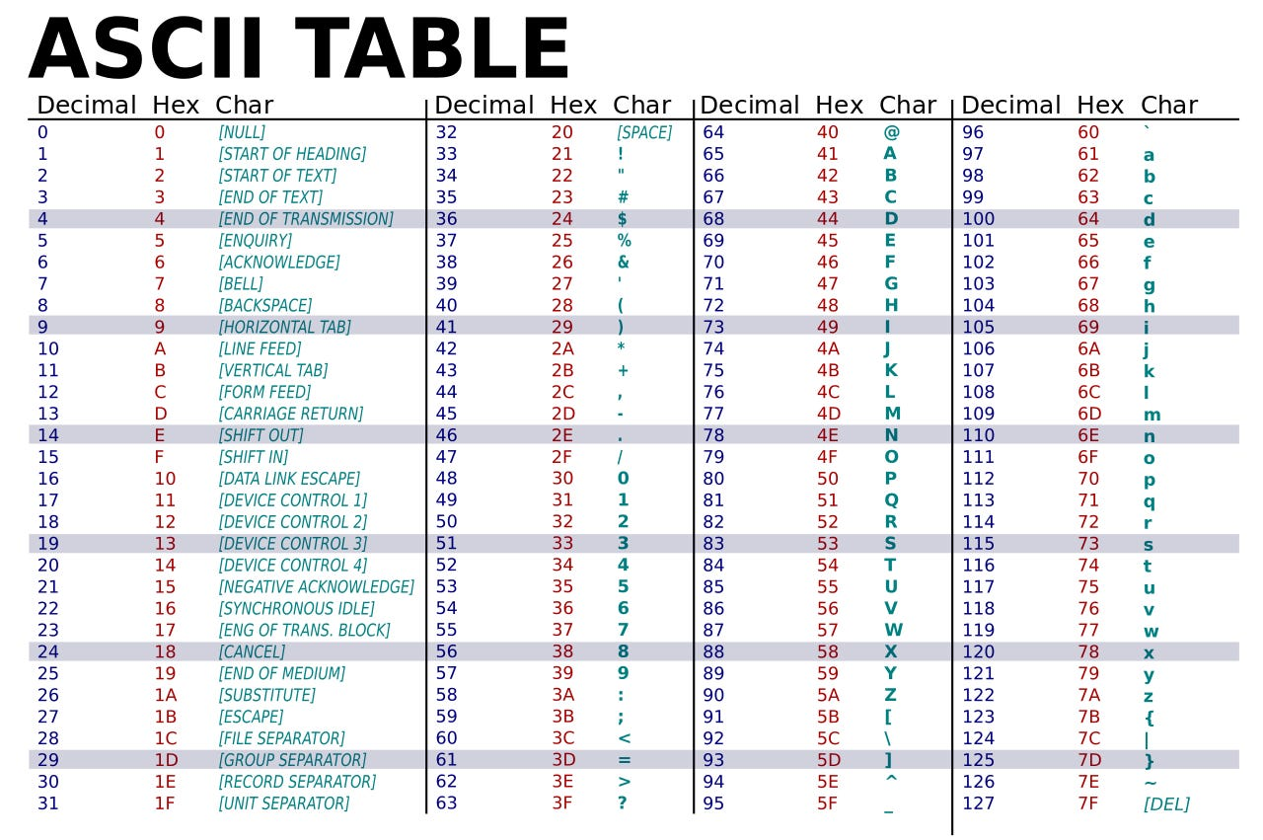
ASCII
A byte to represent a character
0 ~ 255 (0x0 ~ 0xFF) (unsigned) characters
  Limited → Unicode
String terminated by 0x0 (NUL, '\0')
Alpha + Digit region starts from 0x30 (48)

Slide 21
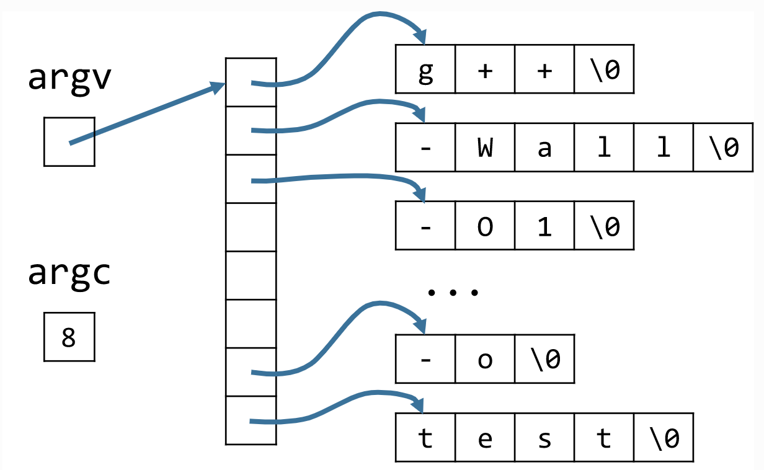
C-Style Strings
String is ‘NULL’ (\0) terminated
char str[6] = { 'h', 'e', 'l', 'l', 'o', '\0' };
Command line arguments
g++ -wall –O1 …. –o test

Slide 22
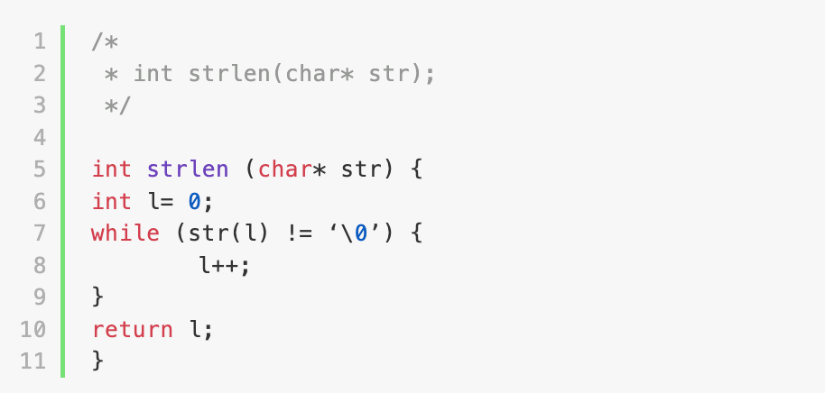
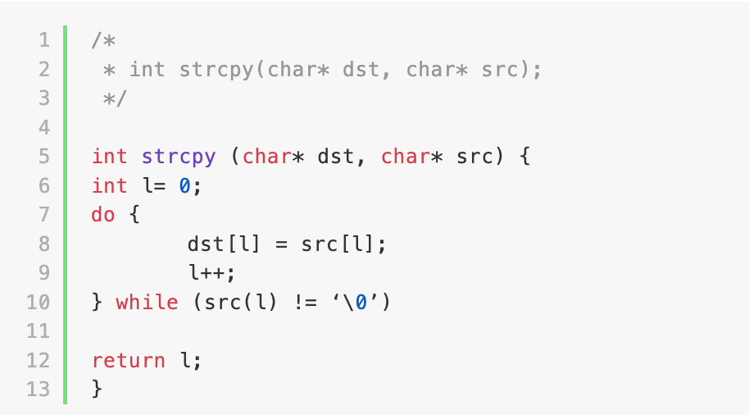
(Naïve) String Functions
int strlen(char* str);
int strcpy(char* dst, char* src);
int strlen (char* str) {
  int l= 0;
  while (str(l) != ‘\0’) {
  l++;
  }
  return l;
}
How about ‘strcmp()’?
Notes:
strcmp() return value man strcmp
https://codimd.syssec.org/Soi-Cnp3Rz-ZvHGNWizyXA

Slide 23
Level 4: Two's complement
scanf ()
strlen()
atoi(), snprintf()
Transformation (XOR'ing)
Check wit Password

Slide 24
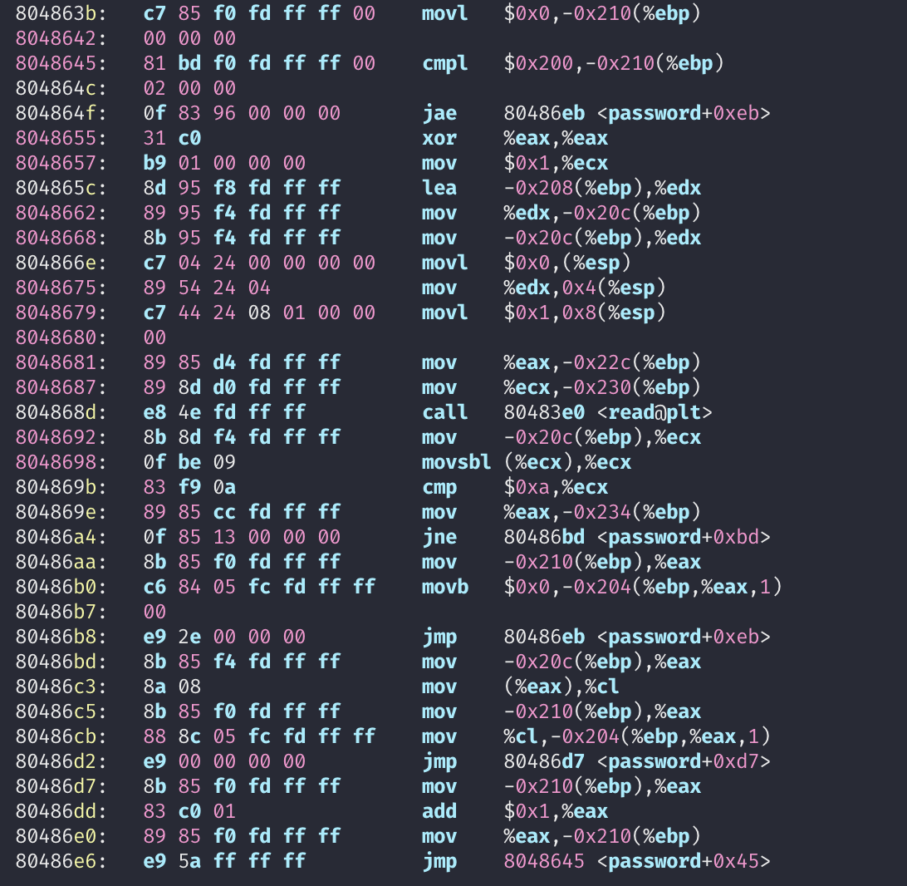
Level 4: Two's complement
scanf()

Slide 25
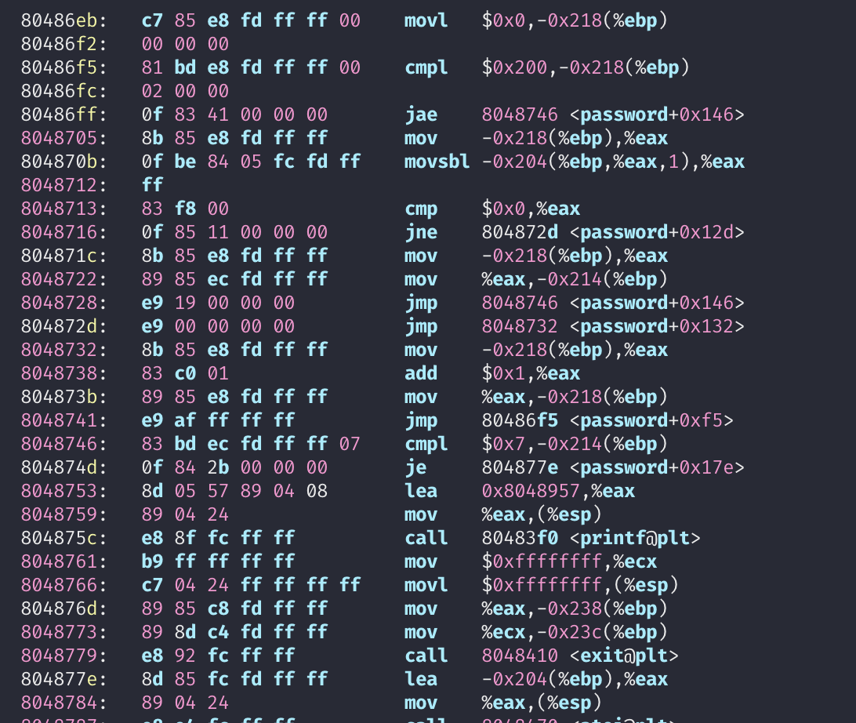
Level 4: Two's complement
strlen()
  length: -0x218(%ebp)

Slide 26
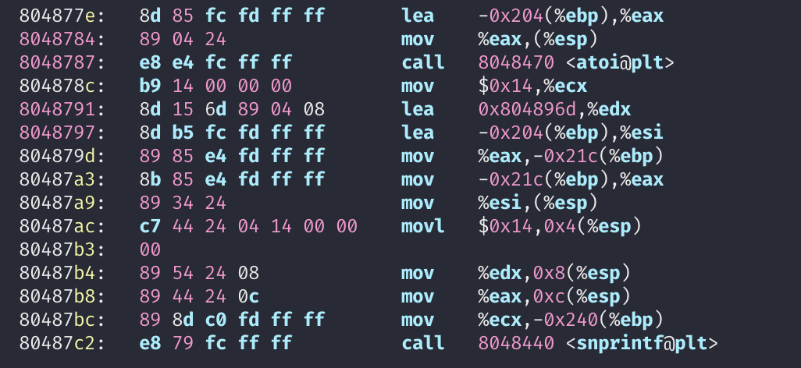
Level 4: Two's complement
library calls
  atoi();
  snprintf();

Slide 27
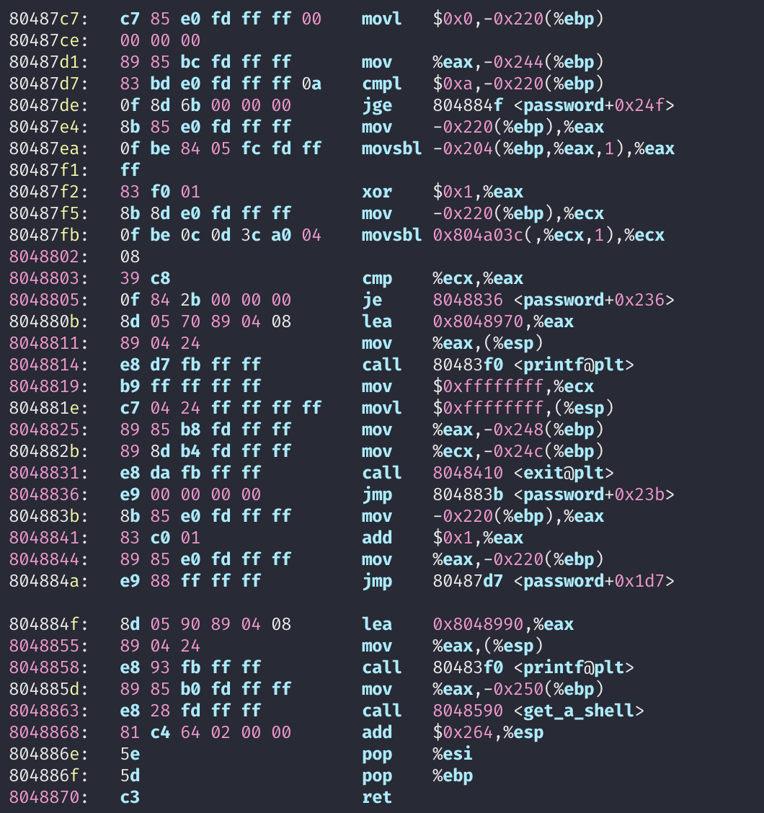
Level 4: Two's complement
Check!

