Slide 1
CS 6332.001: Systems Security and Malware Code Analysis
Lecture 03
Kangkook Jee
Sep 3, 2024

Slide 2

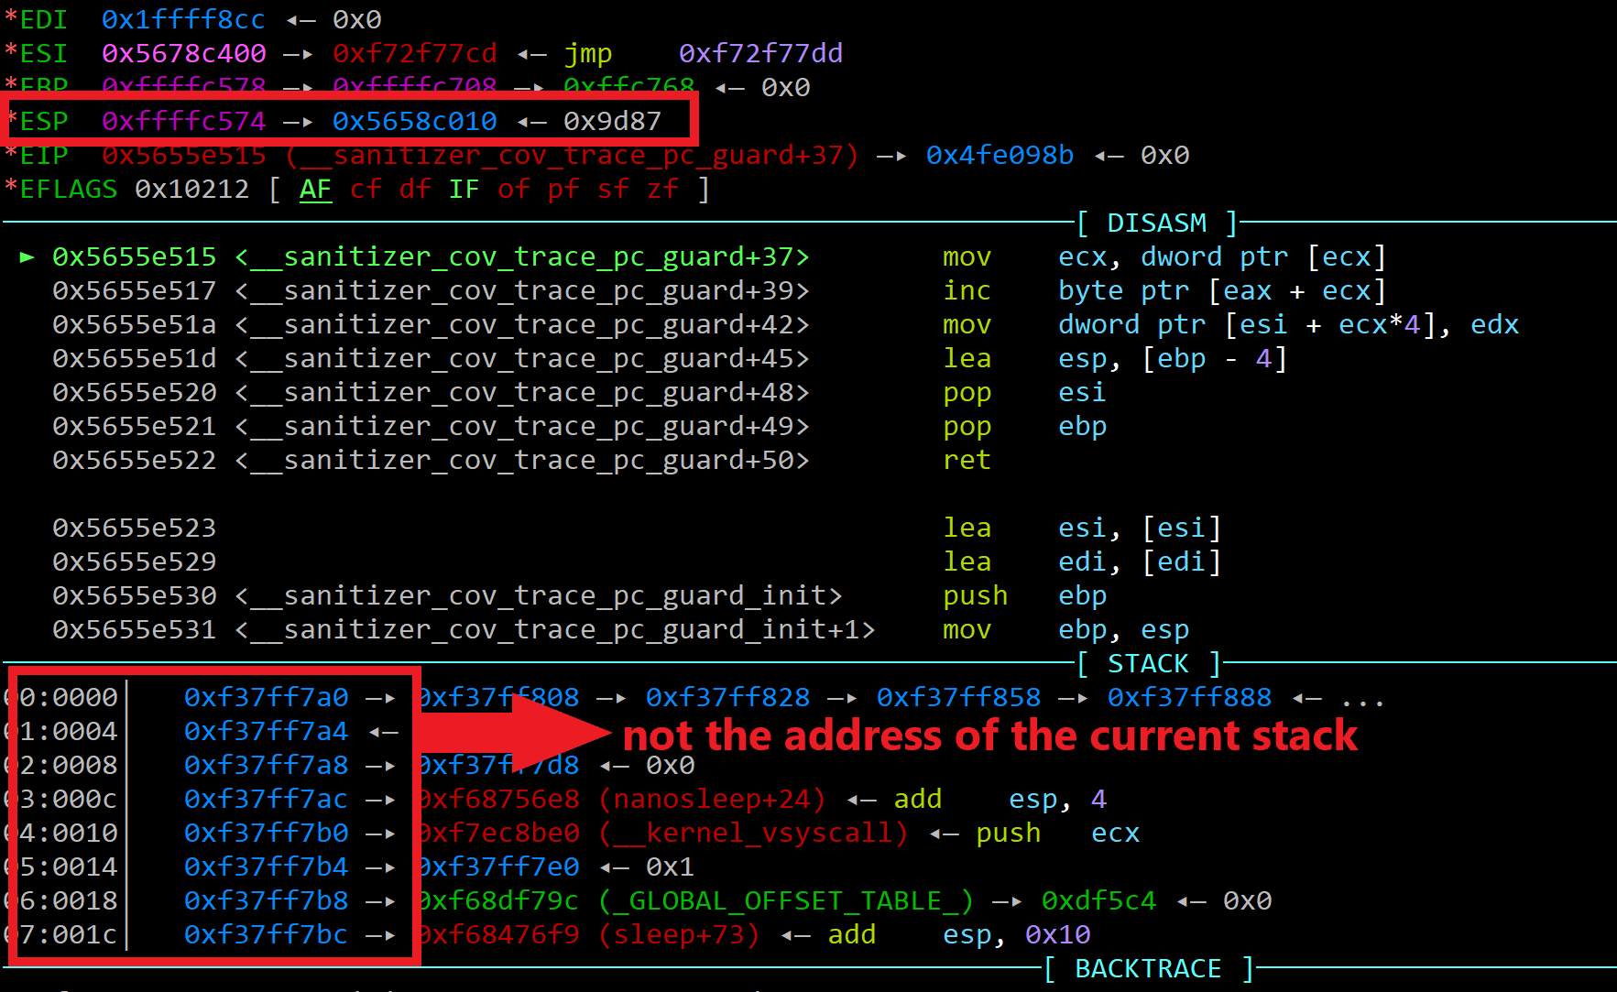
Agenda
Data encoding review
Machine code
  X86 assembly, ARM assembly
  GAS (GNU Assembly). inline assembly
Calling convention
  i386, x86_64, ARM7, ARM8
  Abstract Binary Interface (ABI)
Hands-on
  GDB + PwnDBG

Slide 3
Unit 2
Intel (i386 / AMD64)
ARM
1-shellcode-32
2-shellcode-64
3-nonzero-shellcode-32
4-nonzero-shellcode-64
5-ascii-shellcode-64
6-short-shellcode-64
7-stack-cookie
8-dep-0
9-dep-1
shellcode-32
nonzero-shellcode-32
ascii-shellcode-64
thumb-shellcode-64
stack overflow + shellcoding0
stack overflow + shellcoding1
stack overflow + shellcoding2
dep-0
dep-1

Slide 4
Data Encoding
Two’s complement encoding
Primitive Types
ASCII
String

Slide 5
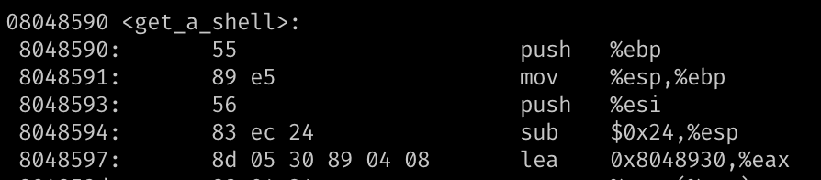
Integer Representations
Unsigned representation (%u)
  8-bit → A byte -> char
Signed
  2’s complement → 1 bit for signedness (%d)
Hexadecimal representation
  0x0 ~ 0xF → 4-bits
  0xB5 → 8-bits (int8_t) → a char
= 214
= 0xD6
Notes:
https://www.electronics-tutorials.ws/binary/signed-binary-numbers.html

Slide 6
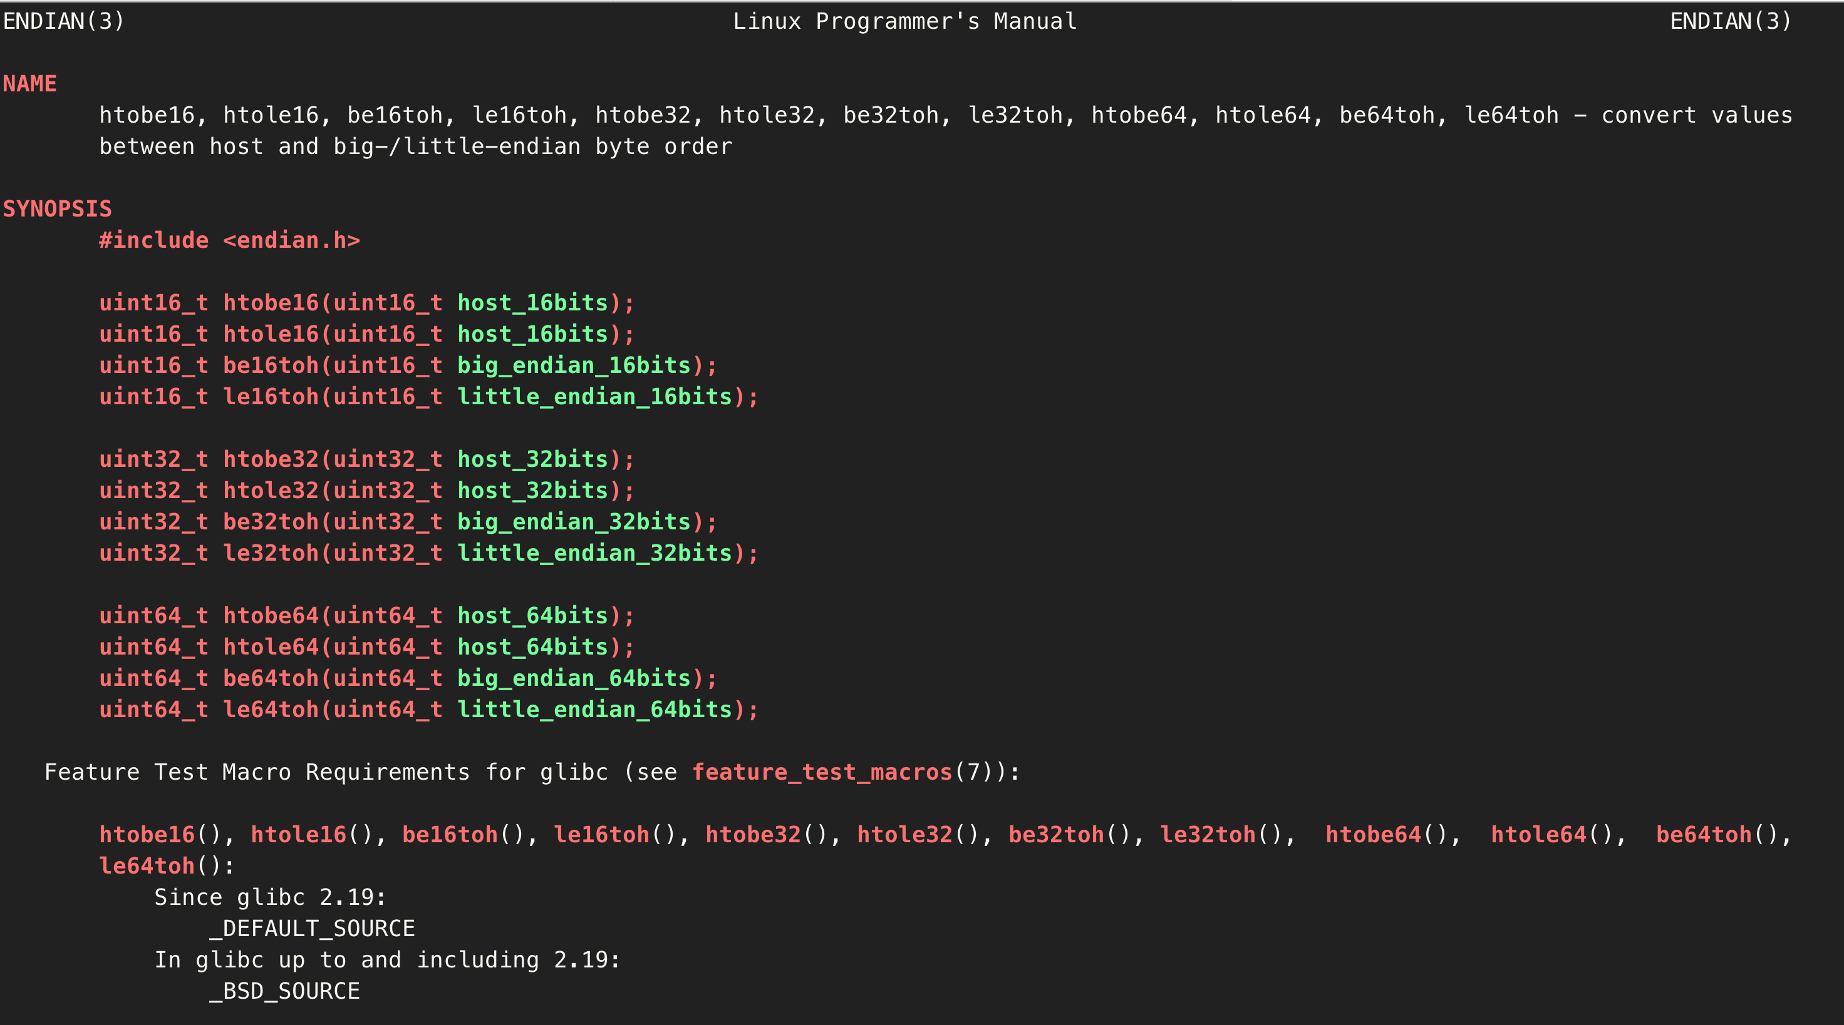
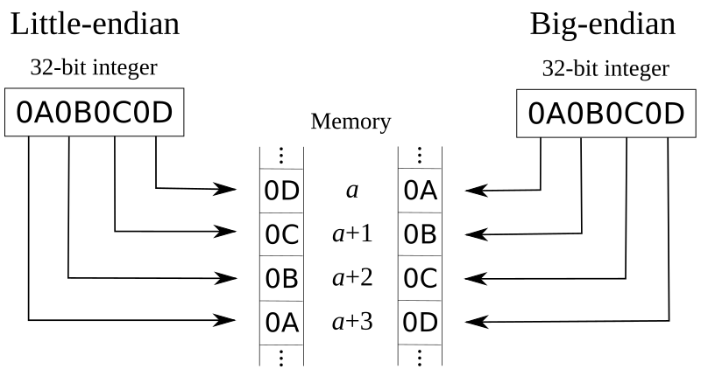
Endianness: Little vs. Big
How the hardware architecture layouts array of bytes
Intel,ARM → Little endian
Network
→ Big endian
"man endian"
Notes:
example needed

Slide 7
Bitwise Operations – Truth Table
& (AND)
1 if both are 1
| (OR)
1 if either of one is 1
^ (XOR)
1 if two values are different
AND | 0 | 1
0 | 0 | 0
1 | 0 | 1
OR | 0 | 1
0 | 0 | 1
1 | 1 | 1
XOR | 0 | 1
0 | 0 | 1
1 | 1 | 0
Do not confuse with Logical operators: "||" , "&&"

Slide 8
Bitwise Operations - Examples
AND
  1 & 2 = ?
    00000001
    00000010
    = 00000000 = 0
  0x32 & 0x47 = ?
    00110010
    01000111
    = 00000010 = 2
OR
  1 | 2 = ?
    00000001
    00000010
    = 00000011 = 3
  0x32 & 0x47 = ?
    00110010
    01000111
    = 01110111 = 0x77
XOR
  1 ^ 2 = ?
    00000001
    00000010
    = 00000011 = 3
  0x32 ^ 0x47 = ?
    00110010
    01000111
    = 01110101 = 0x75

Slide 9
Bitwise Operations – Reversible XOR
XOR is a reversible operator
  A ^ B = C
  C ^ B = ?
    C = (A^B)
    C ^ B = (A ^ B) ^ B = A ^ (B ^ B)
  # XOR-ing the same value, zero
  B^B = 0
  # A’s 0s will be zero
  # A’s 1s will be one
  A ^ 0 = A
XOR and SWAP
Suppose you have
int a,b;
Swap – temp variable
  int t = a;
  a = b;
  b = t;
Swap – XOR
  a = a^b
  b = a^b ⬄ (a^b)^b => a
  a = a^b ⬄ (a^b)^a => b

Slide 10
Bitwise Operations: AND
Use it to get the least significant bits (byte)
sign-extends a single byte
movsbl: move (int8_t) (*addr) → int32_t (integer)
  0x0804868c <+44>: movsbl (%eax,%ecx,1),%eax
  0x08048690 <+48>: add $0x20,%eax
  0x08048693 <+51>: and $0xff,%eax
  %eax = [%eax + %ecx * 1]; // read 1 byte (movsbl)
  %eax += 0x20;
  %eax &= 0xff
  int a;
  a += 0x20;
  a &= 0xff; // retain only a byte
Notes:
todo: update example

Slide 11
Bitwise Operations: AND
  An unsigned character value could be in the range from 0 to 255
  The code adds '32 (0x20)' to the character value.
  What if the original value (*a) is 255?
    255 + 32 = 287 = 0x11f ← not a character
  287 & 0xff?
    0x11f & 0xff
    0x1f!
int a; a += 0x20; a &= 0xff;
0x011f = 00000001 00011111
0x00ff = 00000000 11111111
------------------
> 00000000 00011111
& (AND)

Slide 12
Integer types | Intel |  | ARM
 | IA32 (32-bit) | AMD64 (64-bit) | arm7l (32-bit) | aarch64 (64-bit)
CHAR_BIT | 8 | 8 | 8 | 8
CHAR_MAX | 127 | 127 | 255 | 127
CHAR_MIN | -128 | -128 | 0 | -128
INT_MAX | 2147483647 | 2147483647 | 2147483647 | 2147483647
INT_MIN | -2147483648 | -2147483648 | -2147483648 | -2147483648
LONG_MAX | 2147483647 | 9223372036854770000 | 2147483647 | 9223372036854770000
LONG_MIN | -2147483648 | -9223372036854770000 | -2147483648 | -9223372036854770000
SCHAR_MAX | 127 | 127 | 127 | 127
SCHAR_MIN | -128 | -128 | -128 | -128
SHRT_MAX | 32767 | 32767 | 32767 | 32767
SHRT_MIN | -32768 | -32768 | -32768 | -32768
UCHAR_MAX | 255 | 255 | 255 | 255
UINT_MAX | 4294967295 | 4294967295 | 4294967295 | 4294967295
ULONG_MAX | 4294967295 | 18446744073709500000 | 4294967295 | 18446744073709500000
USHRT_MAX | 65535 | 65535 | 65535 | 65535

Slide 13
<stdint.h>
Be explicit on
  Data types
    Value or pointer
  Data width: a byte (8-bit), four bytes (32-bit), eight bytes (64-bit)
    2^4 = 16, 2^5 = 32 ….
    2^10 = 1024 ≈ 1K, 2 ^ 20 = 1024 X 1024 ≈ 1M …
      Q: 2^32 ?
  Signedness
Beware of side effects
  overflow, underflow …
Use <stdint.h>
#include <stdint.h>
int32_t a; // 4 bytes
uint8_t b; // 1 byte
…
int8ptr_t c; // 4 bytes
int32ptr_t d; // 4 bytes
…

Slide 14
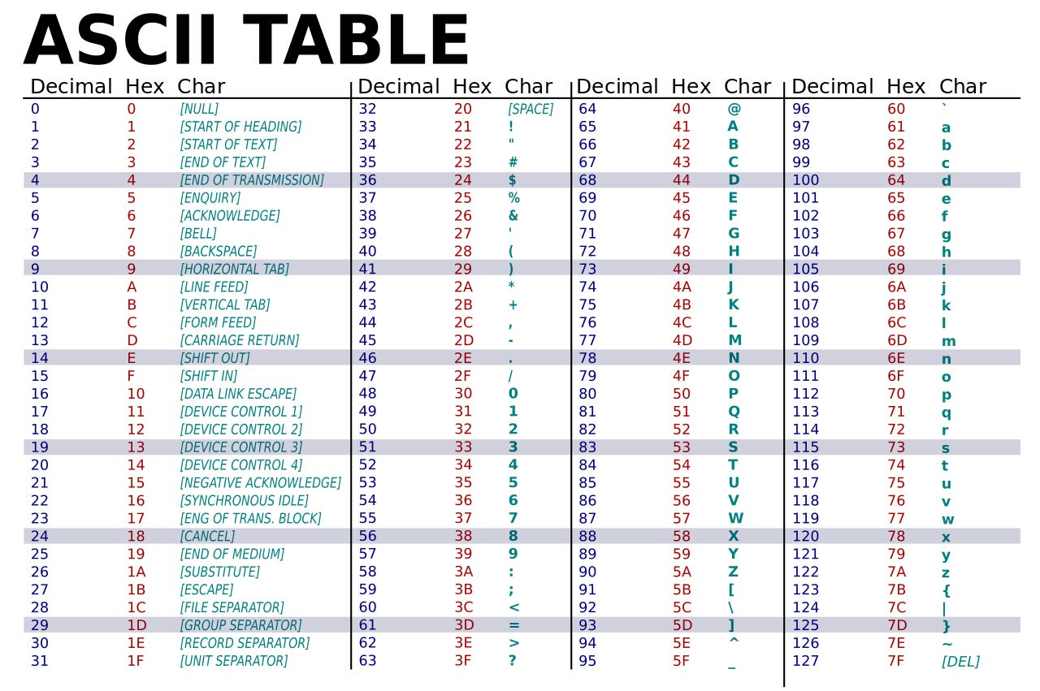
ASCII
A byte to represent a character
0 ~ 255 (0x0 ~ 0xFF) (unsigned) characters
  Limited → Unicode
String terminated by 0x0 (NUL, '\0')
Alpha + Digit region starts from 0x30 (48)

Slide 15
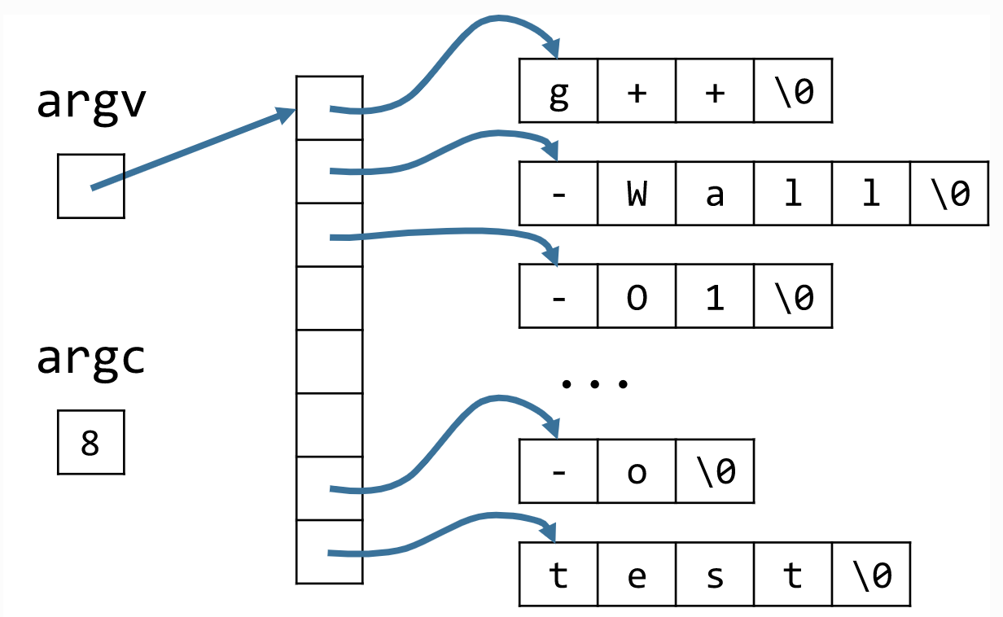
C-Style Strings
String is ‘NULL’ (\0) terminated
char str[6] = { 'h', 'e', 'l', 'l', 'o', '\0' };
Command line arguments
g++ -wall –O1 …. –o test

Slide 16
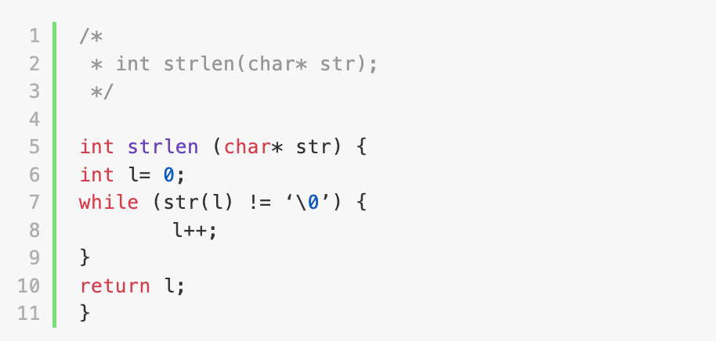
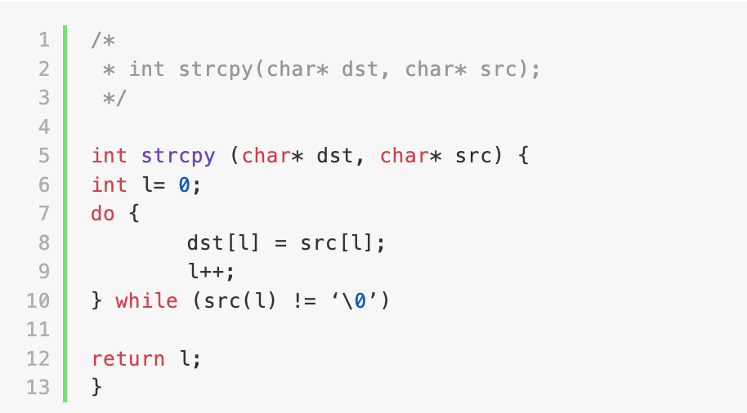
(Naïve) String Functions
int strlen(char* str);
int strcpy(char* dst, char* src);
int strlen (char* str) {
  int l= 0;
  while (str(l) != ‘\0’) {
  l++;
  }
  return l;
}
How about ‘strcmp()’?
Notes:
strcmp() return value man strcmp
https://codimd.syssec.org/Soi-Cnp3Rz-ZvHGNWizyXA

Slide 17
Level 4: Two's complement
scanf ()
strlen()
atoi(), snprintf()
Transformation (XOR'ing)
Check wit Password

Slide 18
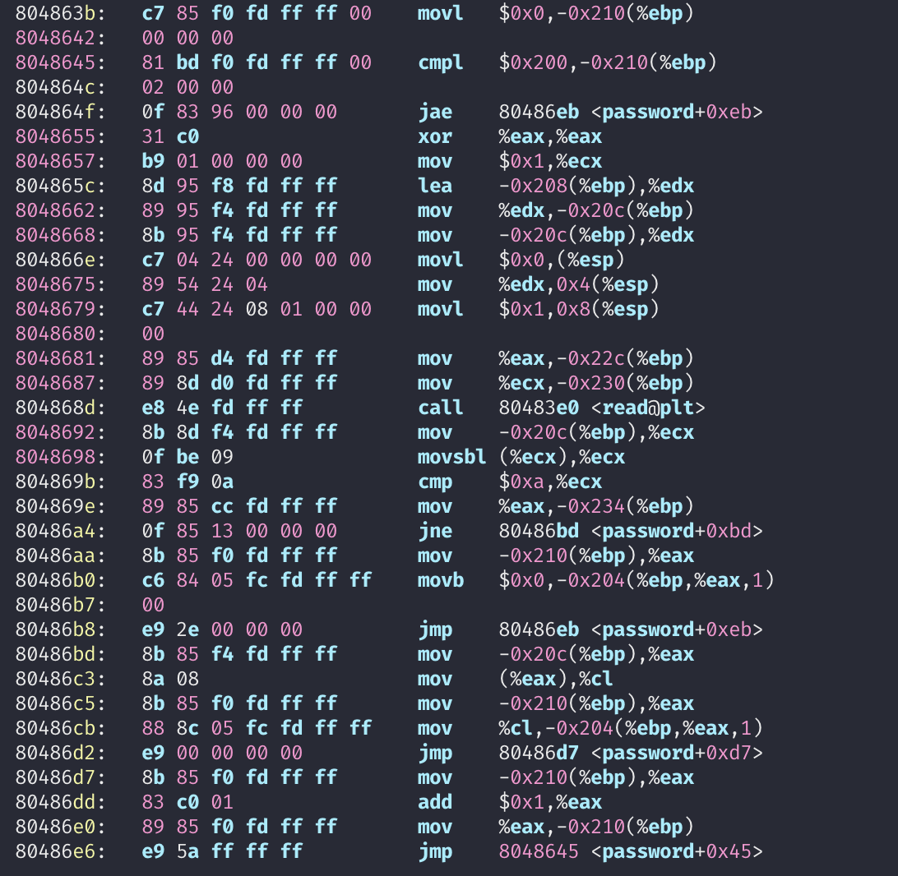
Level 4: Two's complement
scanf()

Slide 19
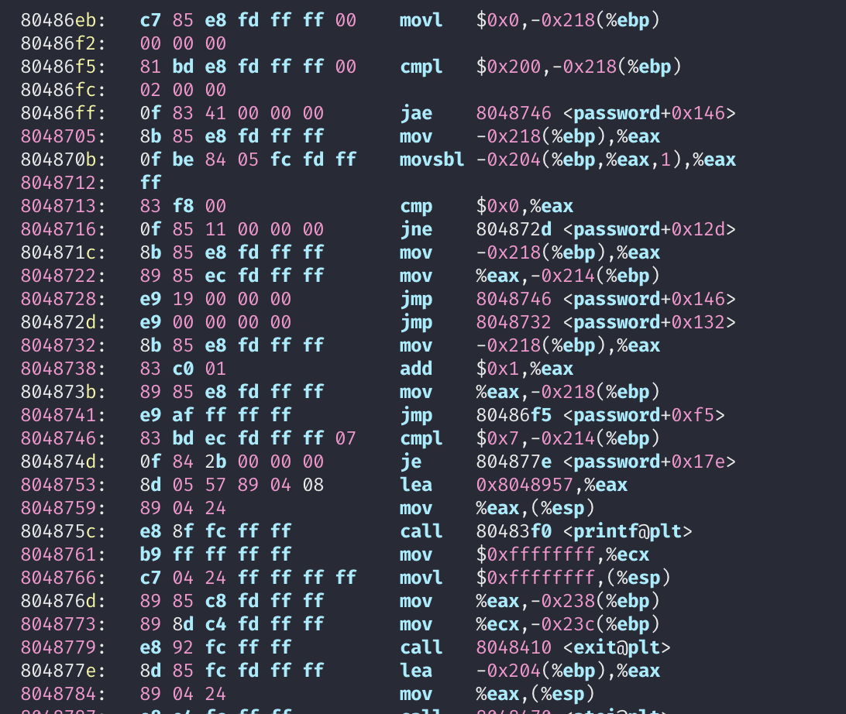
Level 4: Two's complement
strlen()
  length: -0x218(%ebp)

Slide 20
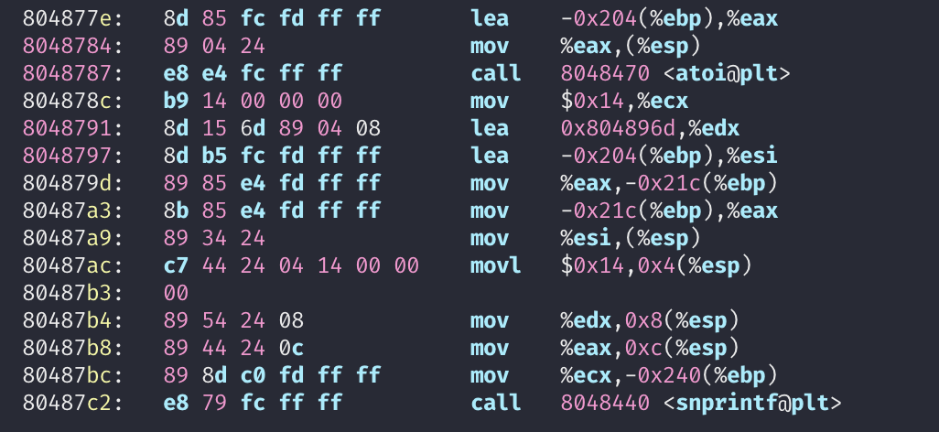
Level 4: Two's complement
library calls
  atoi();
  snprintf();

Slide 21
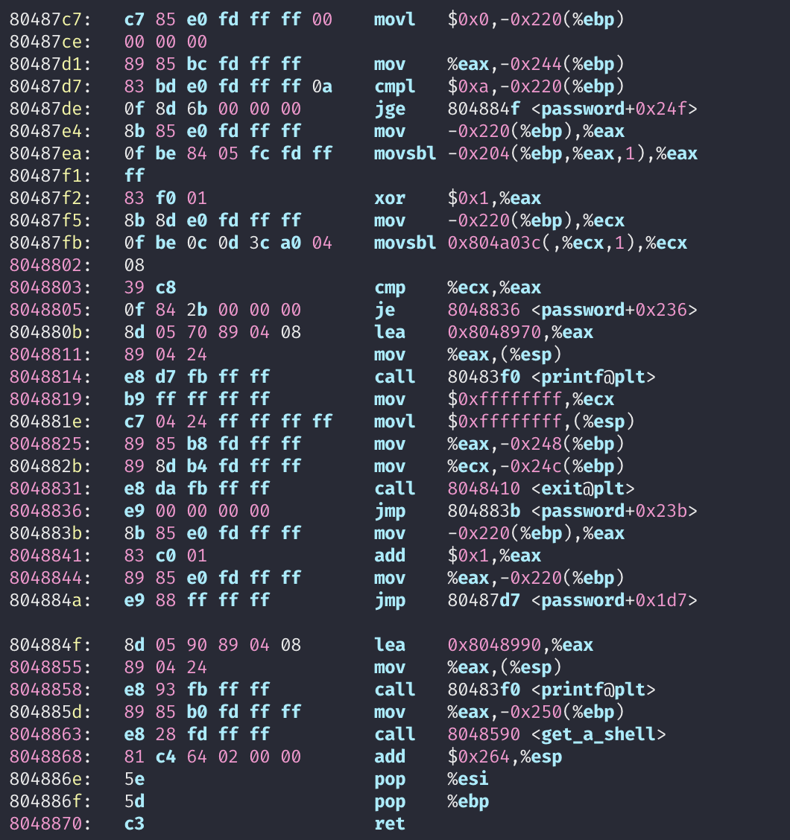
Level 4: Two's complement
Check!

Slide 22
Function Support and Stack Operation

Slide 23
Function Support
Function is the only language construct that has CPU level support
  Turing machine does not define the function
Lambda calculus works on functions
  Church – Turing Theorem
    ➔ Turing machine == Lambda calculus (equally capable)
    ➔ C program == LISP program (equally capable)
    ➔ Java program == Scala program (equally capable)
  Promoted to 1-class citizen
Function helps programmers
  Defining logical sub-components
  Scoping variables (E.g., Globals vs. Locals, Locals vs. Locals)
Notes:
This slide maybe a redundant, or distraction…

Slide 24
Function Support
Pointer registers
  %ebp (or %rbp): stack base pointer
  %esp (or %rsp): stack pointer
Instructions
  push, pop ← stack operation support
  call, ret ← function call support (prologue)
  enter,leave ← stack frame management (epilogue)
Notes:
enter: prolog

Slide 25
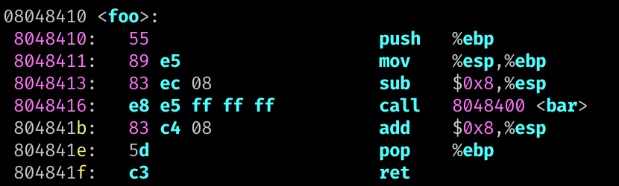
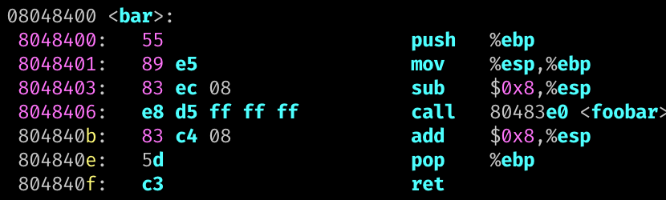
call and ret
call foo
  Pushes %eip to the stack and jump to foo
  push %eip # next instruction
  jmp foo
ret
  Pops to %eip from stack
  pop %eip # Invalid operation
Grows downward
0x804841b
Notes:
Only special instruction can update %eip

Slide 26
IA32 Stack Operation
ARG2
%ebp+c
Stores local variables (negative access over %ebp)
mov %eax, -0x4(%ebp)
lea -0x20c(%ebp), %edx
Function arguments from registers with stack
(positive access over %ebp)
  mov 0x8(%ebp), %eax
Function arguments to callee
  mov 0x8(%ebp), (%esp)
  mov –0x4(%ebp), 4(%esp)
Grow
ARG1
Relative to %ebp
Return IP
%ebp
Saved EBP
Local A
Relative to %esp
Local B
%esp
Local C

Slide 27
Stack Instructions
4 bytes (32-bit)
%ebp : 0xdeadbeef
push %ebp
  Store the value of %ebp at the top of the stack (%esp gets -4)
  mov %ebp, (%esp)
  sub $4, %esp
pop %ebp
  Move the value at the stack top to %ebp (%esp gets +4)
  mov (%esp), %ebp
  add $4, %esp
%esp
Return EIP
Grows downward
Notes:
This is an important slide …
popa, pusha

Slide 28
Stack Instructions
%ebp : 0xdeadbeef
push %ebp
  Store the value of %ebp at the top of the stack (%esp gets -4)
  mov %ebp, (%esp)
  sub $4, %esp
pop %ebp
  Move the value at the stack top to %ebp (%esp gets +4)
  mov (%esp), %ebp
  add $4, %esp
Return EIP
Grows downward
%esp
0xdeadbeef
Notes:
This is an important slide …
popa, pusha

Slide 29
Stack Instructions
push %ebp
  Store the value of %ebp at the top of the stack (%esp gets -4)
  mov %ebp, (%esp)
  sub $4, %esp
pop %ebp
  Move the value at the stack top to %ebp (%esp gets +4)
  mov (%esp), %ebp
  add $4, %esp
Return EIP
Grows downward
%esp
Saved EBP
Notes:
This is an important slide …
popa, pusha

Slide 30
Stack Instructions
%ebp
push %ebp
  Store the value of %ebp at the top of the stack (%esp gets -4)
  mov %ebp, (%esp)
  sub $4, %esp
pop %ebp
  Move the value at the stack top to %ebp (%esp gets +4)
  mov (%esp), %ebp
  add $4, %esp
%esp
Return EIP
Grows downward
Notes:
This is an important slide …
popa, pusha

Slide 31
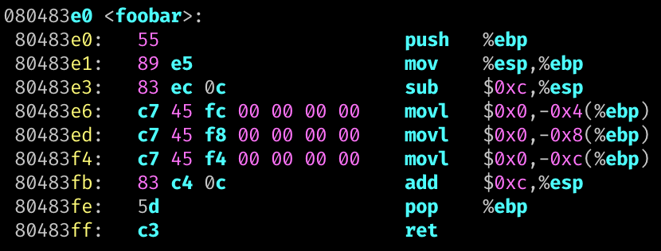
Multiple Function Calls
foo();
0x804841b
Saved EBP
bar();
0x804840b
%ebp
Saved EBP
Local A
foobar();
Local B
%esp
Local C

Slide 32

Function Prologue and Epilogue
Stack frame managements
  alias instructions: enter, leave
Allocation / de-allocation for local variables
Prologue → ’enter’
Allocate locals
De-allocate locals
Epilogue. → ‘leave‘

Slide 33
Calling Convention
Defines caller / callee responsibilities at machine language level
Different calling conventions
  cdecl for IA32 (Stack based arg passing)
  x86-64 for AMD64 (Register based arg passing)
  ARM calling convention (Register based arg passing)
Seek to find an answer for
How does your code call printf() from a library?
  Loader/linker will first find the address of printf()
  Q1: How can pass function arguments?
    Stack or Register?
  Q2: How to order function argument?
  Q3: How to pass the return value?
    %eax (%rax)

Slide 34
IA32 Stack Operations
ARG2
%ebp+c
Grow
Callee
ARG1
%ebp+8
Return IP
Relative to
  Stack pointer: %esp (%rsp)
  Base (frame) pointer: %ebp (%ebp)
Local variables (negative indexing over %ebp)
  mov -0x8(%ebp), %eax -- value at ebp-0x8
  lea -0x24(%ebp), %eax -- address at ebp-0x24
Function arguments from caller (positive indexing over %ebp)
  mov 0x8(%ebp), %eax -- 1st arg
  mov 0xc(%ebp), %eax -- 2nd arg
Prepare function arguments to callee (positive indexing over the stack)
  mov %eax, (%esp) -- 1st arg
  mov $0x4, 0x4(%esp) -- 2nd arg
%ebp
Saved EBP
Local A
%ebp-4
Local B
%ebp-8
%esp
%ebp-c
Local C

Slide 35
IA32 Stack Operations
ARG2
%ebp+c
Grow
Callee
ARG1
%ebp+8
Return IP
Relative to
  Stack pointer: %esp (%rsp)
  Base (frame) pointer: %ebp (%ebp)
Local variables (negative indexing over %ebp)
  mov -0x8(%ebp), %eax -- value at ebp-0x8
  lea -0x24(%ebp), %eax -- address at ebp-0x24
Function arguments from caller (positive indexing over %ebp)
  mov 0x8(%ebp), %eax -- 1st arg
  mov 0xc(%ebp), %eax -- 2nd arg
Prepare function arguments to callee (positive indexing over the stack)
  mov %eax, (%esp) -- 1st arg
  mov $0x4, 0x4(%esp) -- 2nd arg
%ebp
Saved EBP
Local A
%ebp-4
Local B
%ebp-8
Local C
%ebp-c
….
Caller
ARG 2
%esp+4
%esp
ARG 1
%esp

Slide 36

IA32: Call, ret, Function Prologue, Epilogue
Return IP
Saved EBP
call <target>
  push %EIP; JUMP <target>
ret
  jmp (%esp); sub 4 (%esp)
  pop %eip
Local A
Prologue
….
ARG 2
ARG 1
Return IP
Epilogue
%ebp
Saved EBP
mov (%ebp), %esp
pop %ebp
Local A
Local B
Local B
%esp

Slide 37
Calling Convention: IA32 vs. AMD64
IA32 (32 bit): pushes argument on the stack (for callee)
  0x4*n (%esp) : n-th argument
  (%esp) : 1st arg accessed by callee via 0x8(%ebp)
  0x4(%esp) : 2nd arg accessed by callee via 0xc(%ebp)
  0x8(%esp) : 3rd arg accessed by callee via 0x10(%ebp)
  Start from +8 for the index for %ebp at the callee…
amd64 (64 bit): use registers to pass argument to callee
  Register order (1st, 2nd, 3rd, 4th, 5th, 6th, etc.)
    %rdi, %rsi, %rdx, %rcx, %r8, %r9, …
    // use stack for more arguments
  Callee also uses these registers to get arguments

Slide 38
printf()
printf() in x86
  lea 0x8048727, %eax
  mov -0x8(%ebp),%ecx
  mov -0xc(%ebp),%edx
  mov %eax,(%esp)
  mov %ecx,0x4(%esp)
  mov %edx,0x8(%esp)
  call 0x8048370 <printf@plt>
printf() in amd64
  movabs $0x400905,%rdi
  mov -0x8(%rbp),%rsi
  mov -0x10(%rbp),%rdx
  callq 0x400500 <printf@plt>
1st
1st
2nd
2nd
3rd
3rd
printf(0x8048727, ebp_8, ebp_c)
printf(0x400905, rbp_8, rbp_10)

Slide 39
AMD64 Stack Operation
Stores local variables (negative access over %rbp)
  mov -0x8(%rbp), %rax
  lea -0x24(%rbp), %rax
Function arguments from registers (not stack)
  mov %rdi, %rax
  mov %rsi, %rax
Function arguments to callee
  mov %rdi, %rax
  mov %rsi, $0x4
  mov %rdx, $0x40006

Slide 40
Example – Function call
%ebp
Points to somewhere up…
NO ARG…
%esp
In level6, main() calls receive_input()
  call 0x8048570 <receive_input>
  0x0804866b <+11>: xor %eax,%eax
Head of receive_input()
  0x08048570 <+0>: push %ebp
  0x08048571 <+1>: mov %esp,%ebp
  0x08048573 <+3>: push %esi
  0x08048574 <+4>: sub $0x54,%esp

Slide 41
Example – Function call
%ebp
Points to somewhere up…
NO ARG…
%esp
In level6, main() calls receive_input()
  call 0x8048570 <receive_input>
  0x0804866b <+11>: xor %eax,%eax
Head of receive_input
  0x08048570 <+0>: push %ebp
  0x08048571 <+1>: mov %esp,%ebp
  0x08048573 <+3>: push %esi
  0x08048574 <+4>: sub $0x54,%esp

Slide 42
Example – Function call
%ebp
Points to somewhere up…
NO ARG…
Return Addr
0x804866b
%esp
In level6, main() calls receive_input()
  call 0x8048570 <receive_input>
  0x0804866b <+11>: xor %eax,%eax
Head of receive_input
  0x08048570 <+0>: push %ebp
  0x08048571 <+1>: mov %esp,%ebp
  0x08048573 <+3>: push %esi
  0x08048574 <+4>: sub $0x54,%esp
Call: push the address to return to the stack, then jump!

Slide 43

Example – Function call
%ebp
Points to somewhere up…
NO ARG…
Return Addr
0x804866b
%esp
In level6, main() calls receive_input()
  call 0x8048570 <receive_input>
  0x0804866b <+11>: xor %eax,%eax
Head of receive_input
  0x08048570 <+0>: push %ebp
  0x08048571 <+1>: mov %esp,%ebp
  0x08048573 <+3>: push %esi
  0x08048574 <+4>: sub $0x54,%esp

Slide 44
Example – Function call
%ebp
Points to somewhere up…
NO ARG…
Return Addr
0x804866b
Saved EBP
%esp
In level6, main() calls receive_input()
  call 0x8048570 <receive_input>
  0x0804866b <+11>: xor %eax,%eax
Head of receive_input
  0x08048570 <+0>: push %ebp
  0x08048571 <+1>: mov %esp,%ebp
  0x08048573 <+3>: push %esi
  0x08048574 <+4>: sub $0x54,%esp

Slide 45
Example – Function call
%ebp
Points to somewhere up…
NO ARG…
Return Addr
0x804866b
Saved EBP
%esp
In level6, main() calls receive_input()
  call 0x8048570 <receive_input>
  0x0804866b <+11>: xor %eax,%eax
Head of receive_input()
  0x08048570 <+0>: push %ebp
  0x08048571 <+1>: mov %esp,%ebp
  0x08048573 <+3>: push %esi
  0x08048574 <+4>: sub $0x54,%esp

Slide 46
Example – Function call
Points to somewhere up…
NO ARG…
Return Addr
0x804866b
%ebp
Saved EBP
%esp
In level6, main() calls receive_input()
  call 0x8048570 <receive_input>
  0x0804866b <+11>: xor %eax,%eax
Head of receive_input
  0x08048570 <+0>: push %ebp
  0x08048571 <+1>: mov %esp,%ebp
  0x08048573 <+3>: push %esi
  0x08048574 <+4>: sub $0x54,%esp

Slide 47
Example – Function call
Previous Base Pointer…
NO ARG…
Return Addr
0x804866b
%ebp
Saved EBP
%esp
In level6, main() calls receive_input()
  call 0x8048570 <receive_input>
  0x0804866b <+11>: xor %eax,%eax
Head of receive_input
  0x08048570 <+0>: push %ebp
  0x08048571 <+1>: mov %esp,%ebp
  0x08048573 <+3>: push %esi
  0x08048574 <+4>: sub $0x54,%esp

Slide 48
Example – Function call
Points to somewhere up…
NO ARG…
Return Addr
0x804866b
Saved EBP
%ebp
In level6, main() calls receive_input()
  call 0x8048570 <receive_input>
  0x0804866b <+11>: xor %eax,%eax
Head of receive_input
  0x08048570 <+0>: push %ebp
  0x08048571 <+1>: mov %esp,%ebp
  0x08048573 <+3>: push %esi
  0x08048574 <+4>: sub $0x54,%esp
Saved ESI
%esp

Slide 49
Example – Function call
Points to somewhere up…
NO ARG…
Return Addr
0x804866b
Saved EBP
%ebp
In level6, main() calls receive_input()
  call 0x8048570 <receive_input>
  0x0804866b <+11>: xor %eax,%eax
Head of receive_input
  0x08048570 <+0>: push %ebp
  0x08048571 <+1>: mov %esp,%ebp
  0x08048573 <+3>: push %esi
  0x08048574 <+4>: sub $0x54,%esp
Saved ESI
%esp

Slide 50
Example – Function call
Points to somewhere up…
NO ARG…
Return Addr
0x804866b
Saved EBP
%ebp
In level6, main() calls receive_input()
  call 0x8048570 <receive_input>
  0x0804866b <+11>: xor %eax,%eax
Head of receive_input
  0x08048570 <+0>: push %ebp
  0x08048571 <+1>: mov %esp,%ebp
  0x08048573 <+3>: push %esi
  0x08048574 <+4>: sub $0x54,%esp
Saved ESI
%esp

Slide 51
Example – Function call
Points to somewhere up…
NO ARG…
Return Addr
0x804866b
Saved EBP
%ebp
Call printf?
movl $0x41414141,-0x8(%ebp)
movl $0x42424242,-0xc(%ebp)
mov -0x8(%ebp),%ecx
mov -0xc(%ebp),%edx
mov %eax,(%esp)
mov %ecx,0x4(%esp)
mov %edx,0x8(%esp)
call 0x8048370 <printf@plt>
Saved ESI
%esp

Slide 52
Example – Function call
Points to somewhere up…
NO ARG…
Return Addr
0x804866b
Saved EBP
%ebp
Call printf?
movl $0x41414141,-0x8(%ebp)
movl $0x42424242,-0xc(%ebp)
mov -0x8(%ebp),%ecx
mov -0xc(%ebp),%edx
mov %eax,(%esp)
mov %ecx,0x4(%esp)
mov %edx,0x8(%esp)
call 0x8048370 <printf@plt>
Saved ESI
0x41414141
%esp

Slide 53
Example – Function call
Points to somewhere up…
NO ARG…
Return Addr
0x804866b
Saved EBP
%ebp
Call printf?
movl $0x41414141,-0x8(%ebp)
movl $0x42424242,-0xc(%ebp)
mov -0x8(%ebp),%ecx
mov -0xc(%ebp),%edx
mov %eax,(%esp)
mov %ecx,0x4(%esp)
mov %edx,0x8(%esp)
call 0x8048370 <printf@plt>
Saved ESI
0x41414141
0x42424242
%esp

Slide 54
Example – Function call
Points to somewhere up…
NO ARG…
Return Addr
0x804866b
Saved EBP
%ebp
Call printf?
movl $0x41414141,-0x8(%ebp)
movl $0x42424242,-0xc(%ebp)
mov -0x8(%ebp),%ecx
mov -0xc(%ebp),%edx
mov %eax,(%esp)
mov %ecx,0x4(%esp)
mov %edx,0x8(%esp)
call 0x8048370 <printf@plt>
Saved ESI
0x41414141
0x42424242
ARG1: 41414141
%esp

Slide 55
Example – Function call
Points to somewhere up…
NO ARG…
Return Addr
0x804866b
Saved EBP
%ebp
Call printf?
movl $0x41414141,-0x8(%ebp)
movl $0x42424242,-0xc(%ebp)
mov -0x8(%ebp),%ecx
mov -0xc(%ebp),%edx
mov %eax,(%esp)
mov %ecx,0x4(%esp)
mov %edx,0x8(%esp)
call 0x8048370 <printf@plt>
Saved ESI
0x41414141
0x42424242
ARG2: 42424242
ARG1: 41414141
%esp

Slide 56
Example – Function call
Points to somewhere up…
NO ARG…
Return Addr
0x804866b
Saved EBP
%ebp
Call printf?
movl $0x41414141,-0x8(%ebp)
movl $0x42424242,-0xc(%ebp)
mov -0x8(%ebp),%ecx
mov -0xc(%ebp),%edx
mov %eax,(%esp)
mov %ecx,0x4(%esp)
mov %edx,0x8(%esp)
call 0x8048370 <printf@plt>
Saved ESI
0x41414141
0x42424242
ARG3: string..
ARG2: 42424242
ARG1: 41414141
%esp

Slide 57
Example – Function Return
Points to somewhere up…
NO ARG…
Return Addr
0x804866b
Saved EBP
%ebp
Function return of receive_input()
add $0x54,%esp
pop %esi
pop %ebp
ret
Saved ESI
0x41414141
0x42424242
ARG3: string..
ARG2: 42424242
ARG1: 41414141
%esp

Slide 58
Example – Function Return
Points to somewhere up…
NO ARG…
Return Addr
0x804866b
Saved EBP
%ebp
Function return of receive_input()
add $0x54,%esp
pop %esi
pop %ebp
ret
Saved ESI
0x41414141
0x42424242
ARG3: string..
ARG2: 42424242
ARG1: 41414141
%esp

Slide 59
Example – Function Return
Points to somewhere up…
NO ARG…
Return Addr
0x804866b
Saved EBP
%ebp
Function return of receive_input()
add $0x54,%esp
pop %esi
pop %ebp
ret
Saved ESI
%esp
0x41414141
0x42424242
ARG3: string..
ARG2: 42424242
ARG1: 41414141

Slide 60
Example – Function Return
Points to somewhere up…
NO ARG…
Return Addr
0x804866b
Saved EBP
%ebp
Function return of receive_input
add $0x54,%esp
pop %esi
pop %ebp
ret
Saved ESI
%esp
0x41414141
0x42424242
ARG3: string..
ARG2: 42424242
ARG1: 41414141

Slide 61
Example – Function Return
Points to somewhere up…
NO ARG…
Return Addr
0x804866b
Saved EBP
%ebp
Function return of receive_input
add $0x54,%esp
pop %esi
pop %ebp
ret
%esp
Saved ESI
0x41414141
0x42424242
ARG3: string..
ARG2: 42424242
ARG1: 41414141

Slide 62
Example – Function Return
Points to somewhere up…
NO ARG…
Return Addr
0x804866b
Saved EBP
%ebp
Function return of receive_input
add $0x54,%esp
pop %esi
pop %ebp
ret
%esp
Saved ESI
0x41414141
0x42424242
ARG3: string..
ARG2: 42424242
ARG1: 41414141

Slide 63
Example – Function Return
%ebp
Points to somewhere up…
NO ARG…
Return Addr
0x804866b
%esp
Saved EBP
Function return of receive_input()
add $0x54,%esp
pop %esi
pop %ebp
ret
Saved ESI
0x41414141
0x42424242
ARG3: string..
ARG2: 42424242
ARG1: 41414141

Slide 64
Example – Function Return
%ebp
Points to somewhere up…
NO ARG…
Return Addr
0x804866b
%esp
Saved EBP
Function return of receive_input()
add $0x54,%esp
pop %esi
pop %ebp
ret
ret: pop %eip, change instruction ptr..
Saved ESI
0x41414141
0x42424242
ARG3: string..
ARG2: 42424242
ARG1: 41414141

Slide 65
Example – Function Return
%ebp
Points to somewhere up…
NO ARG…
%esp
Return Addr
0x804866b
Saved EBP
Function return of receive_input()
add $0x54,%esp
pop %esi
pop %ebp
ret
Saved ESI
0x41414141
0x42424242
ARG3: string..
ARG2: 42424242
ARG1: 41414141

Slide 66
Example – Function Return
%ebp
Points to somewhere up…
%ebp
Points to somewhere up…
NO ARG…
NO ARG…
%esp
%esp
Return Addr
0x804866b
Saved EBP
Saved ESI
0x41414141
0x42424242
ARG3: string..
ARG2: 42424242
ARG1: 41414141

Slide 67
Buffer Overflow
Points to somewhere up…
NO ARG…
Return Addr
0x804866b
Saved EBP
%ebp
Writing values over the variables
In the figure right,
  -0x8(%ebp) stores 0x41414141
  -0xc(%ebp) stroes 0x42424242
  -0x10(%ebp) is a buffer, size 4 byte.
Program gets input from you via
  fgets(buffer, 128, stdin);
  Read 128 bytes..
What if you type in “1111aaaabbbb”?
Saved ESI
0x41414141
0x42424242
Buffer..
Buffer at ebp-0x10
ARG1: 41414141
%esp

Slide 68
Buffer Overflow
Points to somewhere up…
NO ARG…
Return Addr
0x804866b
Saved EBP
%ebp
4-byte buffer…
What if you type “1111aaaabbbb”?
Saved ESI
0x41414141
0x42424242
Buffer..
Buffer at ebp-0x10
ARG1: 0x41414141
%esp

Slide 69
Buffer Overflow
Points to somewhere up…
NO ARG…
Return Addr
0x804866b
Saved EBP
%ebp
4 bytes buffer…
What if you type “1111aaaabbbb”?
Saved ESI
0x41414141
0x42424242
0x31313131
Buffer at ebp-0x10
ARG1: 41414141
%esp

Slide 70
Buffer Overflow
Points to somewhere up…
NO ARG…
Return Addr
0x804866b
Saved EBP
%ebp
4 bytes buffer…
What if you type “1111aaaabbbb”?
Saved ESI
0x41414141
0x61616161
0x31313131
Buffer at ebp-0x10
ARG1: 41414141
%esp

Slide 71
Buffer Overflow
Points to somewhere up…
NO ARG…
Return Addr
0x804866b
Saved EBP
%ebp
4 byte buffer…
What if you type “1111aaaabbbb”?
Saved ESI
0x62626262
0x61616161
0x31313131
Buffer at ebp-0x10
ARG1: 41414141
%esp

Slide 72
Buffer Overflow
Points to somewhere up…
NO ARG…
Return Addr
0x804866b
Saved EBP
%ebp
4 byte buffer…
What if you type “1111aaaabbbb”?
You can change variables!
Saved ESI
0x62626262
0x61616161
0x31313131
Buffer at ebp-0x10
ARG1: 41414141
%esp

Slide 73
Return Address
Points to somewhere up…
NO ARG…
Return Addr
0x804866b
Saved EBP
%ebp
Store the execution points after the call
  0x08048666 <+6>: call 0x8048570 <receive_input>
  0x0804866b <+11>: xor %eax,%eax
Should store 0x804866b on calling receive_input…
Saved ESI
0x62626262
0x61616161
0x31313131
Buffer at ebp-0x10
ARG1: 41414141
%esp

Slide 74
Buffer Overflow
Points to somewhere up…
NO ARG…
Return Addr
0x804866b
Saved EBP
%ebp
4 byte buffer…
What if you type “1111aaaabbbbccccddddeeee”?
Saved ESI
0x62626262
0x61616161
0x31313131
Buffer at ebp-0x10
ARG1: 41414141
%esp

Slide 75
Buffer Overflow
Points to somewhere up…
NO ARG…
Return Addr
0x804866b
Saved EBP
%ebp
4 byte buffer…
What if you type “1111aaaabbbbccccddddeeee”?
0x63636363
0x62626262
0x61616161
0x31313131
Buffer at ebp-0x10
ARG1: 41414141
%esp

Slide 76
Buffer Overflow
Points to somewhere up…
NO ARG…
Return Addr
0x804866b
0x64646464
%ebp
4 byte buffer…
What if you type “1111aaaabbbbccccddddeeee”?
0x63636363
0x62626262
0x61616161
0x31313131
Buffer at ebp-0x10
ARG1: 41414141
%esp

Slide 77
Buffer Overflow
Points to somewhere up…
NO ARG…
0x65656565
0x64646464
%ebp
4 bytes buffer…
What if you type “1111aaaabbbbccccddddeeee”?
0x63636363
0x62626262
0x61616161
0x31313131
Buffer at ebp-0x10
ARG1: 41414141
%esp

Slide 78
Buffer Overflow
Points to somewhere up…
NO ARG…
0x65656565
0x64646464
%ebp
4 byte buffer…
What if you type “1111aaaabbbbccccddddeeee”?
Overwrites the return address!
0x63636363
0x62626262
0x61616161
0x31313131
Buffer at ebp-0x10
ARG1: 41414141
%esp

Slide 79
Buffer Overflow
Points to somewhere up…
NO ARG…
0x65656565
0x64646464
%ebp
4 byte buffer…
What if you type “1111aaaabbbbccccddddeeee”?
Overwrites the return address!
Can you set that as the address of
  get_a_shell()?
0x63636363
0x62626262
0x61616161
0x31313131
Buffer at ebp-0x10
ARG1: 41414141
%esp

Slide 80
Buffer Overflow
Points to somewhere up…
NO ARG…
get_a_shell()
0x64646464
%ebp
4 byte buffer…
What if you type “1111aaaabbbbccccddddeeee”?
Overwrites the return address!
Can you set that as the address of
  get_a_shell()?
0x63636363
0x62626262
0x61616161
0x31313131
Buffer at ebp-0x10
ARG1: 41414141
%esp

Slide 81
Buffer Overflow
Points to somewhere up…
NO ARG…
get_a_shell()
0x64646464
%ebp
Function return of receive_input
add $0x54,%esp
pop %esi
pop %ebp
ret
0x63636363
0x62626262
0x61616161
0x31313131
Buffer at ebp-0x10
ARG1: 41414141
%esp

Slide 82
Buffer Overflow
Points to somewhere up…
NO ARG…
get_a_shell()
0x64646464
%ebp
Function return of receive_input
add $0x54,%esp
pop %esi
pop %ebp
ret
0x63636363
%esp
0x62626262
0x61616161
0x31313131
Buffer at ebp-0x10
ARG1: 41414141

Slide 83
Buffer Overflow
Points to somewhere up…
NO ARG…
get_a_shell()
0x64646464
%esp
%ebp
Function return of receive_input
add $0x54,%esp
pop %esi
pop %ebp
ret
0x63636363
0x62626262
0x61616161
0x31313131
Buffer at ebp-0x10
ARG1: 41414141

Slide 84
Buffer Overflow
Points to somewhere up…
%ebp: 0x64646464, INVALID
NO ARG…
get_a_shell()
%esp
0x64646464
Function return of receive_input
add $0x54,%esp
pop %esi
pop %ebp
ret
0x63636363
0x62626262
0x61616161
0x31313131
Buffer at ebp-0x10
ARG1: 41414141

Slide 85
Buffer Overflow
Points to somewhere up…
%ebp: 0x64646464, INVALID
NO ARG…
%esp
get_a_shell()
0x64646464
Function return of receive_input
add $0x54,%esp
pop %esi
pop %ebp
ret
0x63636363
0x62626262
0x61616161
0x31313131
Buffer at ebp-0x10
Run get_a_shell()!
ARG1: 41414141

