Slide 1
CS 6332.001: Systems Security and Binary Code Analysis Lecture 05
Kangkook Jee
Sep 18, 2025

Slide 2
Today’s Agenda
Binary attack + defense
What are stack cookies?
How do saved registers get restored after returning from a function call?
What is the NX bit, why does it exist, and how can I check if it's enabled?
More on shellcoding

Slide 3
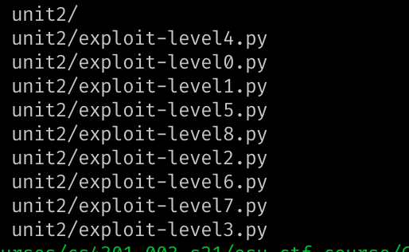
Unit 2
Due: Sep 25, midnight
Write-ups
Due: Sep 26, midnight
Assembly code (shellcode.S) for shellcode challenges
Python code (pwntools) to run the solution
Submission menu
zip or tar.gz
#!/usr/bin/env python
from pwn import *
p = process("./bof-level1")
print(p.recv())
p.sendline("A" * 32)
p.interactive()

Slide 4
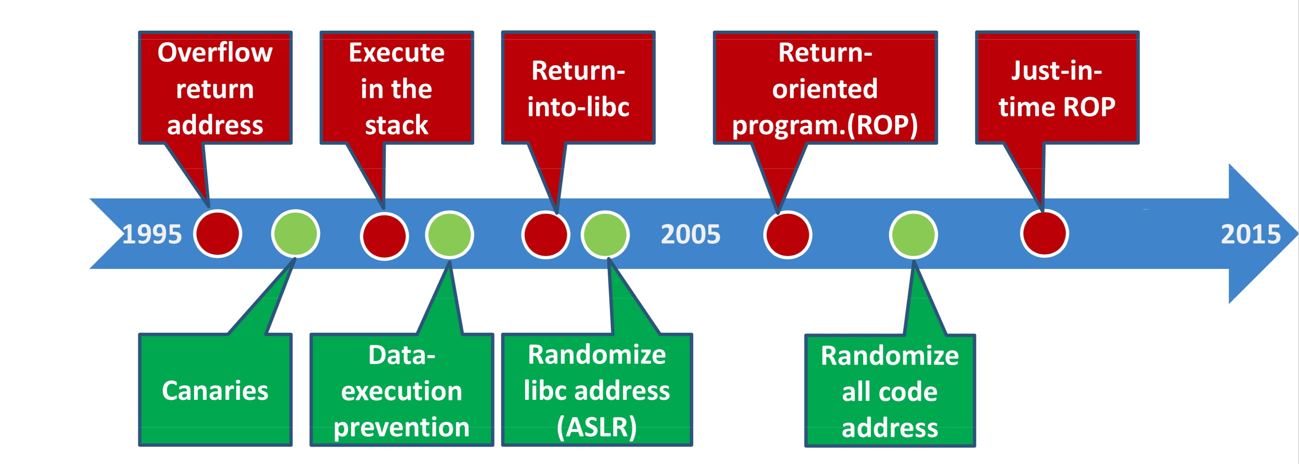
Binary Attack and Defenses
Control hijacking attacks
System security defense
Stack canaries
DEP / NX
ASLR
Advanced attacks
AR/AW with format string
ROP
Heap Overflow
Notes:
xxd, pwntools

Slide 5
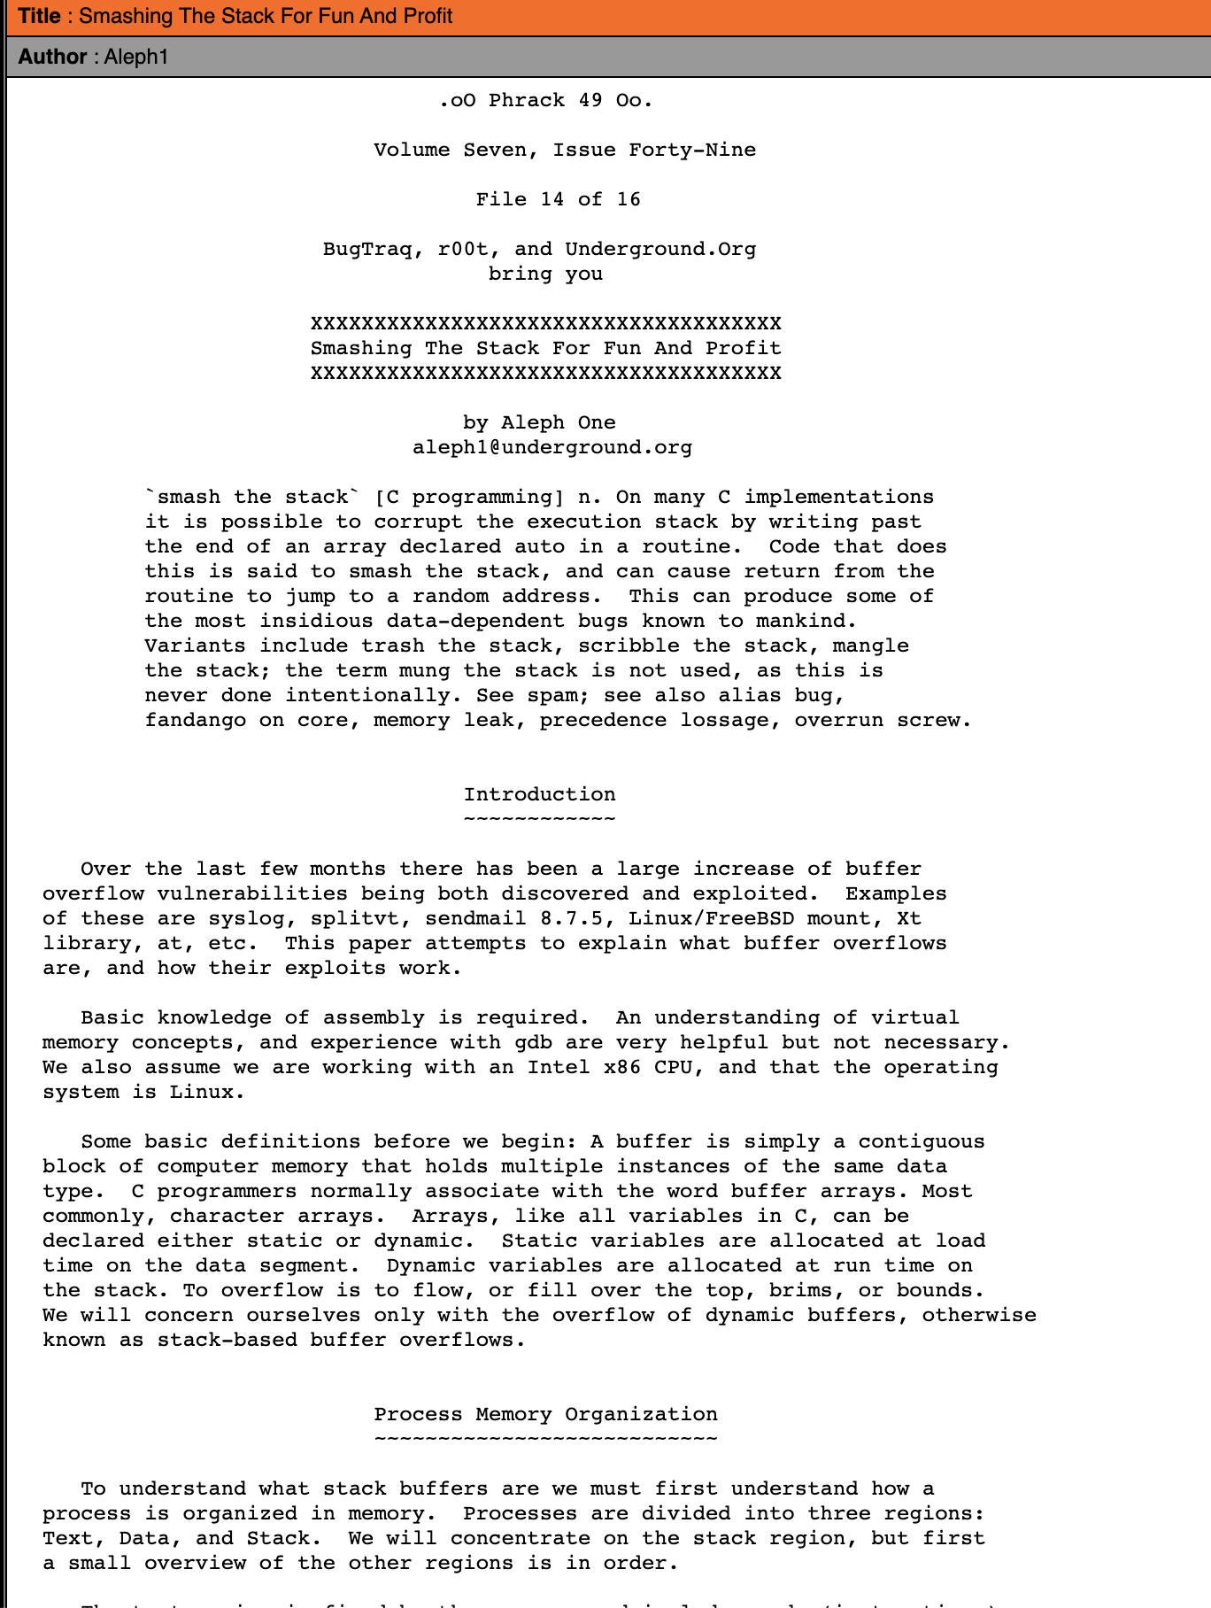

Buffer Overflows
Smashing the stack for fun and profit by Aleph One

Slide 6
Control Flow Hijack Principle: Always Computation + Control
payload (get_a_shell?) | padding | &buf
computation + control
BOF
Code injection
Return-to-libc
Heap metadata overwrite
return-oriented programming
...
Same principle! different mechanism

Slide 7
Channeling Vulnerabilities
... arise when control and data are mixed into one channel.
Situation | Data Channel | Control Channel | Security
Stack | Stack data | Return address | Control hijack
Format Strings | Output string | Format parameters | Disclose or write to memory
malloc buffers | malloc data | Heap metadata info | Control hijack/write to memory
Phreaking | Voice or data | Operator tones | Seize line control

Slide 8
Control Flow Hijack Defenses Canaries, DEP, and ASLR

Slide 9
Control Flow Hijack: Always control + computation
shellcode (aka payload) | padding | &buf
computation + control
code injection
return-to-libc
Format string
Heap metadata overwrite
return-oriented programming
...
Same principle, different mechanism

Slide 10
Control Flow Hijacks
… happen when an attacker gains control of
the instruction pointer.
Common hijack methods:
Buffer overflows (also leads to Ret2Libc, ROP, …)
Format string attacks (Arbitrary Read /Arbitrary Write)
Heap overflows

Slide 11
Control Flow Hijack Defenses
Bugs are the root cause of hijacks!
Find bugs with analysis tools
Prove program correctness
Mitigation Techniques:
Canaries
Data Execution Prevention/No eXecute
Address Space Layout Randomization

Slide 12
Proposed Defense Scorecard
Aspect | Defense
Performance | Smaller impact is better
Deployment | Can everyone easily use it?
Compatibility | Doesn’t break libraries
Safety Guarantee | Completely secure! or easy to bypass!
* http://blogs.technet.com/b/srd/archive/2009/03/16/gs-cookie-protection-effectiveness-and-limitations.aspx

Slide 13
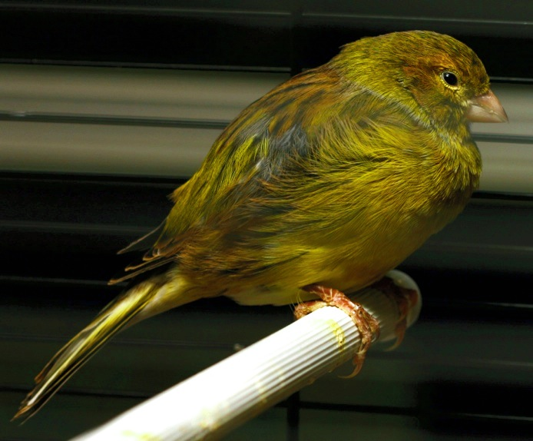
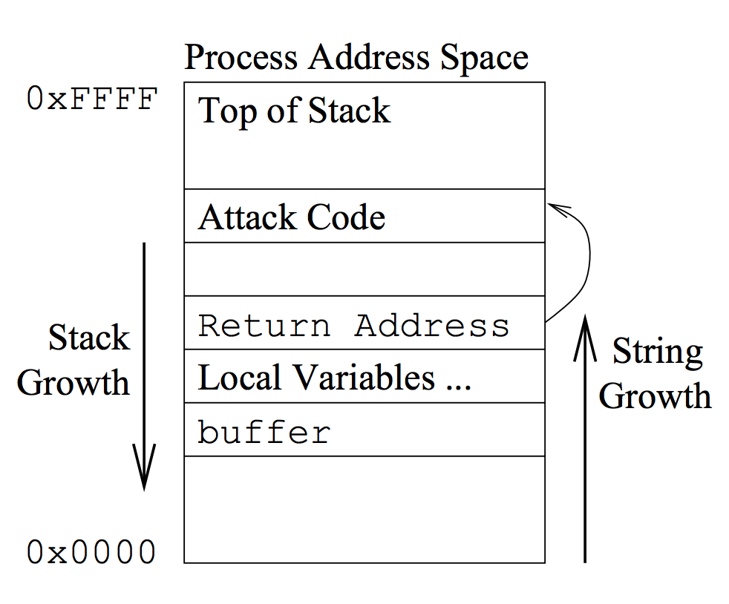
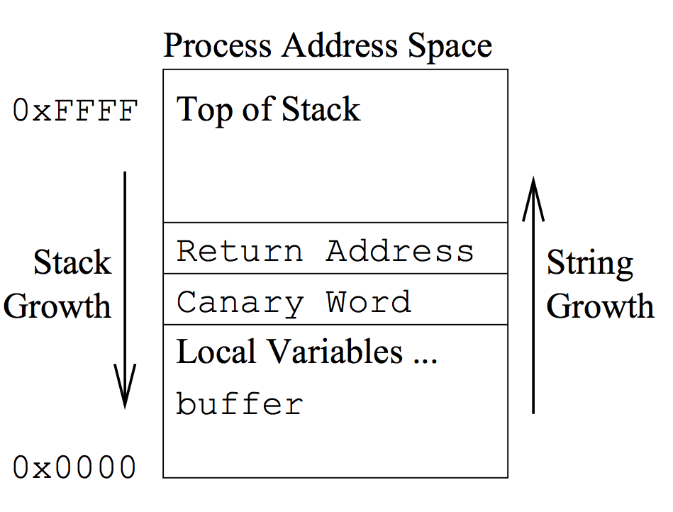
Canary / Stack Cookies

Slide 14
“A”x68 . “\xEF\xBE\xAD\xDE”
#include<string.h>
int main(int argc, char **argv) {
char buf[64];
strcpy(buf, argv[1]);
}
Dump of assembler code for function main:
0x080483e4 <+0>: push %ebp
0x080483e5 <+1>: mov %esp,%ebp
0x080483e7 <+3>: sub $72,%esp
0x080483ea <+6>: mov 12(%ebp),%eax
0x080483ed <+9>: mov 4(%eax),%eax
0x080483f0 <+12>: mov %eax,4(%esp)
0x080483f4 <+16>: lea -64(%ebp),%eax
0x080483f7 <+19>: mov %eax,(%esp)
0x080483fa <+22>: call 0x8048300 <strcpy@plt>
0x080483ff <+27>: leave
0x08048400 <+28>: ret
…
argv
argc
return addr
caller’s ebp
buf (64 bytes)
argv[1]
buf
%ebp
%esp

Slide 15
“A”x68 . “\xEF\xBE\xAD\xDE”
#include<string.h>
int main(int argc, char **argv) {
char buf[64];
strcpy(buf, argv[1]);
}
Dump of assembler code for function main:
0x080483e4 <+0>: push %ebp
0x080483e5 <+1>: mov %esp,%ebp
0x080483e7 <+3>: sub $72,%esp
0x080483ea <+6>: mov 12(%ebp),%eax
0x080483ed <+9>: mov 4(%eax),%eax
0x080483f0 <+12>: mov %eax,4(%esp)
0x080483f4 <+16>: lea -64(%ebp),%eax
0x080483f7 <+19>: mov %eax,(%esp)
0x080483fa <+22>: call 0x8048300 <strcpy@plt>
0x080483ff <+27>: leave
0x08048400 <+28>: ret
…
argv
argc
return addr
caller’s ebp
buf (64 bytes)
argv[1]
buf
0xDEADBEEF
AAAA
AAAA… (64 in total)
corrupted
overwritten
overwritten
%ebp
%esp
15

Slide 16
Stack Canary
Idea:
prologue introduces a canary word between return addr and locals
epilogue checks canary before function returns
Wrong Canary => Overflow
…
arg 2
arg 1
return addr
caller’s ebp
callee-save
CANARY
locals
%ebp
%esp

Slide 17
gcc Stack-Smashing Protector
Dump of assembler code for function main:
0x08048440 <+0>: push %ebp
0x08048441 <+1>: mov %esp,%ebp
0x08048443 <+3>: sub $76,%esp
0x08048446 <+6>: mov %gs:20,%eax
0x0804844c <+12>: mov %eax,-4(%ebp)
0x0804844f <+15>: xor %eax,%eax
0x08048451 <+17>: mov 12(%ebp),%eax
0x08048454 <+20>: mov 4(%eax),%eax
0x08048457 <+23>: mov %eax,4(%esp)
0x0804845b <+27>: lea -68(%ebp),%eax
0x0804845e <+30>: mov %eax,(%esp)
0x08048461 <+33>: call 0x8048350 <strcpy@plt>
0x08048466 <+38>: mov -4(%ebp),%edx
0x08048469 <+41>: xor %gs:20,%edx
0x08048470 <+48>: je 0x8048477 <main+55>
0x08048472 <+50>: call 0x8048340 <__stack_chk_fail@plt>
0x08048477 <+55>: leave
0x08048478 <+56>: ret
Compiled with: gcc -fstack-protector -O1 …
return addr
caller’s ebp
CANARY
buf (64 bytes)
17

Slide 18
Canary should be HARD to Forge
Terminator Canary
4 bytes: 0,CR,LF,-1 (low->high)
terminate strcpy(), gets(), …
Random Canary
4 random bytes chosen at load time
stored in a guarded page
need good randomness

Slide 19
Canary Scorecard
Aspect | Canary
Performance | several instructions per function time: a few percent on average size: can optimize away in safe functions
Deployment | recompile suffices; no code change
Compatibility | perfect—invisible to outside
Safety Guarantee | not really…
Notes:
https://github.com/trailofbits/cb-multios/blob/master/challenges/REMATCH_4--CGCRPC_Server--MS08-067/README.md

Slide 20
Bypass: Data Pointer Subterfuge
Overwrite a data pointer first…
int *ptr;
char buf[64];
memcpy(buf, user1);
*ptr = user2;
return addr
caller’s ebp
CANARY
ptr
buf (64 bytes)
Notes:
user1 overwrite ptr to point to return addr
user2 overwites return addr with user2

Slide 21

Canary Weakness
Check does not happen until epilogue…
Function pointer tricks
func ptr subterfuge
C++ vtable hijack
Long jumps
exception handler hijack
…

Slide 22
Data Execution Prevention (DEP) / No eXecute (NX)

Slide 23
How to defeat exploits?
shellcode | padding | &buf
computation + control
DEP
Canary

Slide 24
Data Execution Prevention
shellcode | padding | &buf
CRASH
(still a Denial-of-Service attack!)

Slide 25
W ^ X
shellcode | padding | &buf
CRASH
Each memory page is exclusively either writable or executable.
(still a Denial-of-Service attack!)

Slide 26
DEP Scorecard
Aspect | Data Execution Prevention
Performance | with hardware support: no impact otherwise: reported to be <1% in PaX
Deployment | kernel support (common on all platforms) modules opt-in (less frequent in Windows)
Compatibility | can break legitimate programs Just-In-Time compilers (self-modifying binaries) unpackers
Safety Guarantee | code injected to NX pages never execute but code injection may not be necessary…

Slide 27
Code Re-Use Attack: Return-to-libc

Slide 28
Return-to-libc Attack
Overwrite return address by address of a libc function
setup fake return address and argument(s)
ret will “call” libc function
No injected code!
“/bin/sh”
fake arg 1
fake ret addr
&system()
caller’s ebp
buf (64 bytes)

Slide 29
Non-executable Stack
Now most of programs built with non-executable stack
Then, how to run a shell?
call system(“/bin/sh”) likewise how we called execute_me()
What if the program does not have system() in the code?
Library!
Return-to-Libc
Code-reuse attack

Slide 30
Dynamically Linked Library
When you build a program, you use functions from library
printf(), scanf(), read(), write(), system(), etc.
Where does that function reside?
1) In the program
2) In #include <stdio.h>, the header file
3) Somewhere in the process’s memory

Slide 31
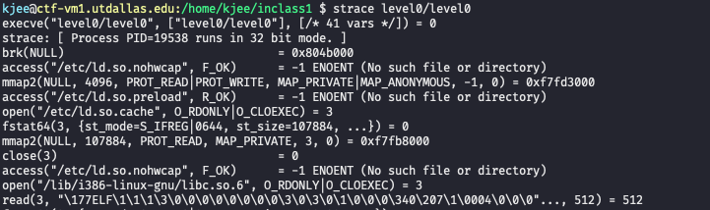

How a Program is Loaded…
execve(target, …, …)
Load the target ELF file first
Load required libraries for the target ELF (header contains the list)
Build stack, heap and other memory
Run!

Slide 32
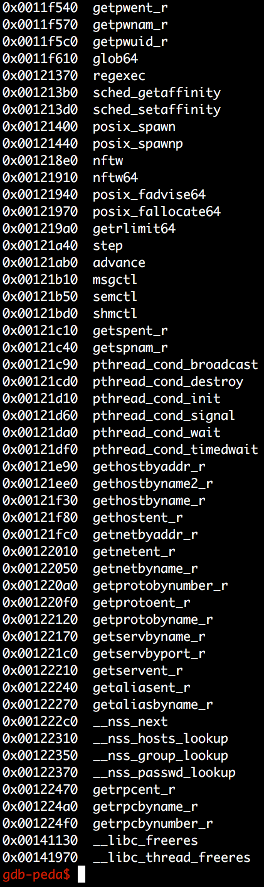
Dynamically Linked Library: libc
The most of programs written in C will be linked with libc
Contains essential functionalities!
execve(), system(), open(), read(), write(), etc.
But where our system() is?
Let’s check with gdb!
Notes:
KJEE-TODO: The most of programs written in C → ??? What are the programs that doesn’t link itself to libc?

Slide 33
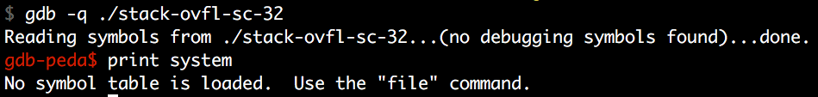
Finding libc Functions
GDB
Why?
You should run the program to see linked libraries

Slide 34

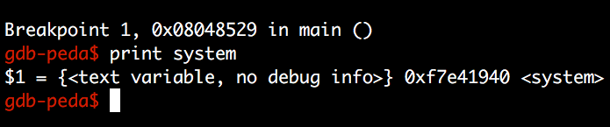
Finding libc Functions
GDB

Slide 35
Stack Overflow Again
Now you know where system() is!
“A” * 0x80 + “BBBB” + “\x40\x19\xe4\xf7”
This will run system()
But how to run system(“/bin/sh”) or system(“a”)?

Slide 36
Function Call and Stack
input_func()
ARG 3
ARG 2
Arguments
0x8(%ebp) is the 1st argument
0xc(%ebp) is the 2nd argument
…
What if we call system() by changing RET?
ARG 1
RETURN ADDR
RET
SAVED %ebp
%ebp
0x83ec5589
Local 1
Local 2
Local 3
Local 4
%esp

Slide 37
Function Call and Stack
%ebp = 0x41414141
input_func()
ARG 3
ARG 2
Overflow
Leave
mov %ebp, %esp
pop %ebp
Return
pop %eip
ARG1
%esp
system()
RETURN ADDR
RET
%esp
AAAA
SAVED %ebp
%ebp
0x83ec5589
Local 1
AAAA
AAAA
Local 2
AAAA
Local 3
Local 4
AAAA
%esp
Notes:
KJEE-TODO: pip %eip is illegal

Slide 38
Function Call and Stack
%ebp = 0x41414141
system()
input_func()
0xc(%ebp)
ARG 2
ARG 3
….
0x8(%ebp)
ARG 1
ARG 2
0xc(%ebp’)
Executing system()
push %ebp
mov %ebp, %esp
sub $0x10c, %esp
Argument access
What is 0x8(%ebp)?
ARG2 of the input_func() will be ARG1 of system()
Ret addr + 8 ! (skip over one frame)
0x4(%ebp)
RETURN ADDR
ARG1
0x8(%ebp’)
%esp
SAVED %ebp
system()
RETURN ADDR
AAAA
%ebp
%esp
AAAA
SAVED %ebp
%ebp’
0x83ec5589
Local 1
AAAA
AAAA
Local 2
AAAA
Local 3
Local 4
AAAA
%esp

Slide 39
Calling system(“/bin/sh”)
ARG 5
ARG 4
ARG 3
ARG 2
Addr of “/bin/sh”
Let’s overwrite
RET ADDR = addr of system()
ARG2 = “/bin/sh”
ARG 1
BBBB
RETURN ADDR
System()
RET
SAVED %ebp
AAAA
%ebp
AAAA
0x83ec5589
Local 1
AAAA
Local 2
Local 3
AAAA
Local 4
AAAA
%esp

Slide 40
Calling system(“/bin/sh”)
ARG 5
ARG 4
ARG 3
ARG 2
Addr of “/bin/sh”
0x8(%ebp)
Let’s overwrite
RET ADDR = addr of system()
ARG2 = “/bin/sh”
When running system…
ARG 1
BBBB
RETURN ADDR
AAAA
RET
%ebp
SAVED %ebp
AAAA
AAAA
0x83ec5589
Local 1
AAAA
Local 2
Local 3
AAAA
Local 4
AAAA
%esp

Slide 41
Backup

Slide 42
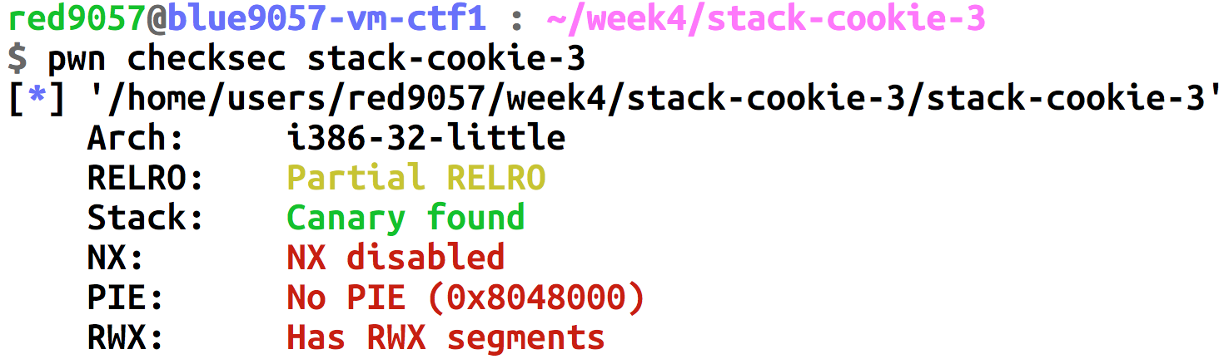
20-Stack-Cookie
Constraints
Break stack canary one-by-one (try 0~255 for 4 times)

Slide 43
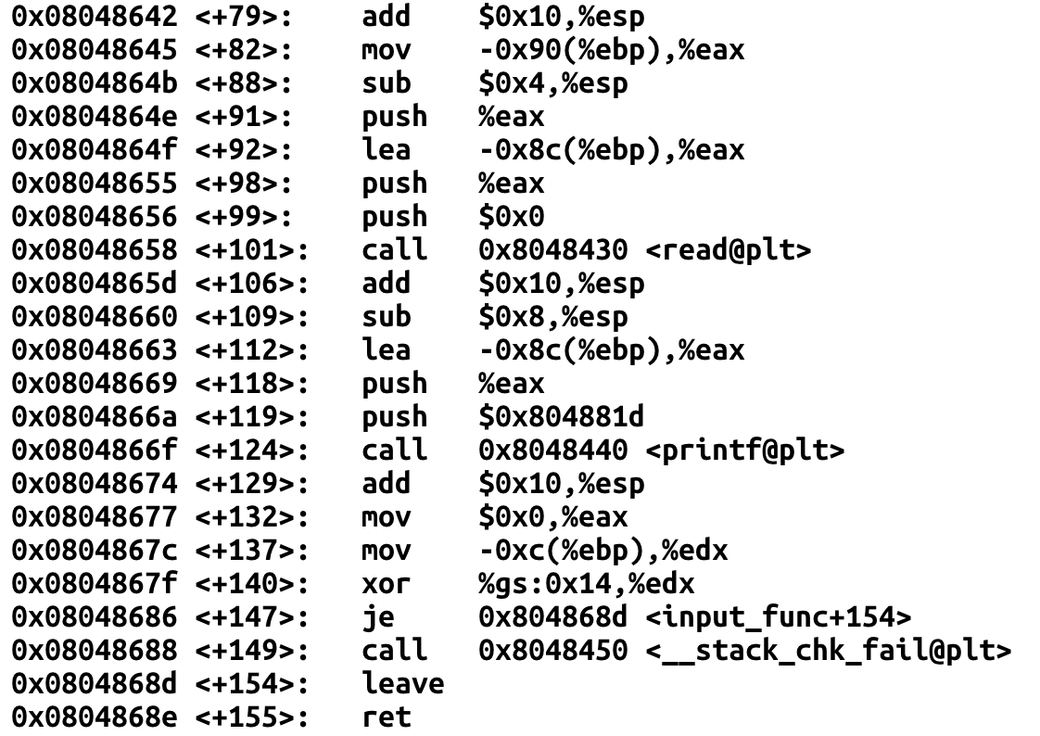
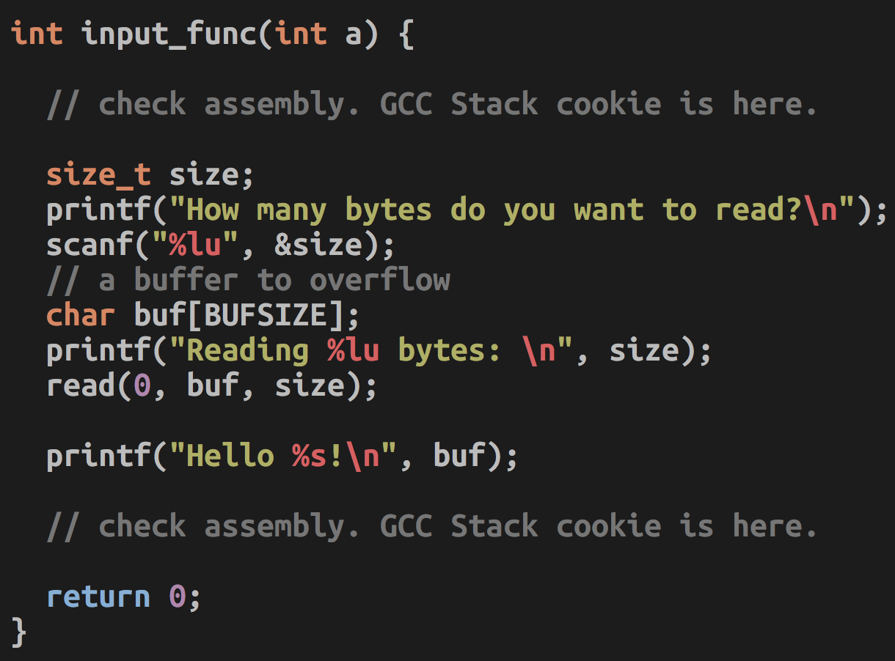
20-Stack-Cookie
Buffer is at -0x8c(%ebp)
Cookie is at –0xc(%ebp)

Slide 44
20-Stack-Cookie: High-level Idea
Return address
Saved %ebp
Not used
Not used
f5
76
38
00
Buffer (0x80)
Not Executable
Overwrite!

Slide 45
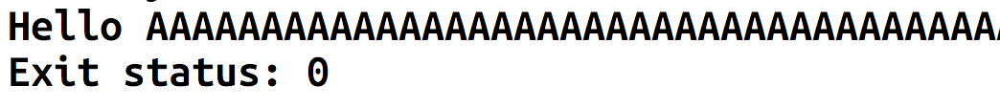
20-Stack-Cookie: High-level Idea
Return address
Guessing…
Saved %ebp
Not used
Not used
OK, no crash, no error
f5
76
38
00
00
Buffer (0x80)
Not Executable
Shellcode + fill
(0x80)
Overwrite!

Slide 46
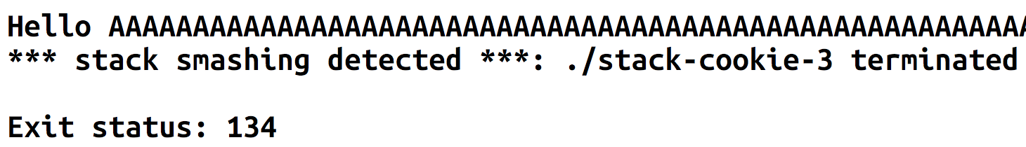
20-Stack-Cookie: High-level Idea
Return address
Guessing…
Saved %ebp
Not used
Not used
NO, no crash, but error
f5
76
38
00
01
Buffer (0x80)
Not Executable
Shellcode + fill
(0x80)
Overwrite!

Slide 47
20-Stack-Cookie: High-level Idea
Return address
Guessing…
Saved %ebp
Not used
Not used
OK, no crash, no error
f5
76
38
00
00
Buffer (0x80)
Not Executable
Shellcode + fill
(0x80)
Overwrite!

Slide 48
20-Stack-Cookie: High-level Idea
Return address
Guessing…
Saved %ebp
Not used
Not used
NO, no crash, but error
f5
76
38
00
00
00
Buffer (0x80)
Not Executable
Shellcode + fill
(0x80)
Overwrite!

Slide 49
20-Stack-Cookie: High-level Idea
Return address
Guessing…
Saved %ebp
Not used
Not used
NO, no crash, but error
f5
76
38
00
01
00
Buffer (0x80)
Not Executable
Shellcode + fill
(0x80)
Overwrite!

Slide 50
20-Stack-Cookie: High-level Idea
Return address
Guessing…
Saved %ebp
Not used
Not used
NO, no crash, but error
f5
76
38
00
02
00
Buffer (0x80)
Not Executable
Shellcode + fill
(0x80)
Overwrite!

Slide 51
20-Stack-Cookie: High-level Idea
Return address
Guessing…
Saved %ebp
Not used
Not used
OK, no crash, no error
f5
76
38
00
38
00
Buffer (0x80)
Not Executable
Shellcode + fill
(0x80)
Overwrite!

Slide 52
20-Stack-Cookie: High-level Idea
Return address
Guessing…
Saved %ebp
Not used
Not used
NO, no crash, but error
f5
76
38
00
00
38
00
Buffer (0x80)
Not Executable
Shellcode + fill
(0x80)
Overwrite!

Slide 53
20-Stack-Cookie: High-level Idea
Return address
Guessing…
Saved %ebp
Not used
Not used
NO, no crash, but error
f5
76
38
00
01
38
00
Buffer (0x80)
Not Executable
Shellcode + fill
(0x80)
Overwrite!

Slide 54
20-Stack-Cookie: High-level Idea
Return address
Guessing…
Saved %ebp
Not used
Not used
NO, no crash, but error
f5
76
38
00
02
38
00
Buffer (0x80)
Not Executable
Shellcode + fill
(0x80)
Overwrite!

Slide 55
20-Stack-Cookie: High-level Idea
Return address
Guessing…
Saved %ebp
Not used
Not used
OK, no crash, no error
f5
76
38
00
76
38
00
Buffer (0x80)
Not Executable
Shellcode + fill
(0x80)
Overwrite!

Slide 56
20-Stack-Cookie: High-level Idea
Return address
Guessing…
Saved %ebp
Not used
Not used
NO, no crash, but error
f5
76
38
00
00
76
38
00
Buffer (0x80)
Not Executable
Shellcode + fill
(0x80)
Overwrite!

Slide 57
20-Stack-Cookie: High-level Idea
Return address
Guessing…
Saved %ebp
Not used
Not used
NO, no crash, but error
f5
76
38
00
01
76
38
00
Buffer (0x80)
Not Executable
Shellcode + fill
(0x80)
Overwrite!

Slide 58
20-Stack-Cookie: High-level Idea
Return address
Guessing…
Saved %ebp
Not used
Not used
NO, no crash, but error
f5
76
38
00
02
76
38
00
Buffer (0x80)
Not Executable
Shellcode + fill
(0x80)
Overwrite!

Slide 59
20-Stack-Cookie: High-level Idea
Return address
Guessing…
Saved %ebp
Not used
Not used
OK, no crash, no error
f5
76
38
00
f5
76
38
00
Buffer (0x80)
Not Executable
Shellcode + fill
(0x80)
Overwrite!

Slide 60
20-Stack-Cookie: High-level Idea
Return address
Now you know the cookie
DDDD
Saved %ebp
CCCC
This will generate a ‘core’!
Get the address of shellcode from core
Not used
BBBB
Not used
AAAA
f5
76
38
00
f5
76
38
00
Buffer (0x80)
Not Executable
Shellcode + fill
(0x80)
Overwrite!

Slide 61
20-Stack-Cookie: High-level Idea
Return address
Now you know the cookie
Address of
SHELLCODE
Saved %ebp
CCCC
Not used
BBBB
Not used
AAAA
f5
76
38
00
f5
76
38
00
Buffer (0x80)
Not Executable
Shellcode + fill
(0x80)
Overwrite!

Slide 62
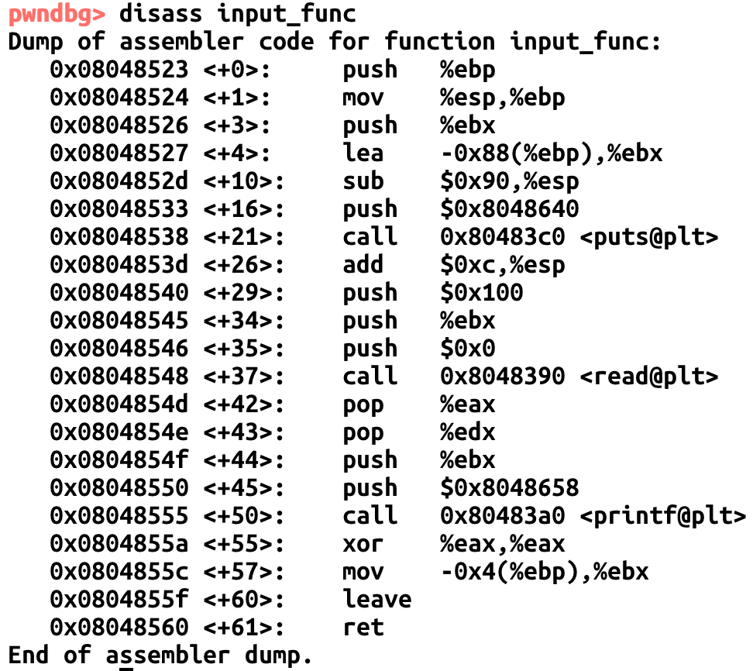
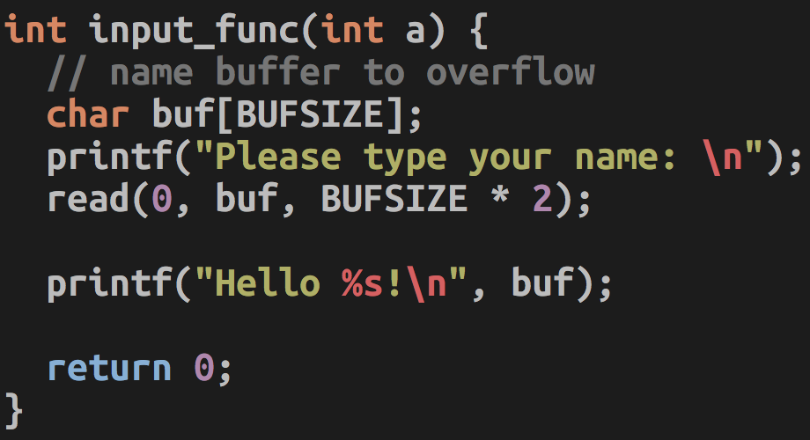
21-DEP-0
Buffer is at -0x88(%ebp)

Slide 63
21-DEP-0
Constraints
Stack is not executable: you cannot use shellcode
Address is fixed: you can call library functions
Program runs setregid(getegid(), getegid()) for you: run system()!
Objective
Execute system(“/bin/sh”) by returning into the system() library function

Slide 64
21-DEP-0: High-level Idea
ARG1
“/bin/sh”
Not used
system(“/bin/sh”)
Return address
system()
LIBC code is executable!
Saved %ebp
Buffer (0x88)
Not Executable
Overwrite!

Slide 65
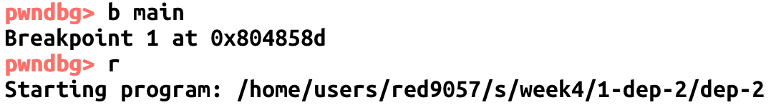
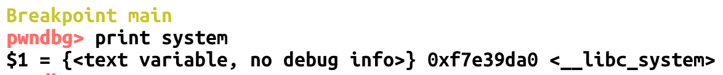
21-DEP-0: Gathering Address
Locating system()
Run….

Slide 66
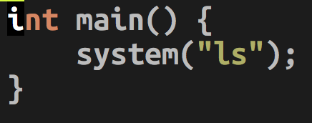
21-DEP-0: Gathering Address
Locating “/bin/sh”
system(“asdf”) -> execve(“/bin/sh”, [“sh”, “asdf”], …)
Write a small program that runs system()…
Build it
gcc -o system system.c -m32

Slide 67
21-DEP-0: Gathering Address
1. Open the program with gdb, set a breakpoint at main()
2. After running of the program, search /bin/sh

Slide 68
21-DEP-0: Exploit
ARG1
0xf7f5da0b
“/bin/sh”
Not used
Return address
0xf7e3cda0
System()
Saved %ebp
b“A” * 0x88 + b“SEBP” + p32(0xf7e39ad0) + b“GGGG” + p32(0xf7f5aa0b)
Buffer (0x88)
Not Executable

Slide 69
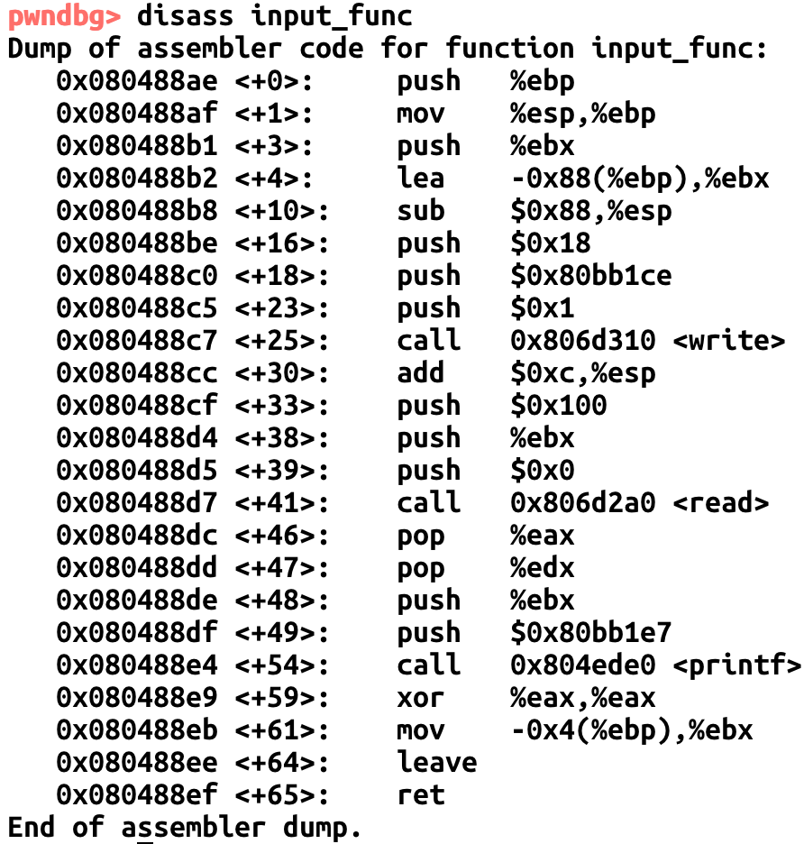
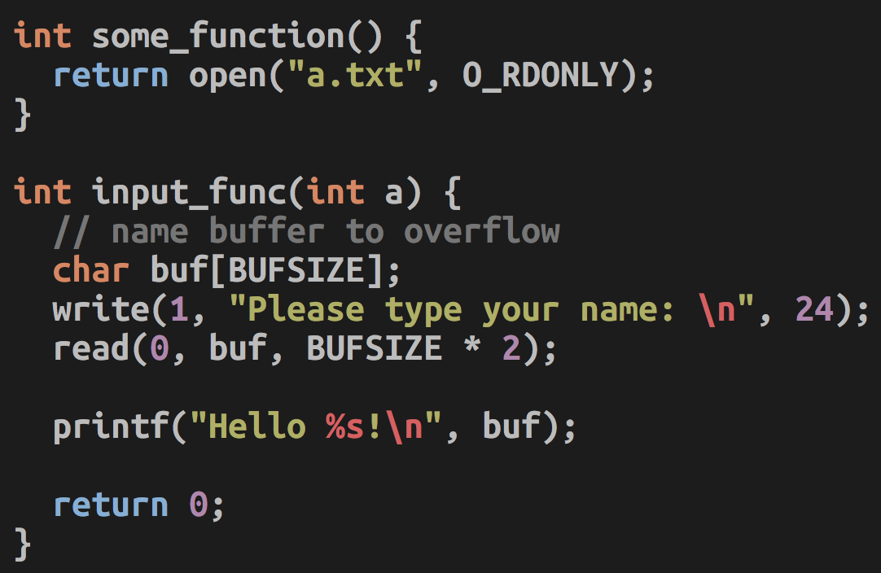
22-DEP-1
Buffer is at -0x88(%ebp)

Slide 70
22-DEP-1
Constraints
Stack is not executable: you cannot use shellcode
Address is fixed: you can call library functions
Program does not run setregid(getegid(), getegid()) for you
Objective
Open “flag” file (fd 3)
Read data from “flag” file (fd 3, stack)
Write the data read to the stdout (fd 1)

Slide 71
22-DEP-1
Tasks
some_function();
This will open ‘a.txt’ as fd 3
Create a symlink
ln -s flag a.txt
read(3, stack_buffer, 100);
Read flag to stack_buffer area
printf(stack_buffer);
Print the flag

Slide 72
22-DEP-1:High-level Idea
Read_ARG3
size = 100
Not used
Read_ARG2
Addr of buffer
Not used
Read_ARG1
fd = 3
Not used
printf(stack)
Print data in stack…
Not used
read()
read(3, stack, 100)
Return address
some_function()
Open a.txt
Saved %ebp
Buffer (0x88)
Not Executable
Overwrite!

Slide 73
22-DEP-1: Chaining Calls
Read_ARG3
size = 100
Read_ARG2
Addr of buffer
Read_ARG1
fd = 3
ret
pop %eip
printf(stack)
Print data in stack…
read()
read(3, stack, 100)
some_function()
Open a.txt
%esp

Slide 74
22-DEP-1: Chaining Calls
Read_ARG3
size = 100
Read_ARG2
Addr of buffer
Read_ARG1
fd = 3
ret
pop %eip
printf(stack)
Print data in stack…
read()
read(3, stack, 100)
%esp
some_function()
Open a.txt

Slide 75
22-DEP-1: Chaining Calls
Read_ARG3
size = 100
Read_ARG2
Addr of buffer
Read_ARG1
fd = 3
ret
pop %eip
printf(stack)
Print data in stack…
%esp
read()
read(3, stack, 100)
some_function()
Open a.txt

Slide 76
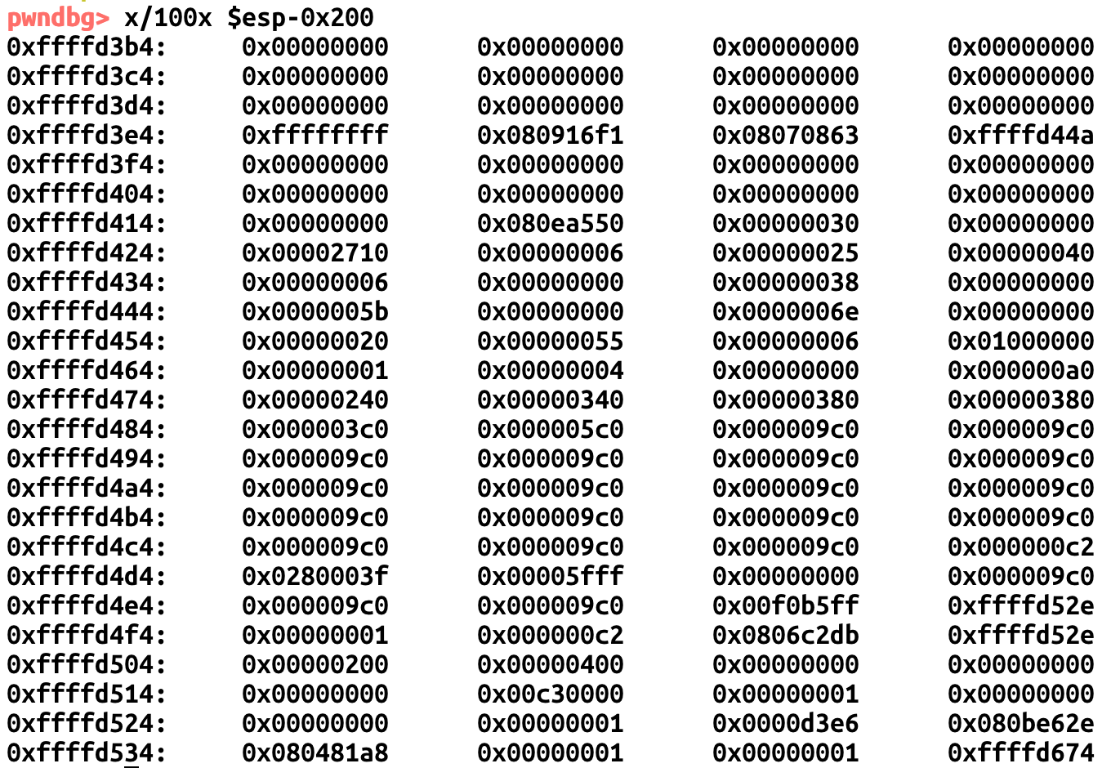
22-DEP-1: Exploit Sketch
Create symlink to ‘flag’ as ‘a.txt’
ln -s flag a.txt
Chain your function calls
some_function()
read(3, 0xffffd3b4, 100)
printf(0xffffd3b4)
Why 0xffffd3b4?
You can use any valid address

