Slide 1
CS 6332.001: How Process Starts?
- How a Process Communicate to Outside?
Kangkook Jee
Sep 23, 2025

Slide 2
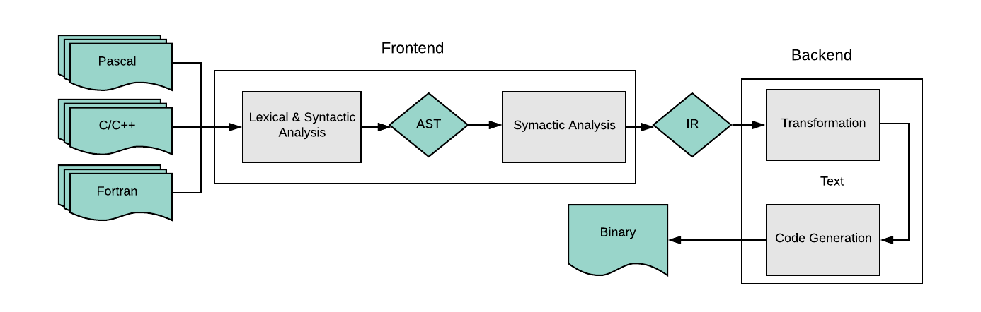
Compilation Process: Source to Code Object
Object file (.o)
Source to Object file
  Before linking
The most of code optimizations and analyses
  Except Link-Time-Optimization (LTO)
Notes:
When to do AST instrumentation, IR instrumentation, and Binary instrumentation

Slide 3
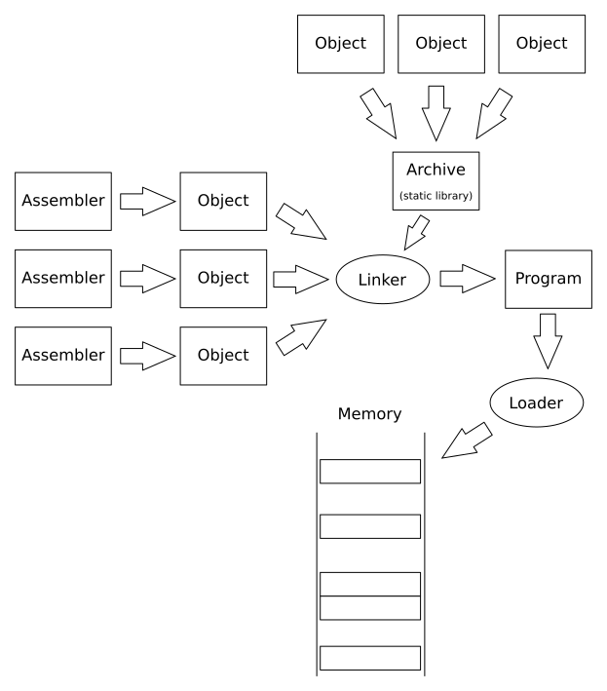
Linking + Loading
Linker for linking object files
  Part of the compilation process
  Q: How functions from different objects can interact?
Loader for
  Loading executable
  Binding shared libraries
    Load-time binding/relocation
    Lazy binding
    Dynamic Loading
Fortran
C/C++
Shared Library
Shared Library
Shared Library
Notes:
[TODO] improve figure to have dynamic loading.

Slide 4
ELF Object File Format: Code + Data
How code (and data) stored as a file?
  ELF (Executable and Linkable Format) for Linux
    Use ‘readelf’ command!
Segments and sections
  Kernel sees segments, maps them into virtual address space using mmap
  Linker sees section, combines them into a executable or shared library
One unified format for
  Executables (ET_EXEC)
    Contains code and data in a form that can be copied directly into memory and then executed
    Must have segments
  Relocatable object file (ET_REL, *.o)
    Contains code and data in a form that can be combined with other relocatable object files to form executable object file
    Must have sections
  Shared dynamic libraries (ET_DYN, *.so)
    Special type of relocatable object file that can be loaded into memory and linked dynamically, at either load-time or run-time
    Both section and segments
  Coredump file
Notes:
Maybe want to work through as
https://blog.k3170makan.com/2018/09/introduction-to-elf-format-elf-header.html

Slide 5
ELF Object File Format (cont.)
Elf header
  Word size, byte ordering, file type (.o, exec, .so), machine type, etc.
Segment header table
  Page size, virtual addresses memory segments (sections), segment sizes.
.text section
  Code
.rodata section
  Read only data: jump tables, string constants, ...
.data section
  Initialized global variables
.bss section
  Uninitialized global variables
  “Block Started by Symbol”
  “Better Save Space”
  Has section header but occupies no space
0
ELF header
Segment header table
(required for executables)
.text section
.rodata section
.data section
.bss section

Slide 6
ELF Object File Format (cont.)
.symtab section
  Symbol table
  Procedure (function) and static variable names
  Section names and locations
.rel.text section
  Relocation info for .text section
  Addresses of instructions that will need to be modified in the executable
  Instructions for modifying.
.rel.data section
  Relocation info for .data section
  Addresses of pointer data that will need to be modified in the merged executable
.debug section
  Info for symbolic debugging (gcc -g)
Section header table
  Offsets and sizes of each section
0
ELF header
Segment header table
(required for executables)
.text section
.rodata section
.data section
.bss section
.symtab section
.rel.txt section
.rel.data section
.debug section
Section header table

Slide 7
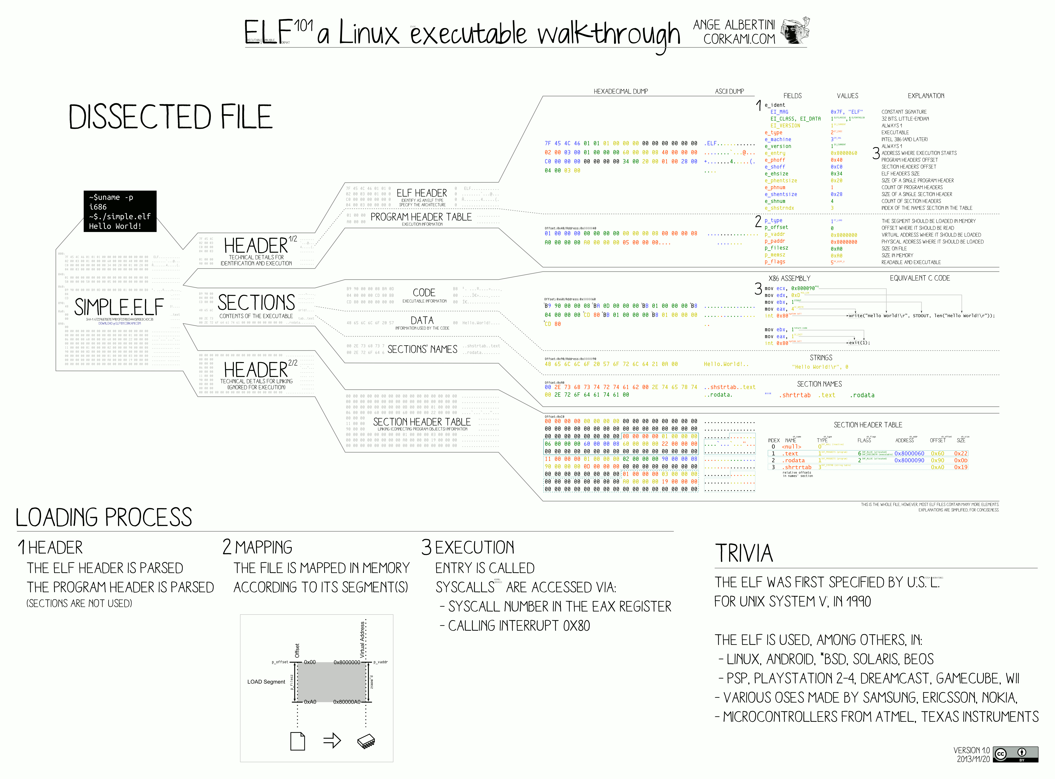
# File header
readelf -Wh ld-2.31.so
# program/segment header
readelf -Wl libc.so
# Section header
readelf -WS ld-2.31.so

Slide 8
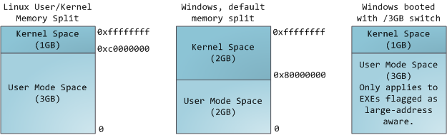
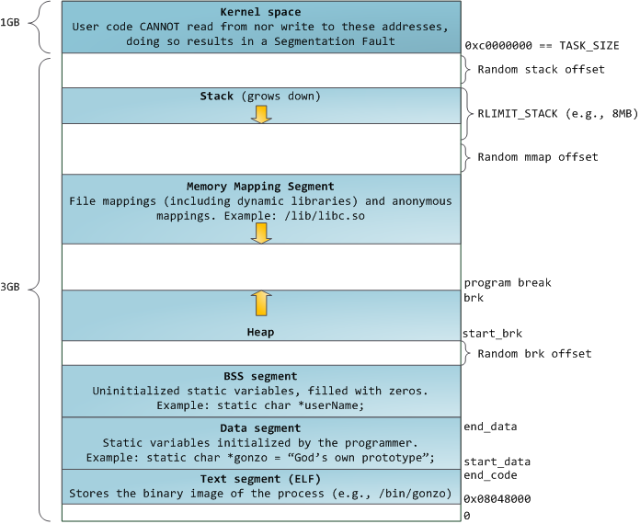
Program Loaded into Memory (32-bit)

Slide 9
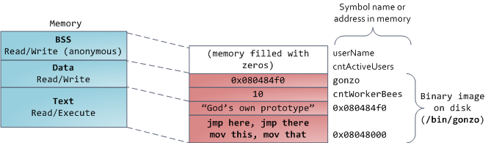
Program Loaded into Memory (32-bit)

Slide 10
Loading Executable Object Files
Executable Object File
Kernel virtual memory
Memory
invisible to user code
0
ELF header
User stack
(created at runtime)
Program header table
(required for executables)
%esp
(stack
pointer)
.init section
.text section
Memory-mapped region for
shared libraries
.rodata section
.data section
.bss section
brk
.symtab
Run-time heap
(created by malloc)
.debug
Read/write data segment
(.data, .bss)
Loaded
from
the
executable
file
.line
.strtab
Read-only code segment
(.init, .text, .rodata)
Section header table
(required for relocatables)
0x400000
Unused
0
Notes:
…
Large heap in the high addresses (mmap)

Slide 11
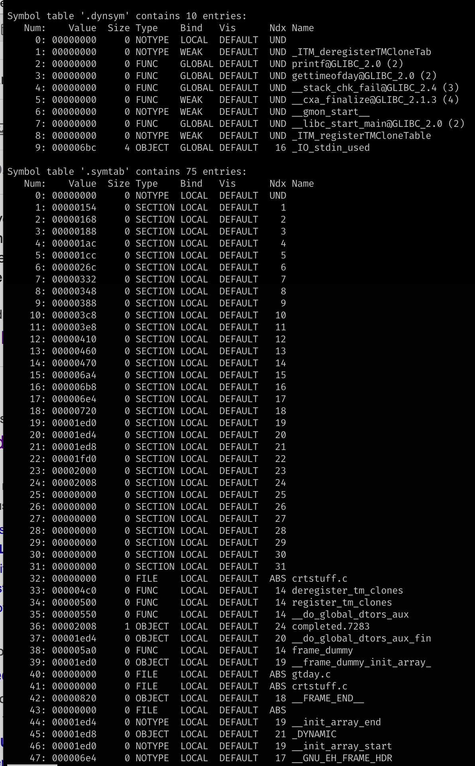
Symbol in Binary
Debug (non-stripped) build vs.
Release (stripped) build
  What does it have?
  Allocable vs. Non-allocable sections
Why do we have Symbol Table ever?
  Exports
  Imports
“A Debugging Symbol Table maps instructions in the compiled binary program to their corresponding variable, function, or line in the source code.” -- GDB manual
Notes:
https://www.tutorialspoint.com/gnu_debugger/gdb_debugging_symbols.htm
https://gcc.gnu.org/onlinedocs/gcc/Debugging-Options.html
https://www.rapidtables.com/code/linux/gcc/gcc-g.html
https://blogs.oracle.com/solaris/inside-elf-symbol-tables-v2
readelf –S

Slide 12
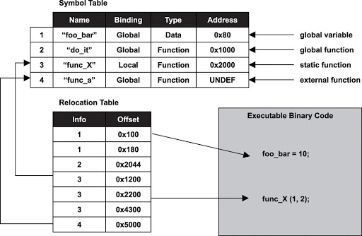
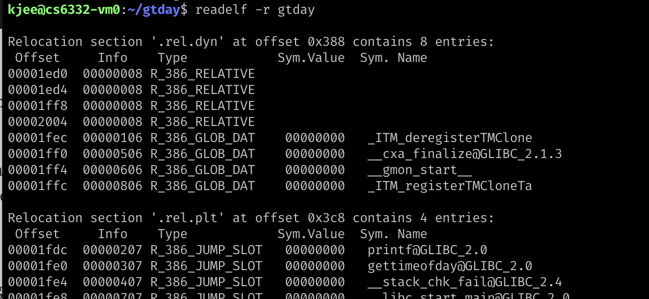
Symbol Table: A Sneak Peek with readelf
Elf header (readelf -h)
Program header (readelf -l)
Section header (readelf -S)
Symbol table (readelf -s)
.symtab: the full symbol table, but somre not needed at runtime (e.g., debugging symbols)
.dynsym : a subset symtab that only contains global symbols (subset)
Notes:
https://blogs.oracle.com/solaris/inside-elf-symbol-tables-v2
https://greek0.net/elf.html
https://codimd.syssec.org/N_9zSHtXQsSCoQIIfMrwwA#
http://www.embeddedlinux.org.cn/rtconforembsys/5107final/LiB0011.html

Slide 13
How Linux Runs a Program?
-- Kernel land

Slide 14
How Linux Runs a Program?: Kernel-land
Reading ELF from kernel
  fs/binfmt_elf.c
Allocate resources and pass control to userland
  load_elf_binary()
Notes:
The ELF format
The ELF (Executable and Linkable Format) format is the main binary format in use on modern Linux systems, and support for it is implemented in the file fs/binfmt_elf.c. It's also a slightly complicated format for the kernel to handle; the main load_elf_binary() function spans over 400 lines, and the ELF support code is more than four times as big as the code that supports the old a.out format.
An ELF file for an executable program (rather than a shared library or an object file) must always contain a program header table near the start of the file, after the ELF header; each entry in this table provides information that is needed to run the program.
The kernel only really cares about three types of program header entries. The first type is the PT_LOAD segment, which describes areas of the new program's running memory. This includes code and data sections that come from the executable file, together with the size of a BSS section. The BSS will be filled with zeroes (thus only its length needs to be stored in the executable file). The second entry of interest is a PT_INTERP entry, which identifies the run-time linker needed to assemble the complete program; for the time being, we'll assume a statically linked ELF binary and return to dynamic linking later. Finally, the kernel also gets a single bit of information from a PT_GNU_STACK entry, if present, which indicates whether the program's stack should be made executable or not.
(This article only focuses on what's needed to load an ELF program, rather than exploring all of the details of the format. The interested reader can find much more information via the references linked from Wikipedia's ELF article or by exploring real binaries with the objdump tool.)

Slide 15
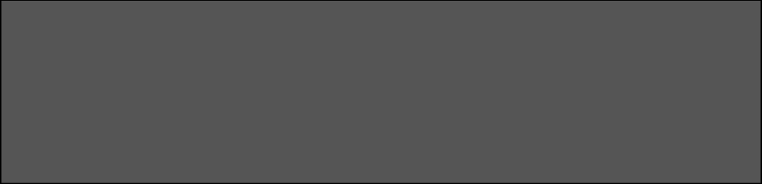
How Linux Runs a Program?: Kernel-land
  Reading:
    How programs get run: ELF binaries
    https://lwn.net/Articles/631631/
    ELF (Executable and Linkable Format)
  Basics:
    execve(char *name, char** argv, char **envp)
    execve(“program path”, argument_vectors, environment_pointers)
    execve(“/bin/sh”, {“sh”, NULL}, {”SHELL=sh”, “TERM=xterm”, …, NULL});

Slide 16
    execve(char *name, char** argv, char **envp)
1. Program path: program to execute; could be an ELF file
  /bin/sh , /bin/ls, /usr/bin/python
2. Argument vectors: list of arguments, each as string (char **argv)
  When running “python a.py 1 2 3”,
  argv[0] = “python”
  argv[1] = “a.py”
  argv[2] = “1”
  argv[3] = ”2”
  argv[4] = “3”
3. Environment Variables: list of environments variables, each as string (char **envp)
  “TERM=xterm”
  “SHELL=sh”
  “EDITOR=/usr/bin/vim”

Slide 17
Kernel Loading Executable Object Files
Kernel virtual memory
execv() system subsequently call
  load_elf_binary() @ binfmt_elf.c
Prepare virtual address space
  Kernel / User-space separation
  mmap segments to address space
Prepare user-level stack before calling main()
Pass control to loader with entry point for the text segment (AT_ENTRY from auxv)
User stack
(created at runtime)
%esp
(stack
pointer)
Memory-mapped region for
shared libraries
brk
Run-time heap
(created by malloc)
Read/write data segment
(.data, .bss)
Loaded
from
the
executable
file
Read-only code segment
(.init, .text, .rodata)
0x400000
Unused
0

Slide 18
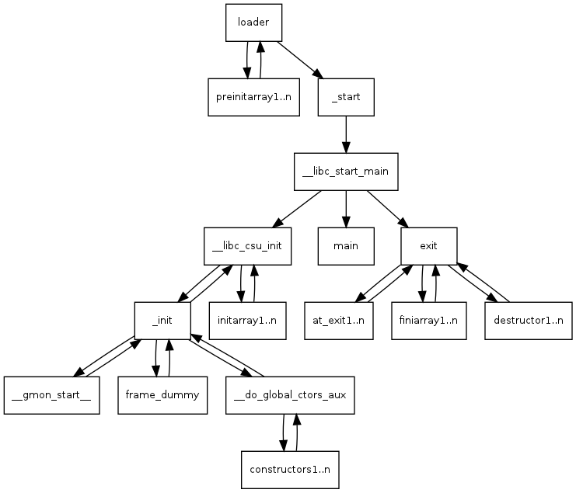
How Linux Runs a Program?
-- Userland

Slide 19
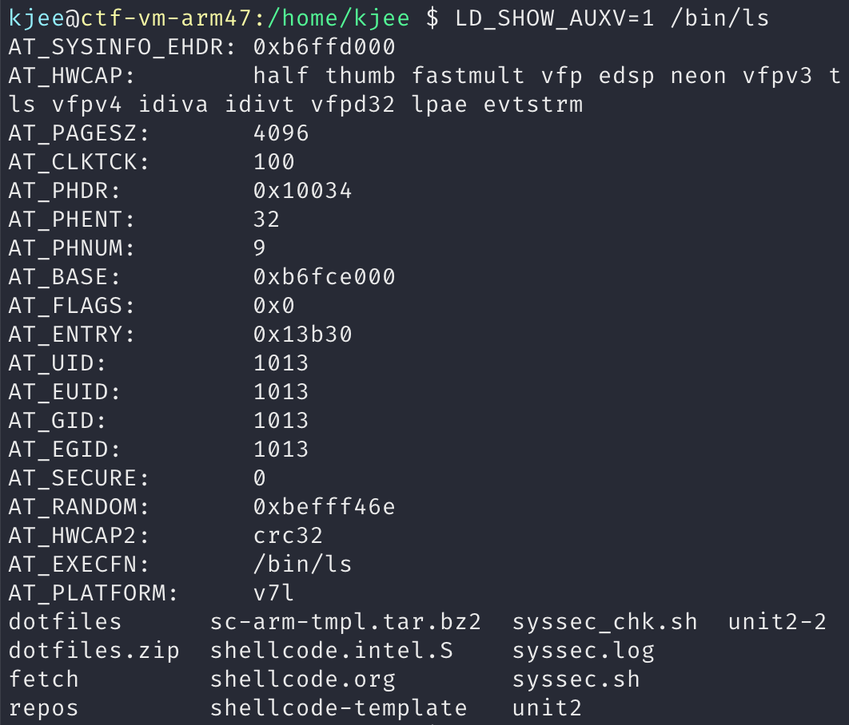
Loading from User Space
E.g., /lib64/ld-linux-x86-64.so.2
Loader took over the control to handle number of choirs
  AT_Entry points to _start symbol
  .interp section contains loader path as an interpreter (e.g., /lib/x86_64-linux-gnu/ld-linux-x86-64.so.2)

Slide 20

How DO We Get to “main()”?
Kernel - load_elf_binary()
Sets-up stack for you: argc, argv, envp, auxv
  File descriptors: 0, 1, 2 (stdin, stdout, stderr)
  pass control to ‘loader’
‘loader’
  Relocates shared libraries
  Calls ‘pre-initializer(s)’
  Then, calls ‘_start()’
→ _start();
→ __libc_start_main();
→ main();
Notes:
https://lwn.net/Articles/631631/

Slide 21
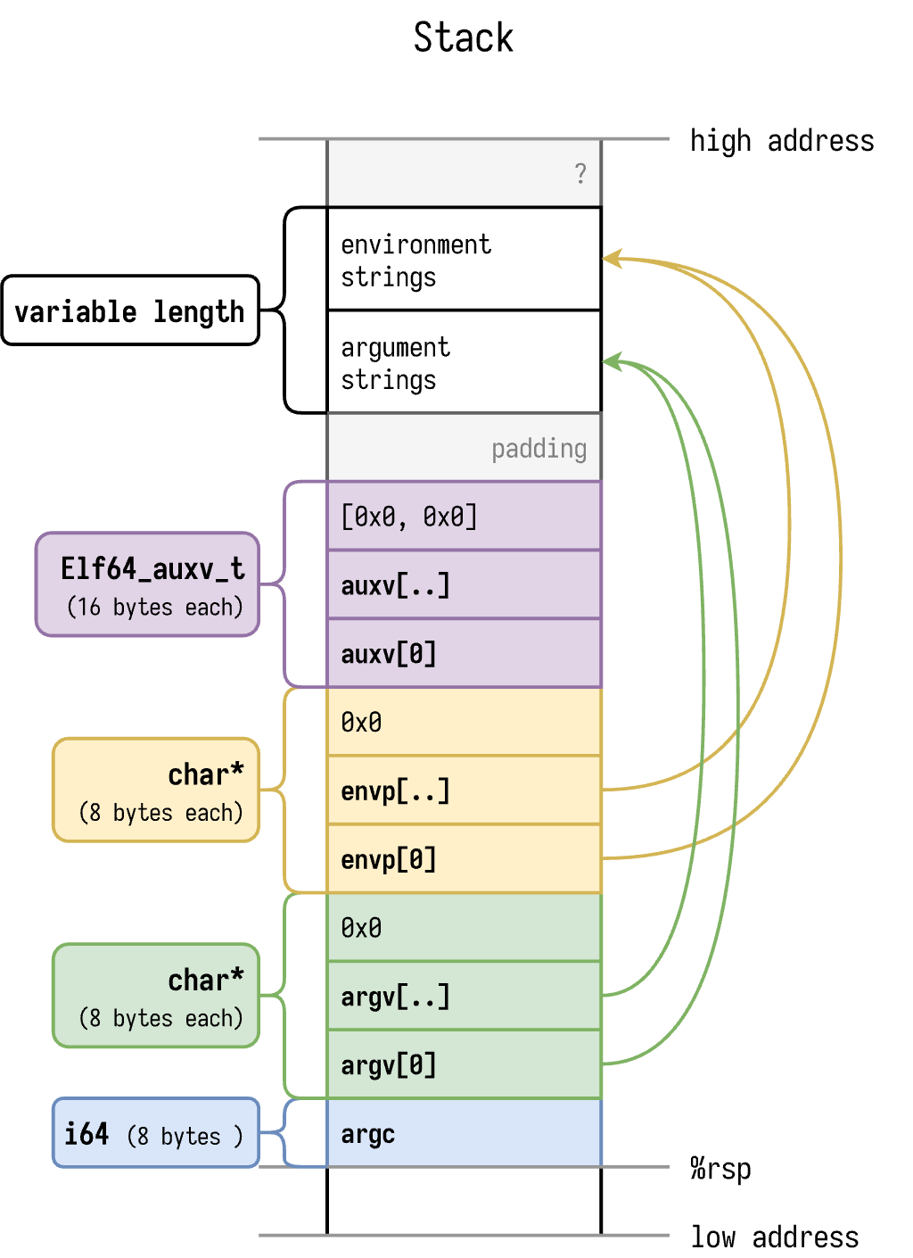
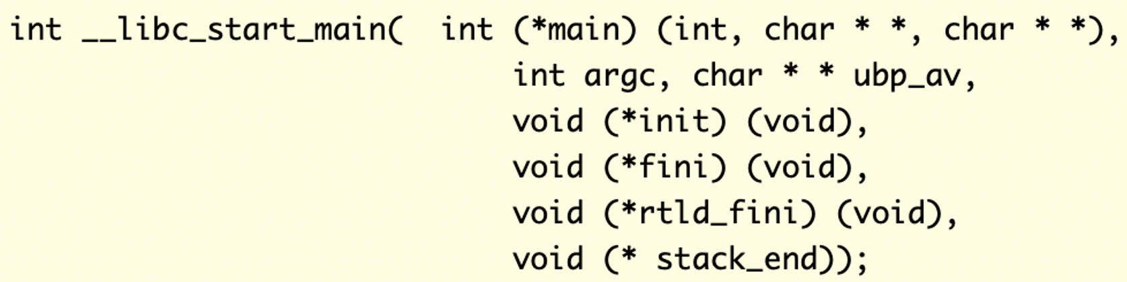
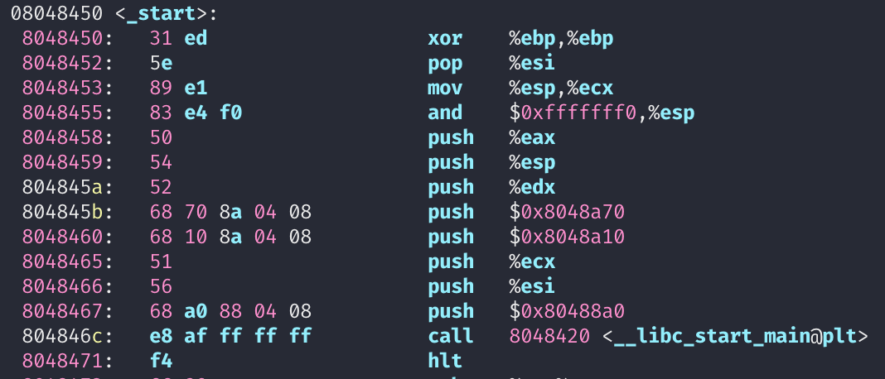
start() -- entrypoint
Notes:
https://fasterthanli.me/series/making-our-own-executable-packer/part-12

Slide 22
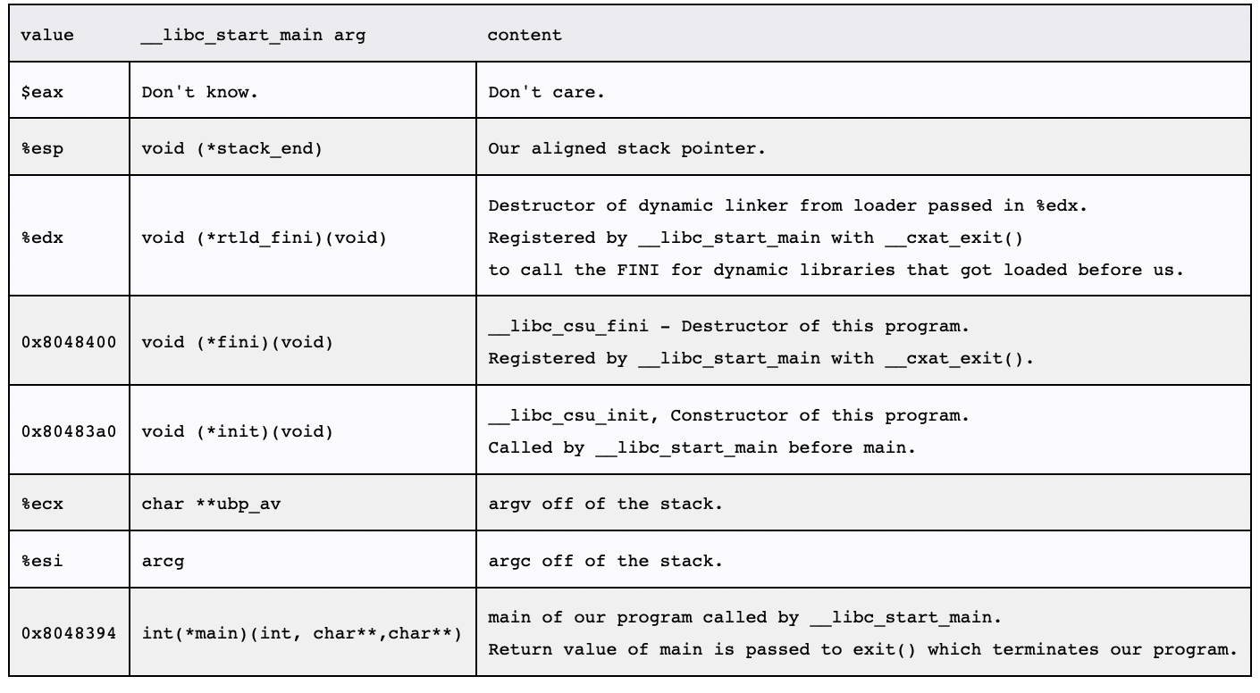
__libc_start_main();
Takes care of some security problems with setuid, setgid programs
Starts up threading
Registers the fini (our program), and rtld_fini (run-time loader) arguments to get run by at_exit to run the program's and the loader's cleanup routines
Calls the init argument
Calls the main with the argc and argv arguments passed to it and with the global __environ argument as detailed above.
Calls exit with the return value of main

Slide 23
Stack
Used for
  Storing local variables
    Your input buffer could be here…
  Passing function arguments
  Storing return address
  Storing frame pointer (i.e., saved %ebp)
What others?
  Auxiliary vector (**auxv)
  Stack: argc, command line arguments (**argv)
  Environment variables (**env)

Slide 24
1. Load the Executable
From the program path (1st arg to execve), the kernel loads code and data to the memory space
  execve(“/bin/sh”, ….)
Code section
  Usually starts from 0x8048000 (32 bit), or 0x400000 (64 bit)
readelf -a /bin/sh
Will store the path name of the program at the bottom of the stack
Program Path
“/bin/sh”

Slide 25
2. Set Environment Variables
Program Path
“/bin/sh”
ENV1
ENV2
Set environmental variables to the current stack.
ENV3 …
ENV Ptrs

Slide 26
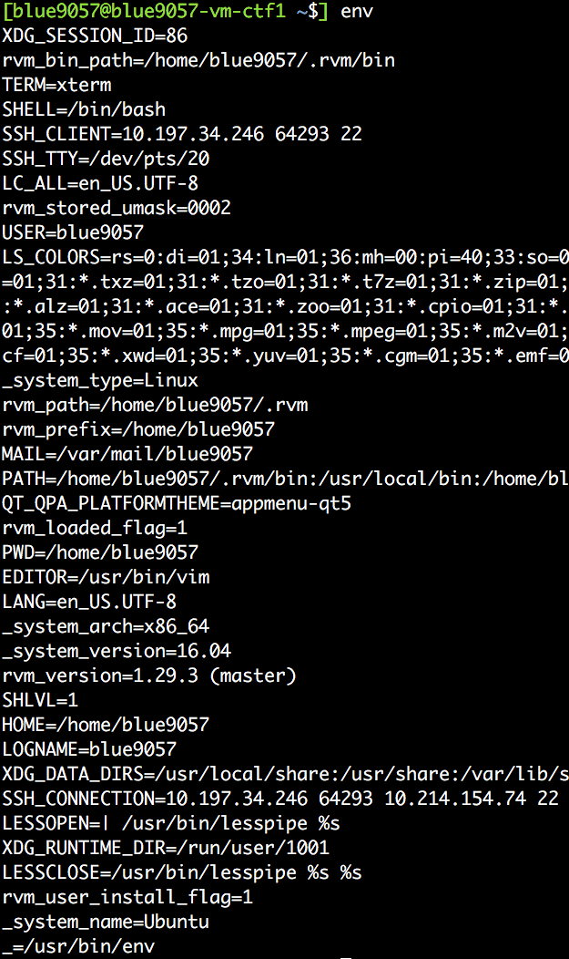
2. Set Environment Variables
Program Path
“/bin/sh”
ENV1
ENV2
Set environmental variables to the current stack.
ENV3
…
ENV Ptrs

Slide 27
3. Set Argument Vectors
Program Path
“/bin/sh”
ENV1
ENV2
Set argument vectors to the current stack.
  When running “python a.py 1 2 3”,
  argv[0] = “python”
  argv[1] = “a.py”
  argv[2] = “1”
  argv[3] = ”2”
  argv[4] = “3”
ENV3
…
ENV Ptrs
ARGV4
ARGV3
…
ARGV Ptrs

Slide 28
4. Call _start
readelf -a …

Slide 29
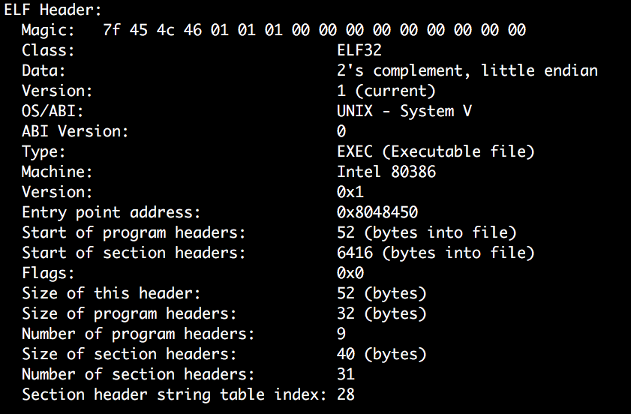
4. Call _start
readelf -a …
Addr of _start()

Slide 30
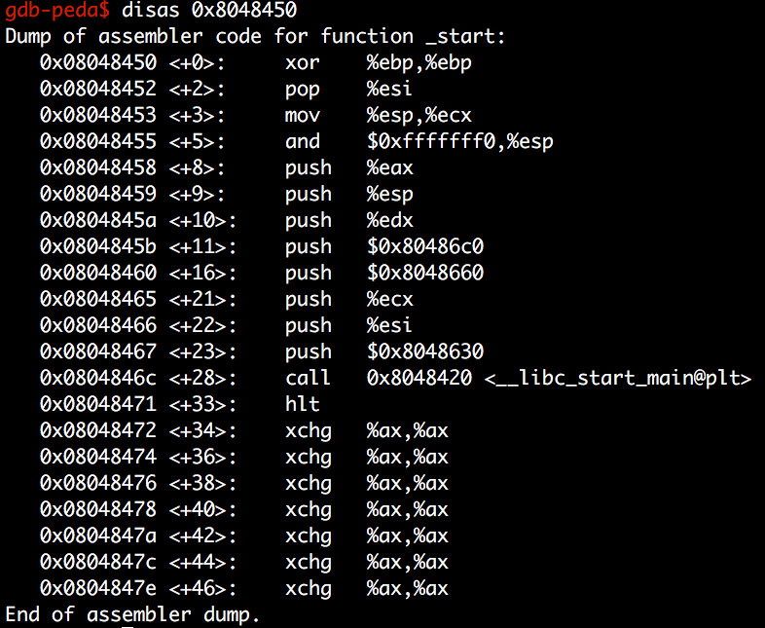
4. Call _start
readelf -a …
Addr of main()

Slide 31
4. Call _start
Program path
ENVS
readelf -a …
Calls __libc_start_main
And then, libc_start_main sets the address of argv, envp, then calls main(argc, argv, envp)
ENVP Ptrs
ARGs
ARGV Ptrs
…
ENVP
ARGV
ARGC
The stack of main() starts at here:

