Slide 1
CS 6332.001: Systems Security and Binary Code Analysis
Lecture 07: PINTOOL
Kangkook Jee
Oct 7, 2025

Slide 2
Unit3 PINTOOL
Counter control hijacking attacks with PINTOOL
Defense against attacks on Return Address on stack
Defense against FSV
  Detect illegal overwrite to GOT section
You are given
  Exploitable binaries; no source
  How can we still run it safely?

Slide 3
PIN
Developed by Intel
  Free for download and use https://www.pintool.org
A framework for Dynamic Binary Instrumentation
Runtime
No need to re-compile or re-link
Insert analysis in the program

Slide 4
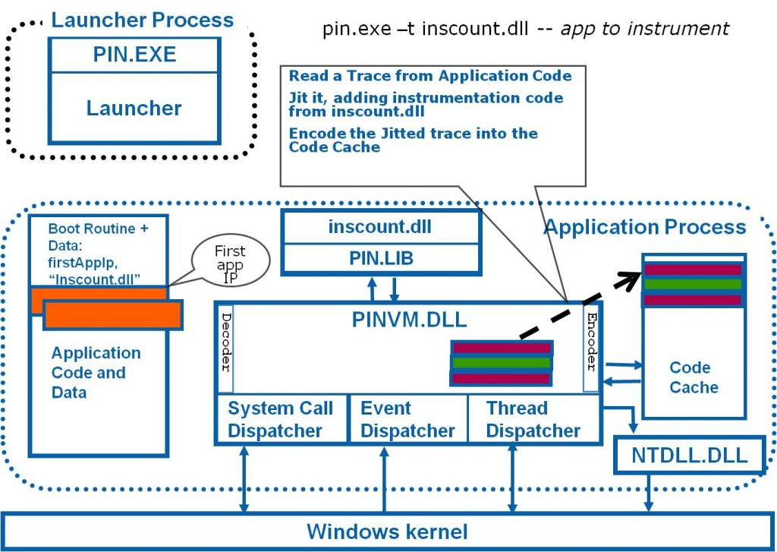
Binary-Only Program Instrumentation
(without Source Code)
Dynamic Binary Instrumentation
  Useful tool for program instrumentation and investigation for DYNAMIC analysis
Intel PIN
  Most popular, developed and supported by Intel
  Supports IA32, x86_64 for Linux and Windows
DynamoRIO
  Similar architecture with Intel PIN
  Lower-level API with finer control
    E.g., Manual register spill / fill
  Support for ARM
Valgrind
  Heavy-weighted instrumentation
  Wide architecture coverage VEX IR
  MEMCHECK runs on Valgrind
Notes:
[TODO] Add more contents later

Slide 5
What is Instrumentation?
A technique that inserts extra code into a program to collect runtime information
  Program Analysis: performance profiling, error detection, capture and replay
  Architectural study: processor and cache simulation, trace collection
Instrumentation approaches:
  Source instrumentation:
    Instrument source programs
Binary instrumentation:
  Directly instrument native binaries (main executable + libraries/shared objects)

Slide 6
Instrumentation vs. Analysis
Instrumentation routines define where instrumentation is inserted
  E.g., before instruction
  Occurs first time an instruction is executed
Analysis routines define what to do when instrumentation is activated
  E.g., increment counter
  Occurs every time an instruction is executed

Slide 7
How to Write and Run Analysis with PIN

Slide 8
PIN Advantages
Dynamic Binary Instrumentation (DBI)
  No need for source code, re-compilation or post-linking
Programmable Instrumentation
  Provides rich APIs to write in C/C++ your own instrumentation tools (called Pintools)
Multiplatform
  Supports IA-32, IA-64, Itanium
  Supports Linux, Windows, MacOS
Robust
  Instrument real life applications: web browsers, databases
  Instrument multithreaded applications
  If you can run it, you can Pin it

Slide 9
Dynamic Binary Instrumentation
Can we step through instructions?
  Something like Programmable GDB
  Instrumentation: insertion of monitoring logics
  Or event replace instructions (or functions)?
Inline monitoring
  Just-in-time (analysis) code instrumentation

Slide 10
DBI Design Goals
Efficient
  Aiming for near-native performance (?)
Transparent
  Match native behavior
Comprehensive
  Control every instruction, in any application
Customizable
  Adapt to satisfy disparate tool needs

Slide 11

DynamoRIO History
DynamoRIO
@MIT
Determina
security startup
VMware
acquires Determina
Google sponsors
Dr. Memory
2001
2003
2007
2010
binary releases
open-sourced
BSD license
2002
2009
Derek Bruening
@Google
Notes:
Dr. Memory
LLVM + ASAN

Slide 12
Direct Code Modification
e9 37 6f 48 92 jmp <callout>
Kernel32!TerminateProcess:
7d4d1028 7c 05 jl 7d4d102f
7d4d102a 33 c0 xor %eax,%eax
7d4d102c 40 inc %eax
7d4d102d eb 08 jmp 7d4d1037
7d4d102f 50 push %eax
7d4d1030 e8 ed 7c 00 00 call 7d4d8d22

Slide 13
Debugger Trap Too Expensive
cc int3 (breakpoint)
Kernel32!TerminateProcess:
7d4d1028 7c 05 jl 7d4d102f
7d4d102a 33 c0 xor %eax,%eax
7d4d102c 40 inc %eax
7d4d102d eb 08 jmp 7d4d1037
7d4d102f 50 push %eax
7d4d1030 e8 ed 7c 00 00 call 7d4d8d22

Slide 14
Basic Interpreter
application code
foo()
bar()
A
interpreter
B
C
fetch
decode
execute
D
E
F
Slowdown: 300x

Slide 15
Improvement #1: Basic Block Cache
application code
basic block cache
foo()
bar()
A
DynamoRIO
A
B
C
C
D
D
E
E
F
F
Slowdown: 300x
25x

Slide 16
Example Basic Block Fragment
add %eax, %ecx
cmp $4, %eax
jle $0x40106f
frag7:
stub0:
stub1:
add %eax, %ecx
cmp $4, %eax
jle <stub0>
jmp <stub1>
mov %eax, eax-slot
mov &dstub0, %eax
jmp context_switch
mov %eax, eax-slot
mov &dstub1, %eax
jmp context_switch
dstub0
target: 0x40106f
dstub1
target: fall-thru

Slide 17
Direct Linking
add %eax, %ecx
cmp $4, %eax
jle $0x40106f
frag7:
stub0:
stub1:
add %eax, %ecx
cmp $4, %eax
jle <frag8>
jmp <stub1>
mov %eax, eax-slot
mov &dstub0, %eax
jmp context_switch
mov %eax, eax-slot
mov &dstub1, %eax
jmp context_switch
dstub0
target: 0x40106f
dstub1
target: fall-thru

Slide 18
Improvement #2: Linking Direct Branches
application code
basic block cache
foo()
bar()
A
DynamoRIO
A
B
C
C
D
D
E
E
F
F
Slowdown: 300x 25x
3x

Slide 19
Improvement #3: Linking Indirect Branches
application code
basic block cache
foo()
bar()
A
DynamoRIO
A
B
C
C
D
D
E
E
indirect branch lookup
F
F
1.2x
Slowdown: 300x 25x 3x

Slide 20
Indirect Branch Transformation
frag8:
mov %ecx, ecx-slot
pop %ecx
jmp <ib_lookup>
ret
ib_lookup:
...
...
...

Slide 21
Improvement #4: Trace Building
basic block cache
trace cache
A
D
G
J
A
G
B
K
B
E
H
K
E
J
F
H
C
F
I
L
D
Traces reduce branching, improve layout and locality, and facilitate optimizations across blocks
  We avoid indirect branch lookup
Next Executing Tail (NET) trace building scheme [Duesterwald 2000]

Slide 22
Incremental NET Trace Building
basic block cache
trace cache
G
J
G
K
G
J
G
K
K
G
J
G
K
K
J

Slide 23
Improvement #4: Trace Building
application code
basic block cache
trace cache
foo()
bar()
A
DynamoRIO
A
B
C
C
ind. br. stays on trace?
A
D
D
C
D
E
E
indirect branch lookup
E
?
F
F
F
1.1x
Slowdown: 300x 25x 3x 1.2x

Slide 24
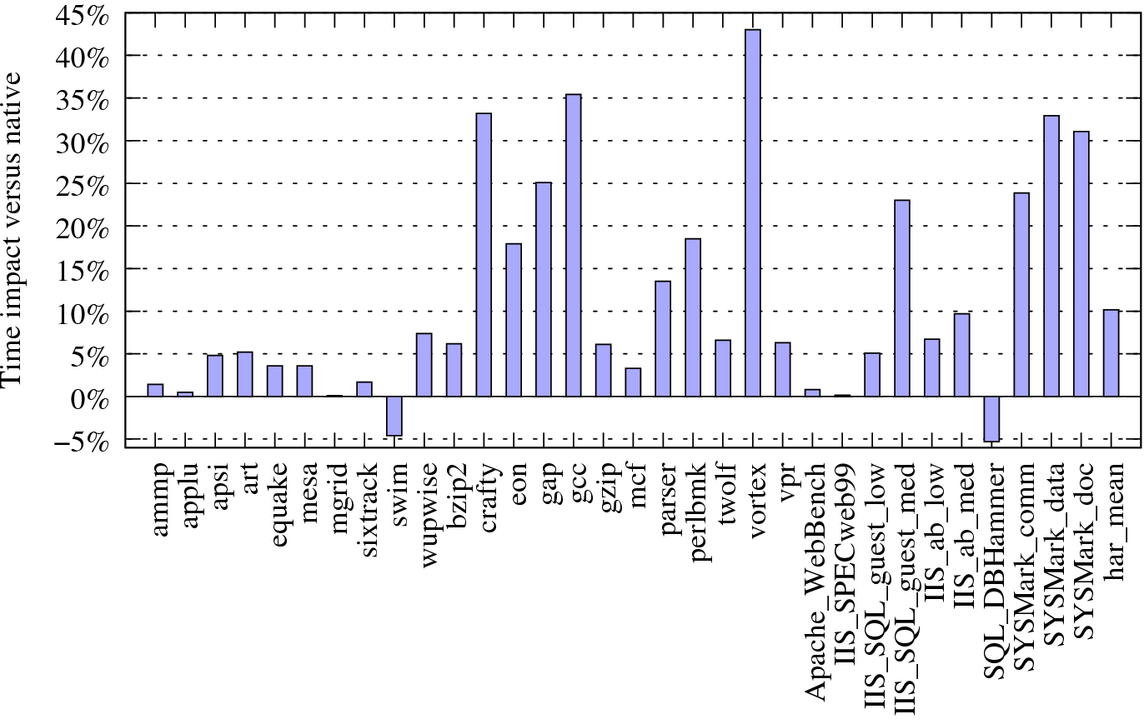
Base Performance
SPEC CPU2000
Server
Desktop

Slide 25
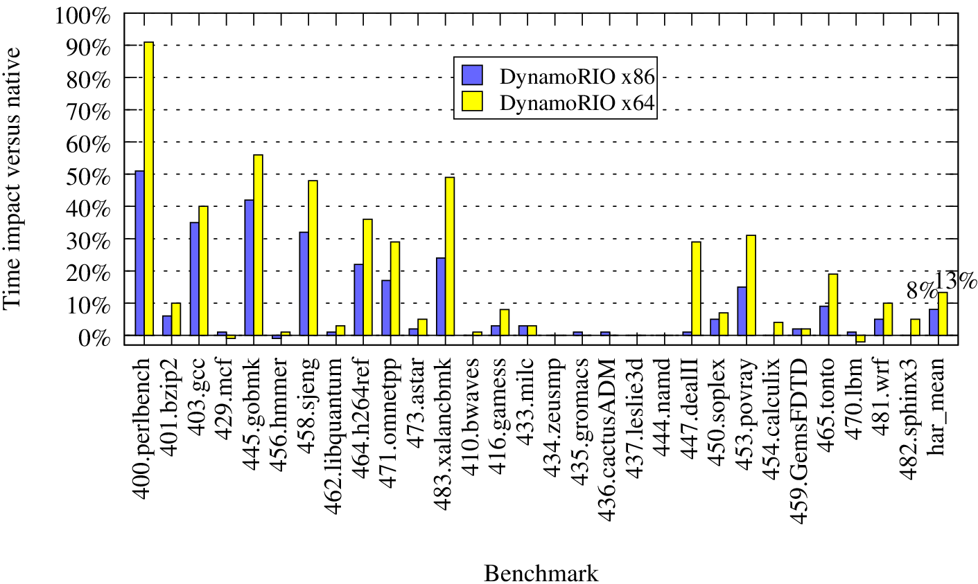
Base Performance: SPEC 2006

Slide 26
ARM: Preliminary Performance Comparison

Slide 27
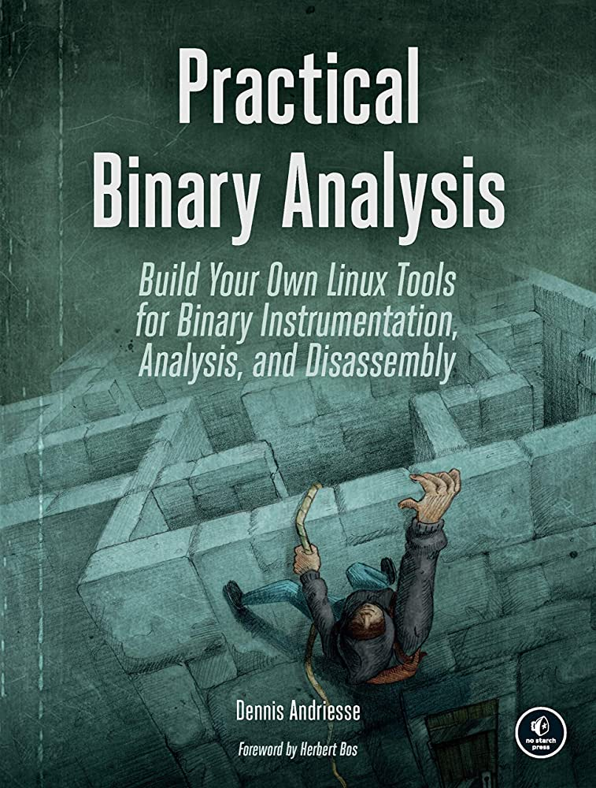
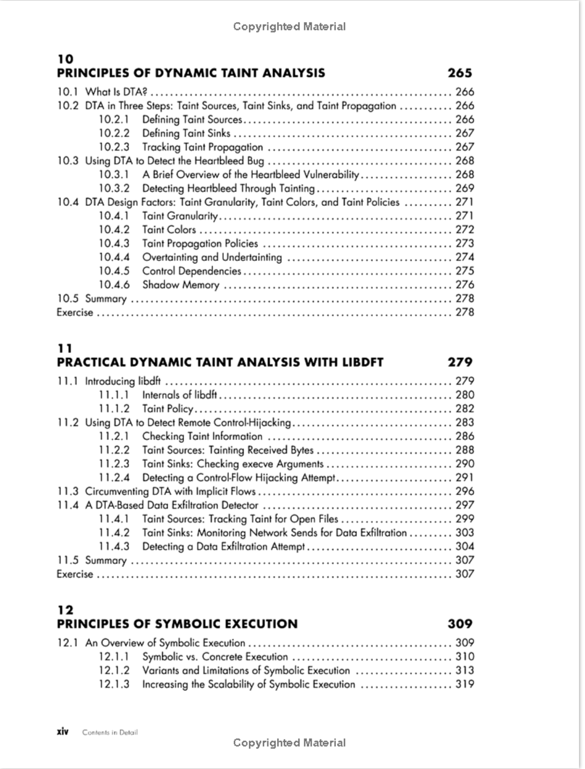

Libdft: Fine Granular Information Flow Tracking Framework
Open-sourced, widely used, and many citations
  Has become a textbook chapter
  300+ citations
Leveraging virtualization layer (Intel PINTOOL)
  Trace at instruction level taint propagation semantics
  Maintain shadow memory
However, old and outdated
  Support Linux 32/64-bit binaries
Practical Binary Analysis

Slide 28
Data Flow Tracking (DFT)
DFT tracks the flow of selected data throughout the execution of a program or system
Shadow Context for
  Tagging, propagation, and checking
Notes:
DFT system tags information from untrusted source as tainted, and trace it throughout the execution. When the suspicious usages of the tagged information are made, the previously defined / specified actions will be triggered to protect the application.
In this example, we tag variable A as ‘tainted’ as it enters the system,
and then taintedness of A is propagated to C during the system’s execution.
The inspection is made to C, when it is used from unintended locations.
->
To implement DFT system, we need a shadow context that implements tag related operations such as tagging, propagation, and checking

Slide 29
DFT: Basic Aspects
DFT is characterized by three aspects
  Data Sources: program or memory locations where data of interest enter the system and is subsequently tagged
  Data tracking: process of propagating data tags according to the program’s semantics
  Data Sinks: program or memory locations where checks for “tagged” data can be made
Notes:
What are the basic aspects of this technique? Let’s see more details of DFT.
(Data source) As any data comes into the system via untrusted or suspicious inputs such as file, network sockets, keyboard
we tag it as untrusted or suspicious
(Data tracking) once it comes into the system it will drift around the system according to rules that specified from original program text or DFT semantics. Then the second component - data tracking, extract/capture tag prop. semantics and duplicate these to the separate memory region of shadow memory space.
(Data sinks) During execution, as any of the tagged data can comes across previously specified regions, such as ret address from stack, target address of indirect jump, permission bits from the memory, and then inspection is made and previously specified/defined action will be triggered.

Slide 30
DFT: Applications and Implementations
Many Interesting applications with different Source, Sink pairs
Applications | Propagation
Software Exploit | Network input → RET address
Privacy Leakage | GPS → Network output
Malware Analysis | Keystroke → Network output
Performance Tuning | Perf. bottleneck → Conf. file
DFT implementation approaches
Approaches | Overhead | Drawbacks
H/W assisted | ~ 10% | No vendor support yet
Source based | ~2x | No COTS binaries
Binary only | 5x ~ 100x | High Overhead
Binary only DFT: Great applicability, but too slow!
Notes:
DFT has many interesting applications connecting different types of input, output pairs.
->
The example includes buffer overflow detection, privacy leakage detection, malware analysis and performance tuning
->
H/W component: very fast less than 10% of overhead
Not flexible, no support from commodity HW vendors yet
->
Source: implemented using src-to-src transformation or as a compiler plug-in
Reasonable fast (2 times slowdown)
It can’t support for ‘off-the-shelf’ binaries and libraries that come without sources.
->
Binary only approach implemented using pervasive virtualization techniques.
General and flexible, can handle legacy code and unknown libraries
Thus, the most promising solution with great applicability, but too slow. It slowdown ranges from 5x to 100x
Depends on applications or implementation approaches
-->
Typically DFT systems implemented by instrumenting/interleaving original codes with codes that performs shadow context operations.
The overall slowdown of the system deeply related to the cost to instrumentation as well as the size of DFT logic itself.
For the case of Binary only DFT, the cost for both operations are not negligible, result in huge slowdowns.
For the rest of talk, I’ll talk about our approach to improve binary only DFT , that comes with great applicability but suffers from too high overhead.

Slide 31
DFT Limitations
Too high-overheads
  2 ~ 10 X slowdown for instrumentation cost
  Memory segment for shadow memory
Over-tainting (FP dependencies) and under-tainting (TN dependencies)
  Grows over time ….

Slide 32
Backup

Slide 33
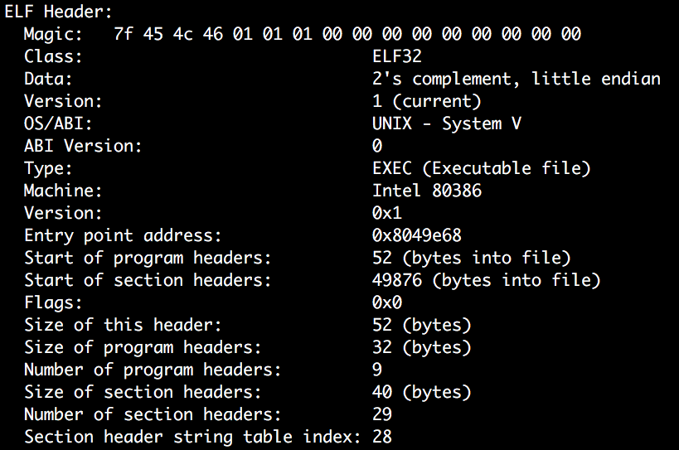
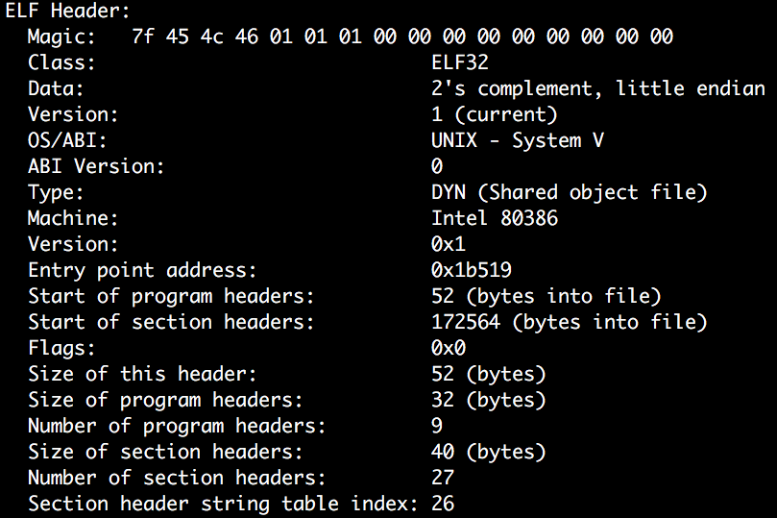
Position Independent Executable (PIE)
/bin/cat from Ubuntu 16.04.3
/bin/sh from Ubuntu 16.04.3

