Slide 1
CS 6332.001: Systems Security and Binary Code Analysis
Lecture 10
Kangkook Jee
Oct 30, 2025

Slide 2
Outline
Virtualization principles
Binary translator
Case study: Light-weighted virtualization; container, docker

Slide 3
Virtualization

Slide 4
Virtualization Intro
Virtualization Overview
  Taxonomy
  CPU virtualization, memory space virtualization, device virtualization
Binary Translators
Light-weighted Virtualization (Containers)
Beginning of many innovations we see today
  Cloud, big data, ML and many more

Slide 5
What is Virtualization?
A virtual machine monitor (VMM a.k.a. hypervisor) is a “kernel” where OSes are ‘applications’
  Abstract memory (guest physical addresses to machine physical)
  Multiplex between OSes and trap on specified exceptions/ violations
  Provide a consistent & abstracted view of hardware
Well-designed architecture (mostly) cleans a lot of crufts needed for legacy support
  Originally no support for real-mode
  64-bit aware, no PAE needed
  Allows VMM to be very small code base

Slide 6
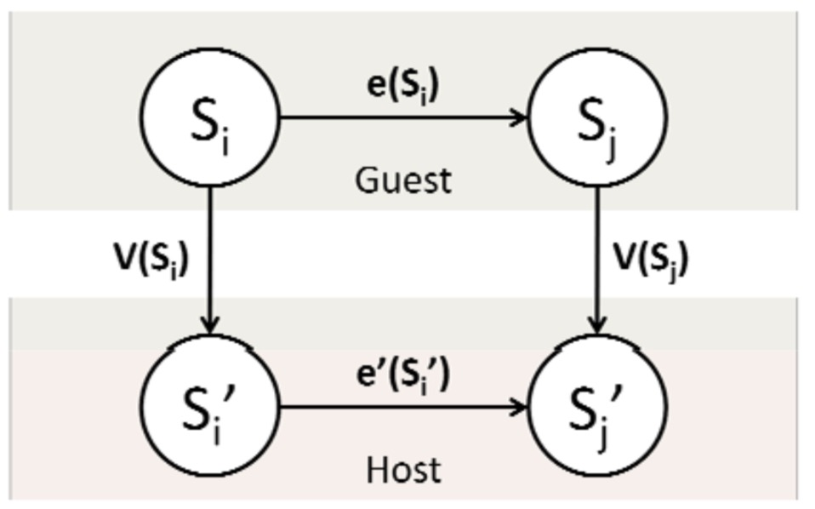
Isomorphism
Formally, virtualization involves the construction of an isomorphism from guest state to host state
Notes:
* Virtualization software constructs an isomorphism from guest to host.
* All guest state S is mapped onto host state S’ through some function V(S).
* Additionally for every state changing operation e(S) in the guest there is a corresponding state changing operation e’(S’) in the host.
* Virtualization software must implement V() and e().
[KJEE]: Examples?
[TODO]: We can improve figure

Slide 7
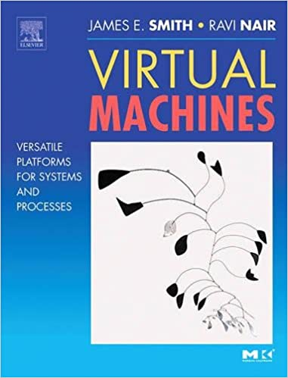
Types of Virtualization
Process Virtualization
  Language construction
    Java, .NET
  Cross-ISA emulation
    Running Android emulator
  Application virtualization
    Sandboxing
Device Virtualization
  RAID, NAT, Bridging
System Virtualization
  Type-1: VMWare, Xen
  Type-2: VirtualBox, VMWare Workstation, Fusion
  Microsoft Hyper-V
Light-Weighted Virtualization (Container)
  Container

Slide 8
Taxonomy
Process VMs
System VMs
Same
ISA
Different
ISA
Same
ISA
Different
ISA
Dynamic Binary
Optimizers
Dynamic
Translators
Hardware
VMs
Whole-System
Emulators
Type-2, Type-3
VMs
HLL VMs
Co-designed
VMs
qemu-process,
JVM, Python VM
Notes:
[KJEE] What is Multi-programmed systems? --- https://en.wikipedia.org/wiki/THE_multiprogramming_system
HLL - https://cs.nyu.edu/courses/spring14/CSCI-GA.3033-015/lecture6.pdf
Co-designed VMM: A codesigned VM has no native ISA applications. Instead, the VMM appears to be part of the hard- ware implementation
From “The Architecture of Virtual Machines “

Slide 9
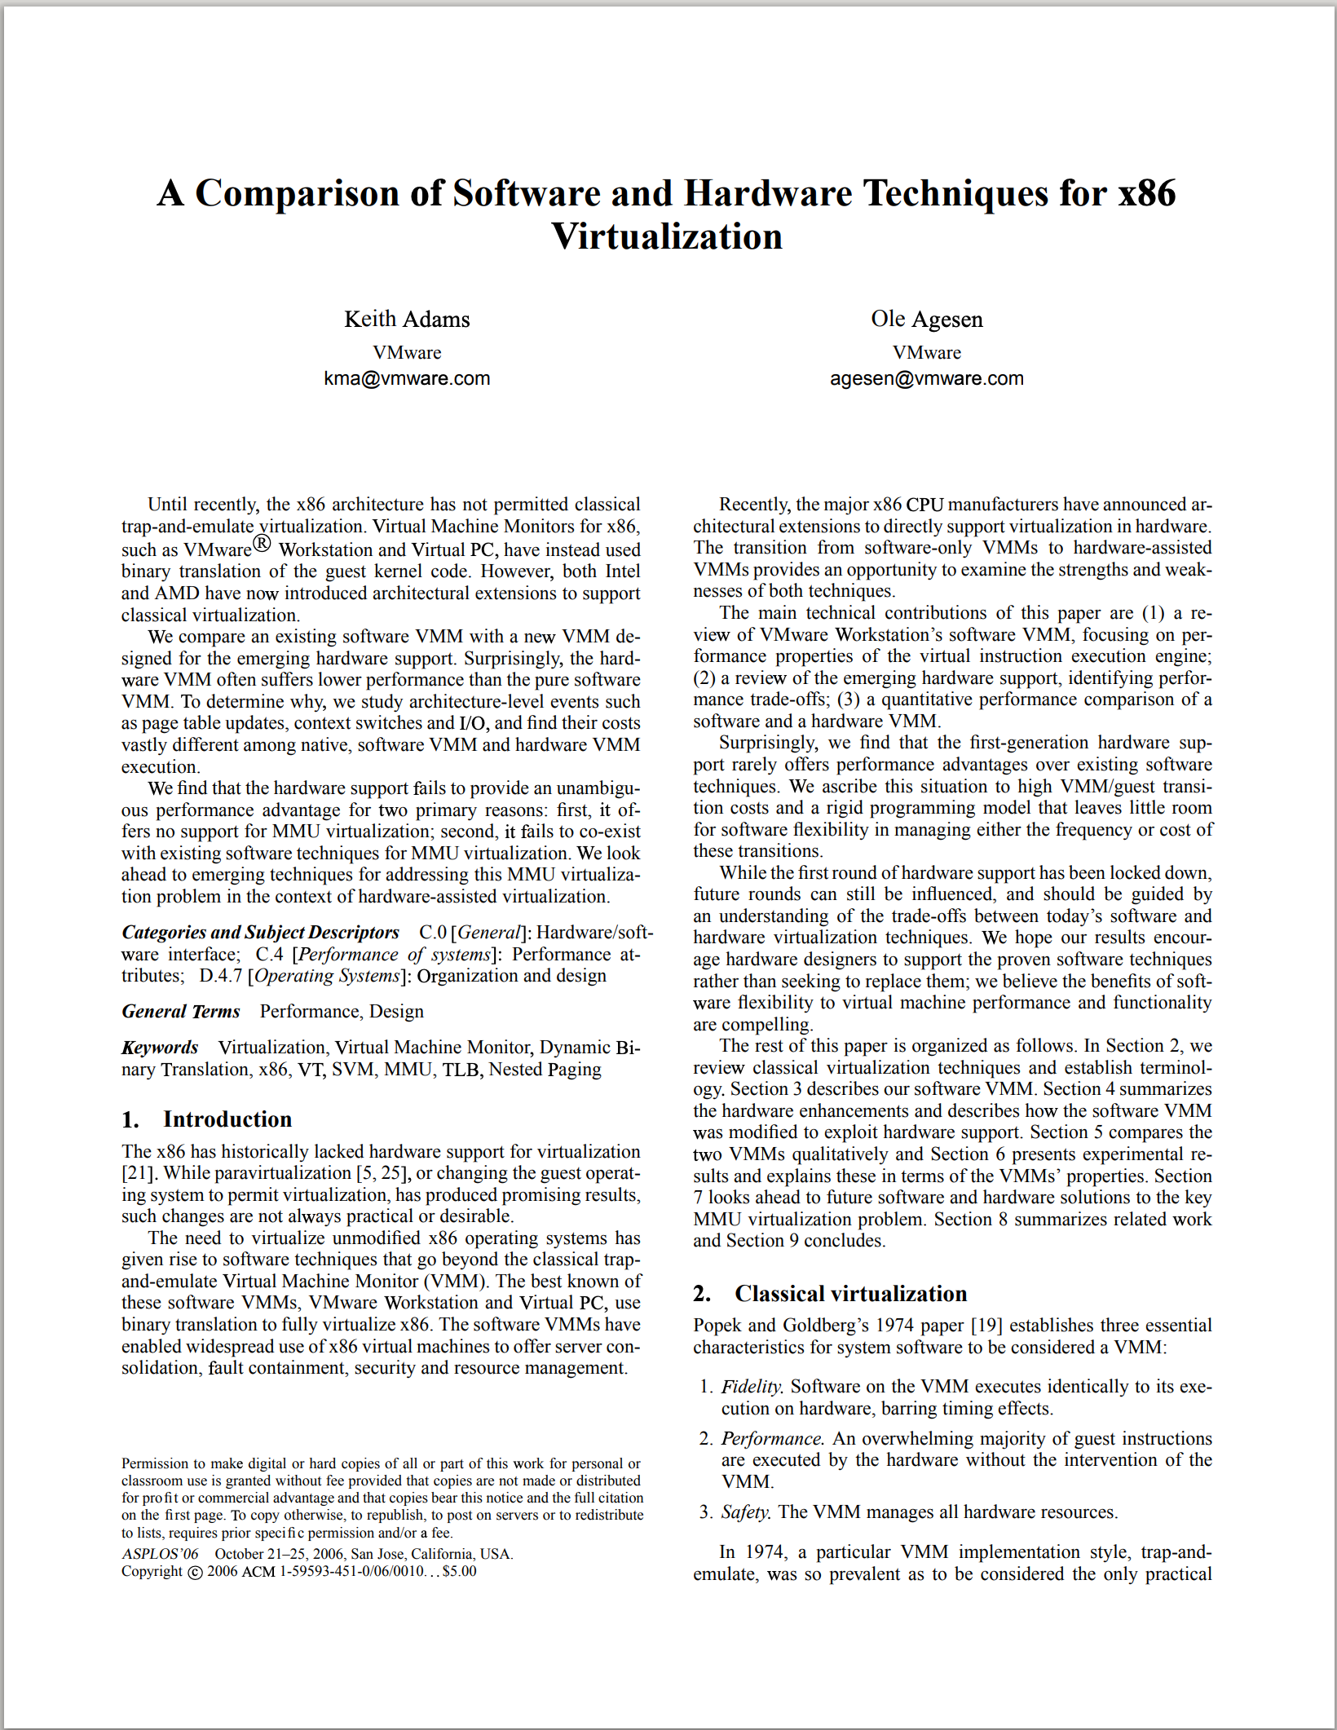
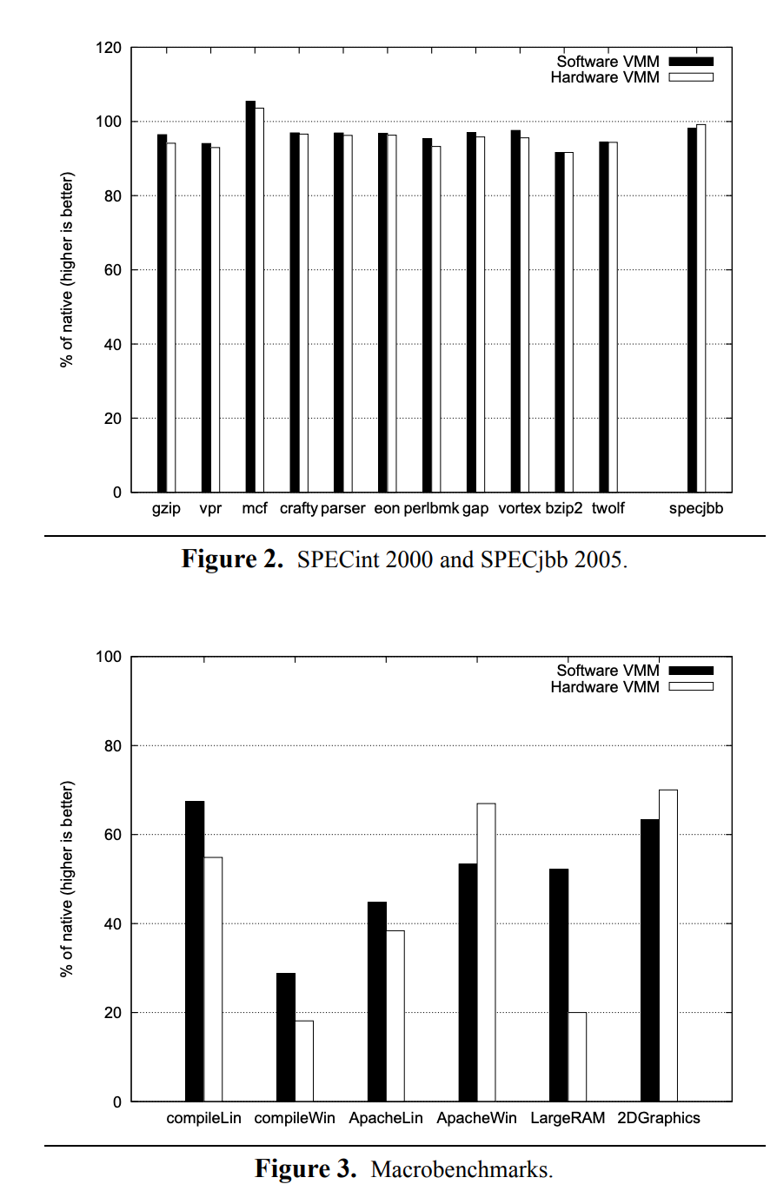
Software vs. Hardware Virtualization
ASPLOS 2006

Slide 10
Virtualization Properties: Isolation
Fault Isolation
  Fundamental property of virtualization
Software Isolation
  Software Versioning
  DLL hell
Performance Isolation
  Accomplished through scheduling and resource allocation
Notes:
First, virtualization provides isolation. Isolation is key for many applications and comes in several flavors.
Fault Isolation. If one virtual machine contains a buggy operating system, that OS can start scribbling all over physical memory. These wild rights must be contained within the VM boundaries.
Performance Isolation. Ideally VMs performance would be independent of the activity going‐on on the hardware. This must be accomplished by smart scheduling and resource allocation policies in the monitor.
Software Isolation. Most of the issues with computers today are complex software configurations. DLL hell on PCs, operating system and library versions, viruses, and other security threats. VMs are naturally isolated for each other by running in separate software environments.

Slide 11
Virtualization Properties: Encapsulation
All VM state can be captured into a file
  Operate on VM by operating on file
  mv, cp, rm
Portability
  Independent of physical hardware
  Enables migration of live, running VMs
Complexity
  Proportional to virtual HW model
  Independent of guest software configuration
Notes:
Encapsulation is the property that all VM state can be described and recorded simply. The VM state is basically the dynamic memory, static memory, and the register state of the CPU and devices. These items typically have a simple layout and are easy to describe. We can checkpoint a VM by writing out these items to a few files. The VM can be moved and copied by moving these files around. You can think about this as similar to doing a backup at the block level vs. doing a backup by recording all the packages, configuration and data files that encompass a file system.

Slide 12
Virtualization Properties: Interposition
All guest actions go through hypervisor (monitor)
Monitor can inspect, modify, deny operations via Instrumentation
Ex)
  Compression
  Encryption
  Profiling
  Translation
  Reference Monitor
CFG
Policy
Op request
Subject
Reference Monitor
Object
Op response
12
Notes:
At some level all access to the hardware passes through the monitor first. This gives the monitor and chance to operate on these accesses. The best example of this is encrypting all data written to a disk. The advantage of this is that it does it without the knowledge of the OS.

Slide 13
Virtualization vs. Emulation
Emulation?
  QEMU runs ARM code from Intel machine
  Need to handle all instructions
Virtualization
  Run Windows from Linux
  Need to handle sensitive + privileged instructions
    Rest instructions can run natively
  Privileged instructions: make changes to CPU status
  Sensitive instructions: make changes to global system status
  Regular (benign) instructions: the rest

Slide 14
Special Instructions
Privileged instructions
  The set of instructions that your ISA defines as privileged
  Only can be executed in “Ring-0” (e.g., Kernel Mode)
  E.g., I/O instruction, halt, Context switching
Sensitive instructions
  observes or modifies privileged machine state that can be used to change the current processor’s privilege level
  E.g., most instructions that we have dealt with
User-sensitive instruction
  Sensitive instruction that executes in user/unprivileged mode
Notes:
https://www.geeksforgeeks.org/privileged-and-non-privileged-instructions-in-operating-system/
https://patents.google.com/patent/US6704925

Slide 15
Sensitive but Non-privileged Instruction
cpuid: CPU identification
rdtsc: Read Time-Stamp Counter
Notes:
https://c9x.me/x86/html/file_module_x86_id_45.html
https://www.felixcloutier.com/x86/rdtsc

Slide 16
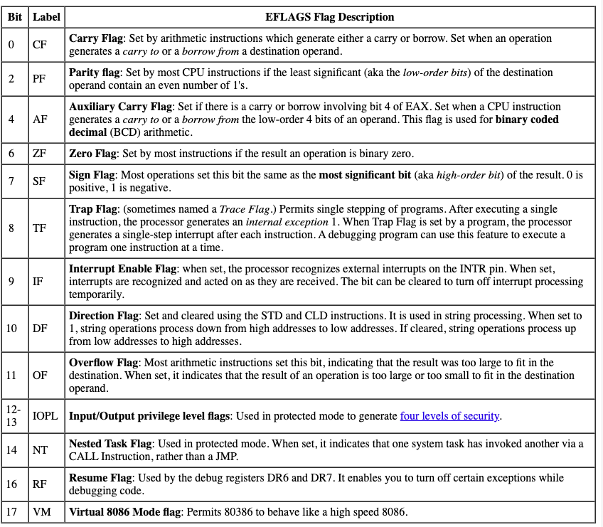
Sensitive but Non-privileged Instruction
cli: Clear Interrupt Table
sti: Set Interrupt Table
popf: restore EFLAGS register
Updates to `CR3` register
  Special register for virtual memory management
  Holds physical address

Slide 17
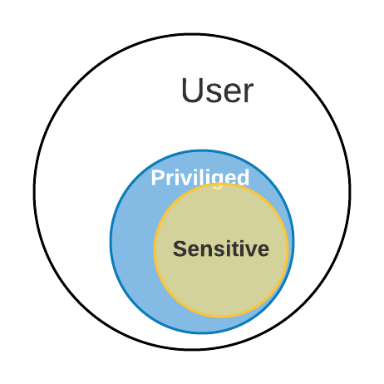
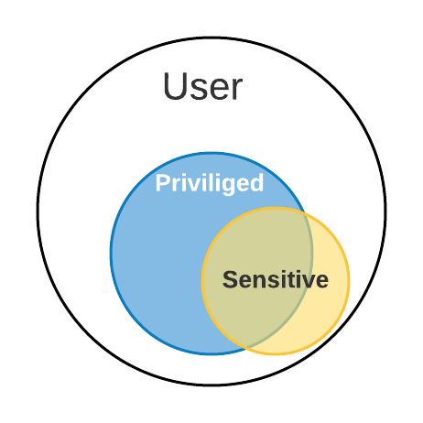
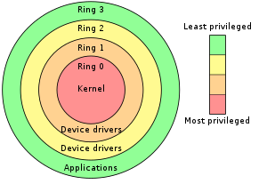
Strictly Virtualizable
an efficient
Goldberg’s Theorem 1
  For any conventional third-generation computer, a virtual machine monitor may be constructed if the set of sensitive instructions for that computer is a subset of the set of privileged instructions.
Privileged instructions (vs. User instructions)
  Only executed inside Kernel (ring-0)
  E.g., INVLPG, HLT …
Sensitive (System) Instructions (vs. innocuous/user instructions )
  Influences global system stage
  CLI, STI …
Satisfies condition –
efficiently virtualizable
Does not satisfy condition

Slide 18
Trap and Emulate
Guest OS + Applications
Unprivileged
Page
Fault
Undef
Instr
vIRQ
Hypervisor (Virtual Machine Monitor)
How can we trap sensitive but non-privileged instructions?
Privileged
MMU
Emulation
CPU
Emulation
I/O
Emulation
Expensive!
A trap, also known as an exception or a fault, is typically a type of synchronous interrupt caused by an exceptional condition (e.g., breakpoint, division by zero, invalid memory access).
Notes:
Direct execution
vIRQ?
a trap, also known as an exception or a fault, is typically^{[NB 1][1]} a type of synchronous interrupt caused by an exceptional condition (e.g., breakpoint, division by zero, invalid memory access).

Slide 19
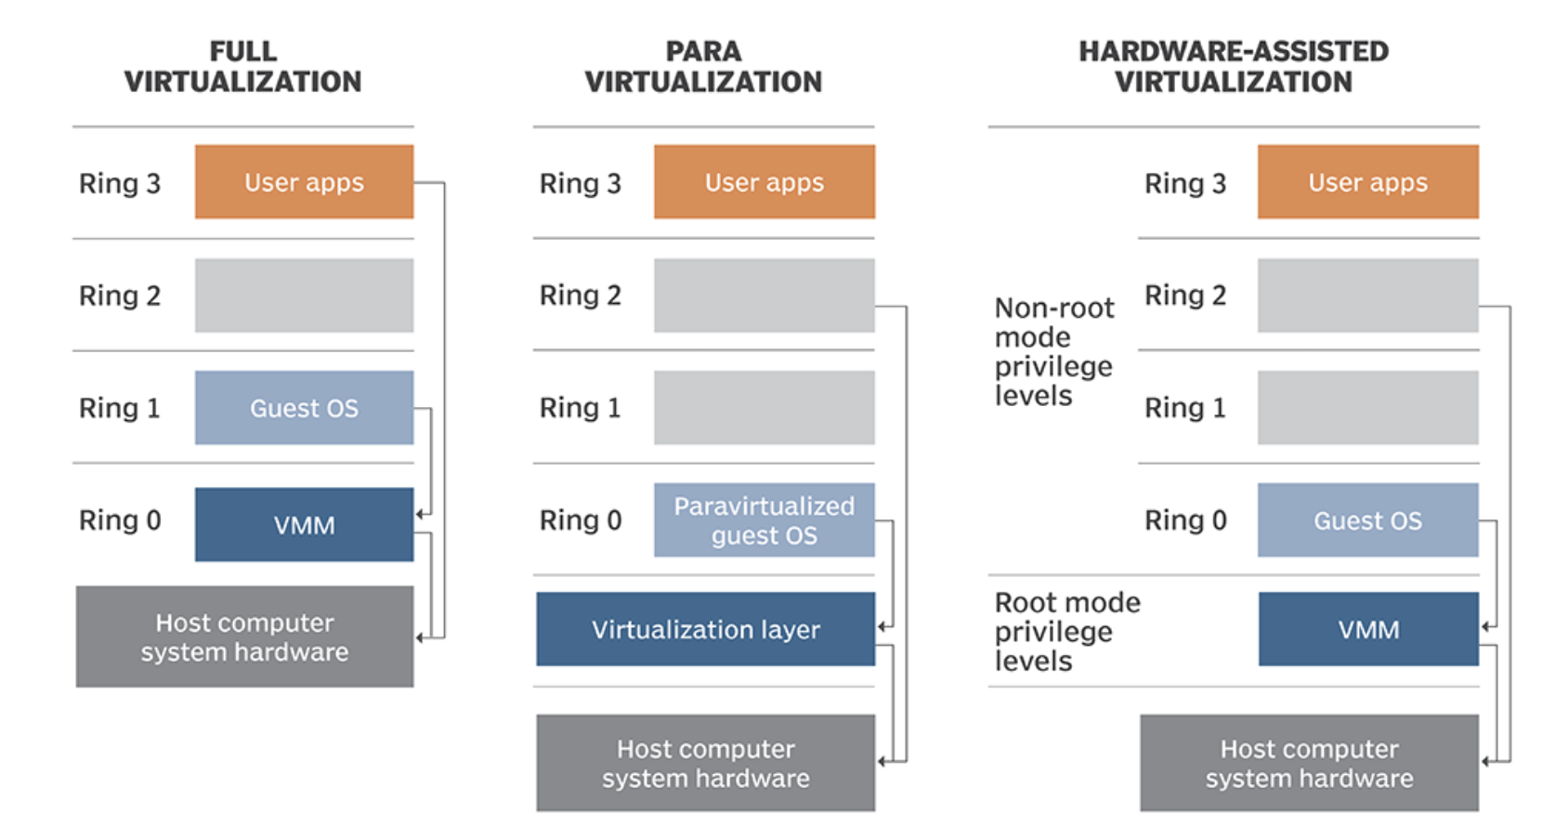
System Virtualization Implementations
Notes:
https://www.techtarget.com/searchitoperations/definition/AMD-V-AMD-virtualization

Slide 20
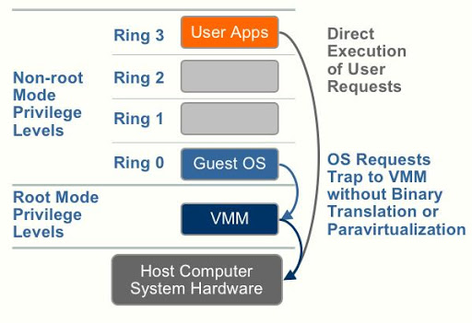
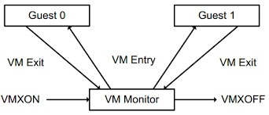
Hardware Assisted Virtualization
Intel VT-X, AMD-V
  Modern CPUs support virtualization extensions
To reduce Trap and Emulate overheads
  Software (kernel) → Hardware
Under VT-X CPU operates on
root and non-root modes
Orthogonal to
  Privilege rings (0-3)
  real, protected, long modes etc.

Slide 21
Binary Translator Workflow
Guest
Code
Translator
Translation
Cache
CPU Emulation
Routines
TC
Index
Callouts
TC: Translation Cache

Slide 22
Basic Blocks
Guest Code
vPC
mov ebx, eax
cli
and ebx, ~0xfff
Straight-line code
Basic Block
mov ebx, cr3
sti
ret
Control flow
cli: clear interrupt, sti: set interrupt
cr3: control register

Slide 23
Basic Blocks
Guest Code
vPC
mov ebx, eax
cli
and ebx, ~0xfff
Straight-line code
Basic Block
mov ebx, cr3
sti
ret
Control flow
cli: clear interrupt, sti: set interrupt
cr3: control register

Slide 24
Binary Translation
Guest Code
Translation Cache
vPC
mov ebx, eax
mov ebx, eax
start
cli
call HANDLE_CLI
and ebx, ~0xfff
and ebx, ~0xfff
mov ebx, cr3
mov [CO_ARG], ebx
sti
call HANDLE_CR3
ret
call HANDLE_STI
jmp HANDLE_RET
Notes:
Dynamic binary translation is used in virtualizing the CPU by translating potentially dangerous (or non-virtualizable) instruction sequences one-by-one into safe instruction sequences.
It works like this:
The monitor inspects the next sequence of instructions. An instruction sequence is typically defined as the next basic block, that is all instructions up to the next control transfer instruction such as a branch. There may be reasons to end a sequence earlier or go past a branch but for now let’s assume we go to the next branch.
Each instruction is translated, and the translation is copied into a translation cache.
Instructions are translated as follows:
Instructions which pose no problems can be copied into the translation cache with modification. We call these “ident” translations.
Some simple dangerous instructions can be translated into a short sequence emulation code. This code is placed directly into the translation cache. We call this “inline” translation. An example is the modification of the Interrupt Enable flag (CLI).
Other dangerous instructions need be performed by emulation code in the monitor. For these instructions calls to the monitor are made. These are called “Call-outs”. An example of these is a change to the page table base (CR3).
The branch ending the basic block needs a call out.
The monitor can now jump to the start of the translated basic block with the virtual registers in the hardware registers.
So dangerous instructions can be privileged instructions, non-virtualizable instructions, control flow, memory accesses.
CR3[edit]
Typical use of CR3 in address translation with 4 KiB pages
Used when virtual addressing is enabled, hence when the PG bit is set in CR0. CR3 enables the processor to translate linear addresses into physical addresses by locating the page directory and page tables for the current task. Typically, the upper 20 bits of CR3 become the page directory base register (PDBR), which stores the physical address of the first page directory entry. If the PCIDE bit in CR4 is set, the lowest 12 bits are used for the process-context identifier (PCID).^{[1]}

Slide 25
Binary Translation
Guest Code
Translation Cache
vPC
mov ebx, eax
mov ebx, eax
start
cli
mov [CPU_IE], 0
and ebx, ~0xfff
and ebx, ~0xfff
mov ebx, cr3
mov [CO_ARG], ebx
sti
call HANDLE_CR3
ret
mov [CPU_IE], 1
test [CPU_IRQ], 1
jne
call HANDLE_INTS
jmp HANDLE_RET
Notes:
Dynamic binary translation is used in virtualizing the CPU by translating potentially dangerous (or non-virtualizable) instruction sequences one-by-one into safe instruction sequences.
It works like this:
The monitor inspects the next sequence of instructions. An instruction sequence is typically defined as the next basic block, that is all instructions up to the next control transfer instruction such as a branch. There may be reasons to end a sequence earlier or go past a branch but for now let’s assume we go to the next branch.
Each instruction is translated, and the translation is copied into a translation cache.
Instructions are translated as follows:
Instructions which pose no problems can be copied into the translation cache with modification. We call these “ident” translations.
Some simple dangerous instructions can be translated into a short sequence emulation code. This code is placed directly into the translation cache. We call this “inline” translation. An example is the modification of the Interrupt Enable flag (CLI).
Other dangerous instructions need be performed by emulation code in the monitor. For these instructions calls to the monitor are made. These are called “Call-outs”. An example of these is a change to the page table base (CR3).
The branch ending the basic block needs a call out.
The monitor can now jump to the start of the translated basic block with the virtual registers in the hardware registers.
So dangerous instructions can be privileged instructions, non-virtualizable instructions, control flow, memory accesses.
CR3[edit]
Typical use of CR3 in address translation with 4 KiB pages
Used when virtual addressing is enabled, hence when the PG bit is set in CR0. CR3 enables the processor to translate linear addresses into physical addresses by locating the page directory and page tables for the current task. Typically, the upper 20 bits of CR3 become the page directory base register (PDBR), which stores the physical address of the first page directory entry. If the PCIDE bit in CR4 is set, the lowest 12 bits are used for the process-context identifier (PCID).^{[1]}

Slide 26
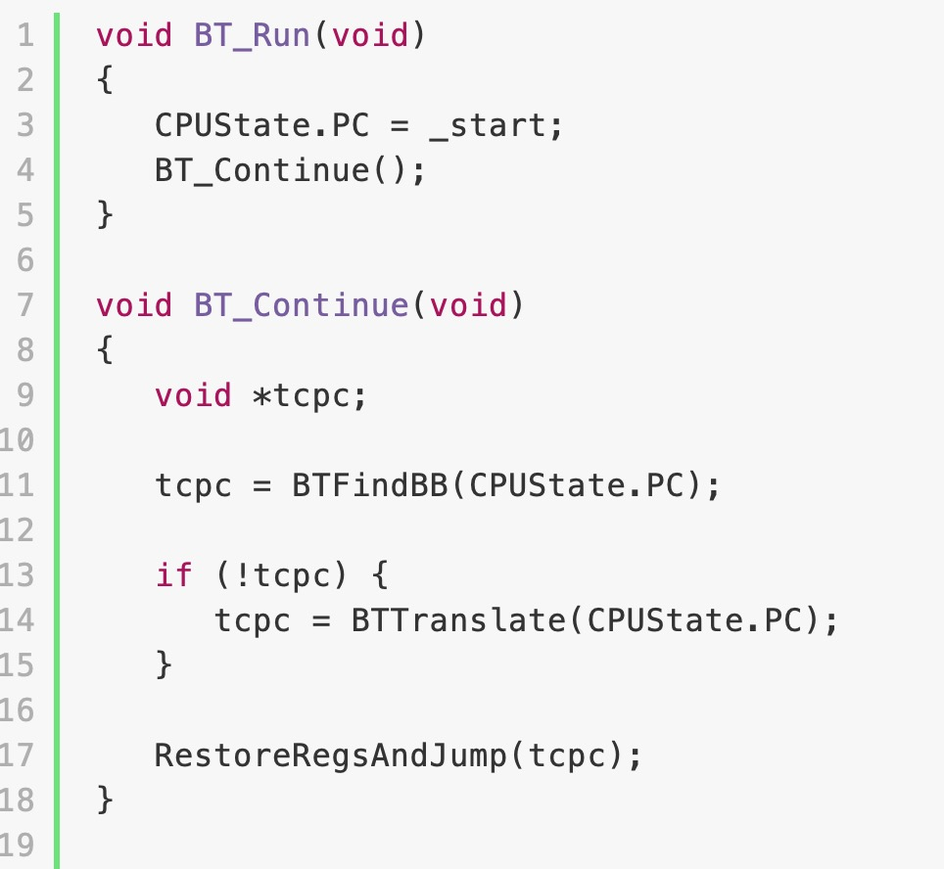
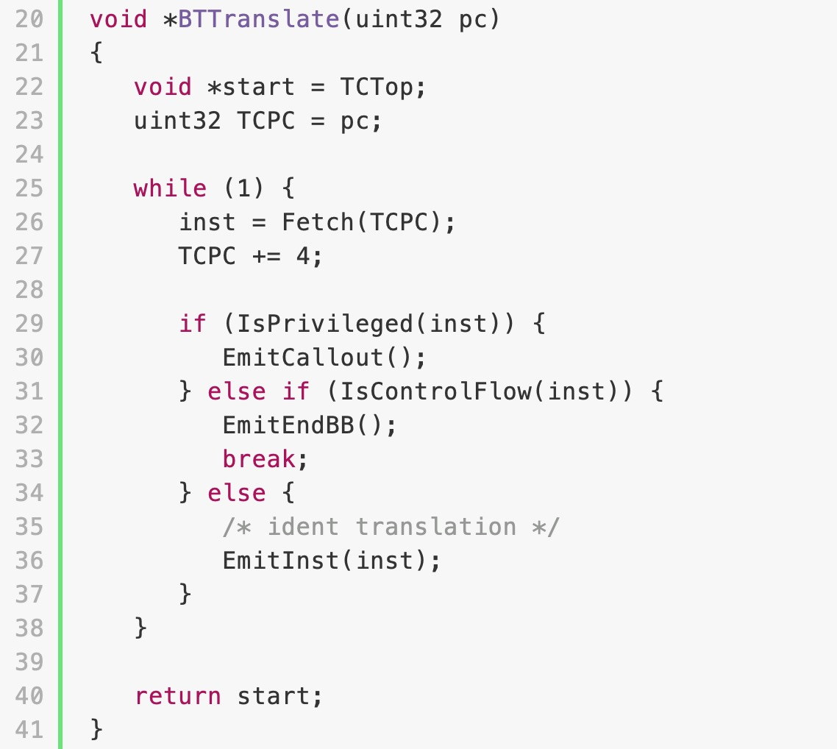
Basic Binary Translator

Slide 27
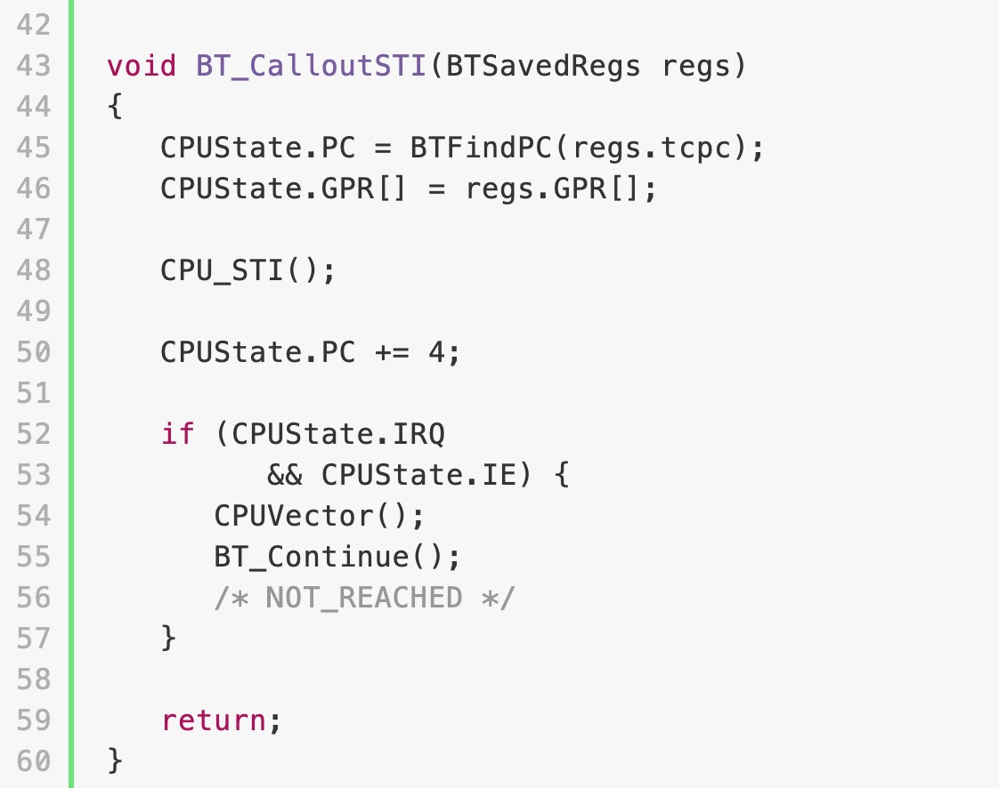
Basic Binary Translator – Part 2

Slide 28
Controlling Control Flow
Guest Code
Translation Cache
vEPC
test eax, 1
test eax, 1
start
jeq
jeq
add ebx, 18
call END_BB
mov ecx, [ebx]
call END_BB
mov [ecx], eax
ret

Slide 29
Controlling Control Flow
Guest Code
Translation Cache
test eax, 1
test eax, 1
jeq
jeq
vEPC
add ebx, 18
call END_BB
find
next
mov ecx, [ebx]
call END_BB
mov [ecx], eax
add ebx, 18
ret
mov ecx, [ebx]
mov [ecx], eax
call HANDLE_RET
eax == 0

Slide 30
Controlling Control Flow
Guest Code
Translation Cache
test eax, 1
test eax, 1
jeq
jeq
vEPC
add ebx, 18
jmp
mov ecx, [ebx]
call END_BB
mov [ecx], eax
add ebx, 18
ret
mov ecx, [ebx]
mov [ecx], eax
call HANDLE_RET
eax == 0

Slide 31
Controlling Control Flow
Guest Code
Translation Cache
test eax, 1
test eax, 1
jeq
jeq
add ebx, 18
jmp
mov ecx, [ebx]
call END_BB
find
next
vEPC
mov [ecx], eax
add ebx, 18
ret
mov ecx, [ebx]
mov [ecx], eax
call HANDLE_RET
mov [ecx], eax
call HANDLE_RET
eax == 1

Slide 32
Controlling Control Flow
Guest Code
Translation Cache
test eax, 1
test eax, 1
jeq
jeq
add ebx, 18
jmp
mov ecx, [ebx]
jmp
vEPC
mov [ecx], eax
add ebx, 18
ret
mov ecx, [ebx]
mov [ecx], eax
call HANDLE_RET
mov [ecx], eax
call HANDLE_RET
eax == 1

Slide 33
Issues with Binary Translation
Translation cache index data structure
PC Synchronization on interrupts
Self-modifying code
  Notified on writes to translated guest code

Slide 34
Other Users for Binary Translation
Cross ISA translators
  Digital FX!32
Optimizing translators
  Pintool, DynamoRIO, Valgrind
High level language byte code translator
  Java Virtual Machine
  .NET / CLI
Notes:
FX!32 is a software emulator program that allows Win32 programs built for the Intel x86 instruction set to execute on DEC Alpha-based systems running Windows NT.
FX!32 achieved speeds for Win32 x86 applications that ran 40-50% as fast as native x86 code

Slide 35
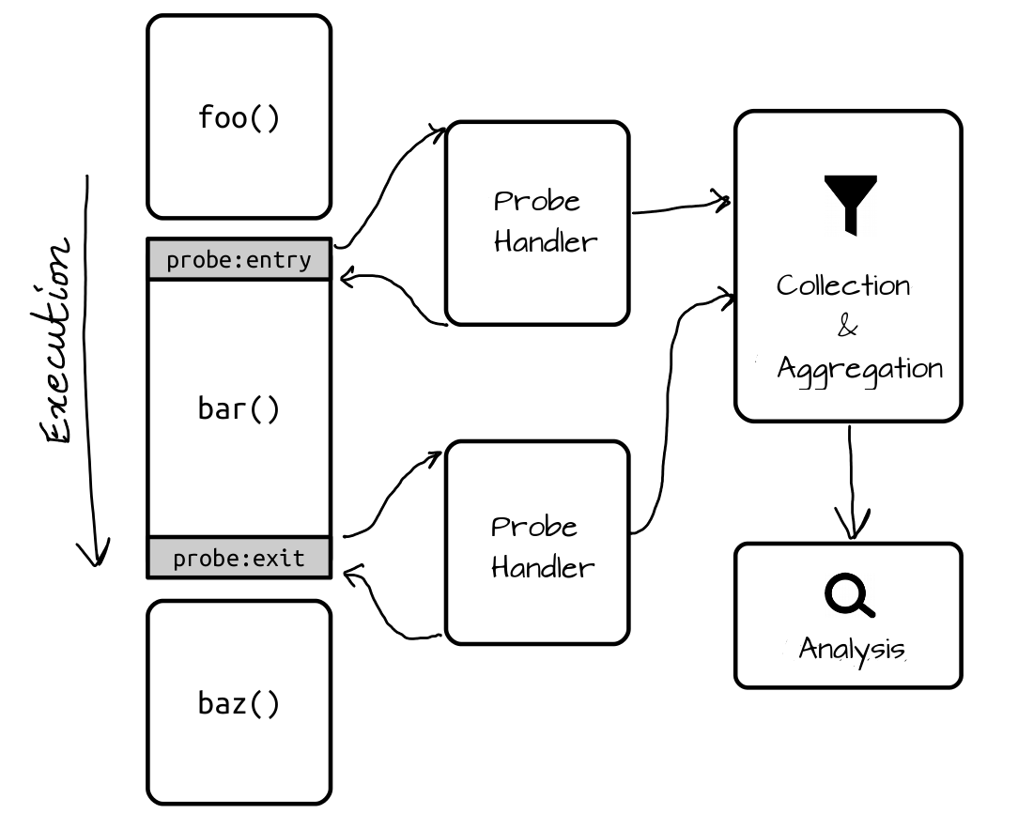
Case Study: Binary-Only Program Instrumentation (without Source Code)
Dynamic Binary Instrumentation
  Useful tool for program instrumentation and investigation for DYNAMIC analysis
Intel PIN
  Most popular, developed and supported by Intel
  Supports IA32, x86_64 for Linux and Windows
DynamoRIO
  Similar architecture with Intel PIN
  Lower-level API with finer control
    E.g., Manual register spill / fill
  Support for ARM
Valgrind
  Heavy-weighted instrumentation
  Wide architecture coverage VEX IR
  MEMCHECK runs on Valgrind
Notes:
[TODO] Add more contents later

Slide 36
Process Virtualization
process
thread
thread
A
A
process
B
C
B
C
process
process
D
D
thread
thread
thread
thread
thread
thread
thread
thread
thread
thread
E
E
F
F
operating system

Slide 37
Design Goals
Efficient
  Aiming for near-native performance (?)
Transparent
  Match native behavior
Comprehensive
  Control every instruction, in any application
Customizable
  Adapt to satisfy disparate tool needs

Slide 38

DynamoRIO History
DynamoRIO
@MIT
Determina
security startup
VMware
acquires Determina
Google sponsors
Dr. Memory
2001
2003
2007
2010
binary releases
open-sourced
BSD license
2002
2009
Derek Bruening
@Google
Notes:
Dr. Memory
LLVM + ASAN

Slide 39
Direct Code Modification
e9 37 6f 48 92 jmp <callout>
Kernel32!TerminateProcess:
7d4d1028 7c 05 jl 7d4d102f
7d4d102a 33 c0 xor %eax,%eax
7d4d102c 40 inc %eax
7d4d102d eb 08 jmp 7d4d1037
7d4d102f 50 push %eax
7d4d1030 e8 ed 7c 00 00 call 7d4d8d22

Slide 40
Debugger Trap Too Expensive
cc int3 (breakpoint)
Kernel32!TerminateProcess:
7d4d1028 7c 05 jl 7d4d102f
7d4d102a 33 c0 xor %eax,%eax
7d4d102c 40 inc %eax
7d4d102d eb 08 jmp 7d4d1037
7d4d102f 50 push %eax
7d4d1030 e8 ed 7c 00 00 call 7d4d8d22

Slide 41
Basic Interpreter
application code
foo()
bar()
A
interpreter
B
C
fetch
decode
execute
D
E
F
Slowdown: 300x

Slide 42
Improvement #1: Basic Block Cache
application code
basic block cache
foo()
bar()
A
DynamoRIO
A
B
C
C
D
D
E
E
F
F
Slowdown: 300x
25x

Slide 43
Example Basic Block Fragment
add %eax, %ecx
cmp $4, %eax
jle $0x40106f
frag7:
stub0:
stub1:
add %eax, %ecx
cmp $4, %eax
jle <stub0>
jmp <stub1>
mov %eax, eax-slot
mov &dstub0, %eax
jmp context_switch
mov %eax, eax-slot
mov &dstub1, %eax
jmp context_switch
dstub0
target: 0x40106f
dstub1
target: fall-thru

Slide 44
Direct Linking
add %eax, %ecx
cmp $4, %eax
jle $0x40106f
frag7:
stub0:
stub1:
add %eax, %ecx
cmp $4, %eax
jle <frag8>
jmp <stub1>
mov %eax, eax-slot
mov &dstub0, %eax
jmp context_switch
mov %eax, eax-slot
mov &dstub1, %eax
jmp context_switch
dstub0
target: 0x40106f
dstub1
target: fall-thru

Slide 45
Improvement #2: Linking Direct Branches
application code
basic block cache
foo()
bar()
A
DynamoRIO
A
B
C
C
D
D
E
E
F
F
Slowdown: 300x 25x
3x

Slide 46
Improvement #3: Linking Indirect Branches
application code
basic block cache
foo()
bar()
A
DynamoRIO
A
B
C
C
D
D
E
E
indirect branch lookup
F
F
1.2x
Slowdown: 300x 25x 3x

Slide 47
Indirect Branch Transformation
frag8:
mov %ecx, ecx-slot
pop %ecx
jmp <ib_lookup>
ret
ib_lookup:
...
...
...

Slide 48
Improvement #4: Trace Building
basic block cache
trace cache
A
D
G
J
A
G
B
K
B
E
H
K
E
J
F
H
C
F
I
L
D
Traces reduce branching, improve layout and locality, and facilitate optimizations across blocks
  We avoid indirect branch lookup
Next Executing Tail (NET) trace building scheme [Duesterwald 2000]

Slide 49
Incremental NET Trace Building
basic block cache
trace cache
G
J
G
K
G
J
G
K
K
G
J
G
K
K
J

Slide 50
Improvement #4: Trace Building
application code
basic block cache
trace cache
foo()
bar()
A
DynamoRIO
A
B
C
C
ind. br. stays on trace?
A
D
D
C
D
E
E
indirect branch lookup
E
?
F
F
F
1.1x
Slowdown: 300x 25x 3x 1.2x

Slide 51
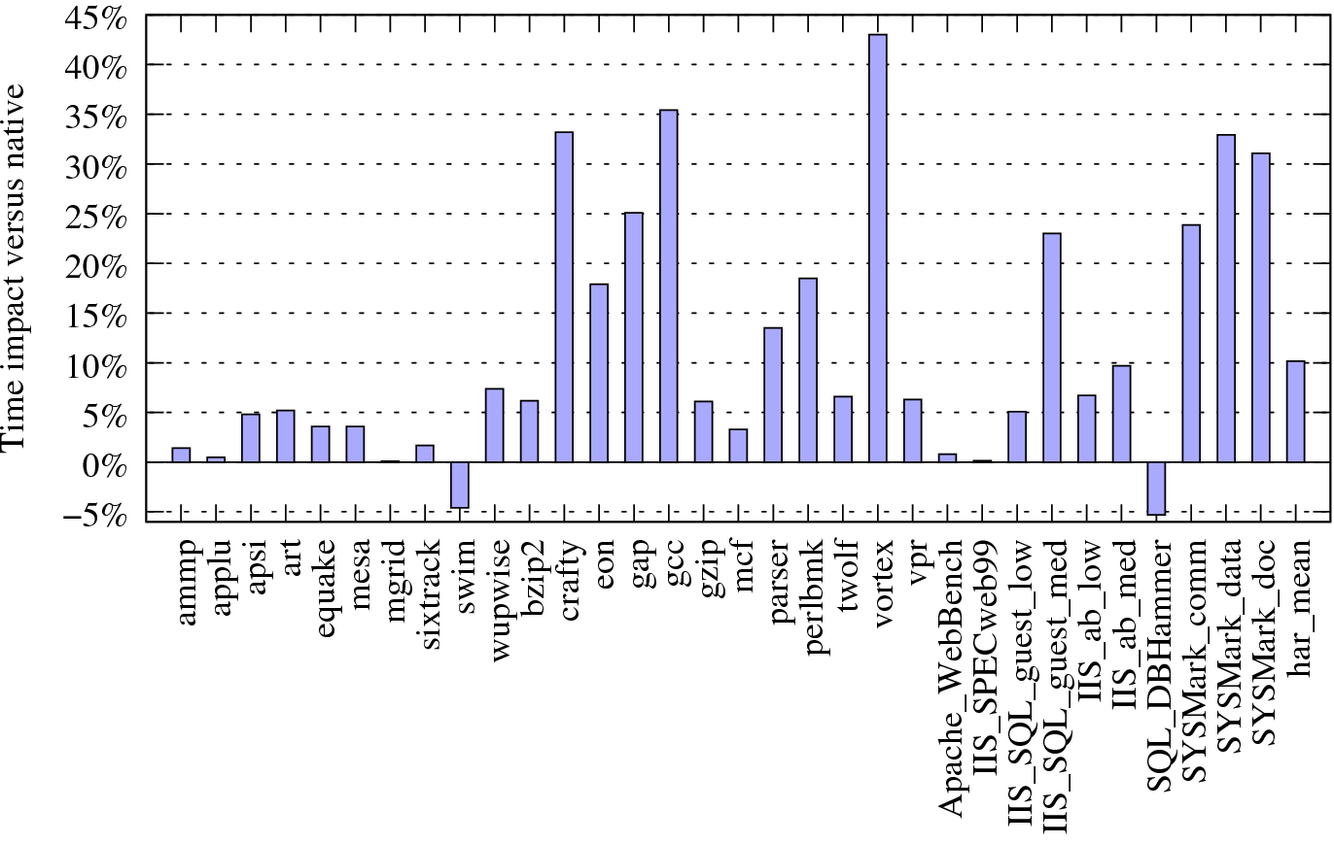
Base Performance
SPEC CPU2000
Server
Desktop

Slide 52
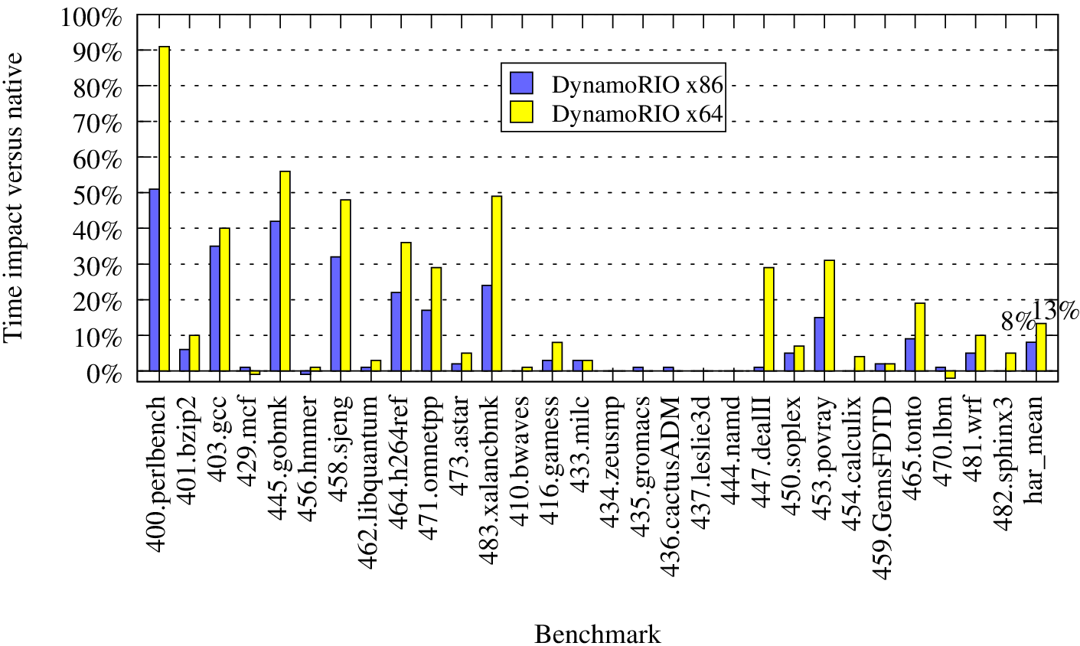
Base Performance: SPEC 2006

Slide 53
ARM: Preliminary Performance Comparison

Slide 54
Sources of Overhead
Extra instructions
  Indirect branch target comparisons
  Indirect branch hash-table lookups
Extra data cache pressure
  Indirect branch hash-table
Branch mis-predictions
  Calls and returns turn into jumps on some architectures
Application code modification

