Slide 1
CS6332: Light-weighted Virtualization
Lecture 10
Container, dockers

Slide 2



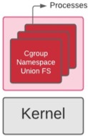

Container: Lighted-Weighted VM
Linux Kernel 3.8 first merged container supports
  System resource provisioning and Isolation
Need considerations for kernel version, OS and architectures
Notes:
Image is ugly --- draw a new one.

Slide 3
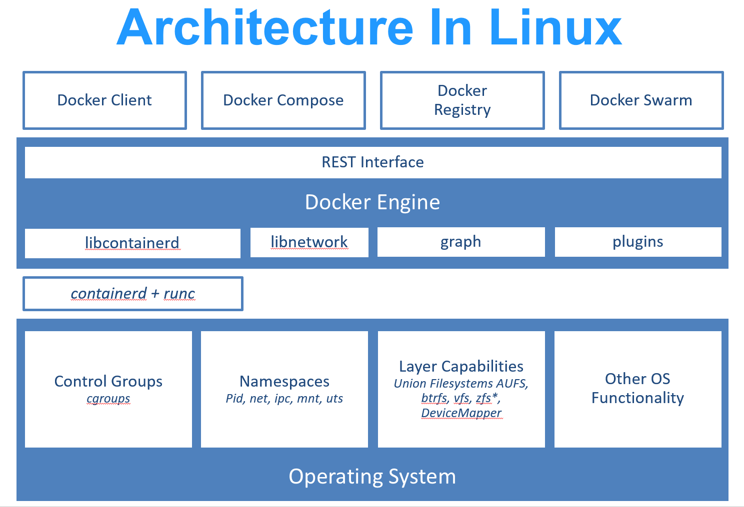
Light-Weighted Virtualization: Linux
Container image
  Files + metadata
  tar files for each layer + manifest.json
Container engine (engine)
  docker, CRI-O, LXC, libcontainerd ….
  Open Container Initiative (OCI)
  Prepare container execution by
    Handling user/API inputs
    Image pulling, mount point set-up
    Parse and prepare metadata
  Call to container runtime
Container runtime
  runc + containerd
Notes:
https://developers.redhat.com/blog/2018/02/22/container-terminology-practical-introduction#containers_101

Slide 4
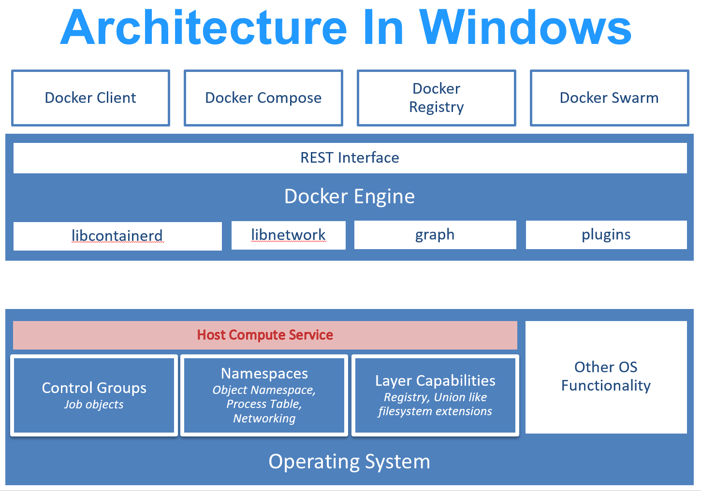
Light-Weighted Virtualization: Windows
Container image
  Files + metadata
  tar files for each layer + manifest.json
Container engine (engine)
  docker, CRI-O, LXC, libcontainerd ….
  Open Container Initiative (OCI)
  Prepare container execution by
    Handling user/API inputs
    Image pulling, mount point set-up
    Parse and prepare metadata
  Call to container runtime
Container runtime
  runc + containerd
Notes:
https://developers.redhat.com/blog/2018/02/22/container-terminology-practical-introduction#containers_101

Slide 5

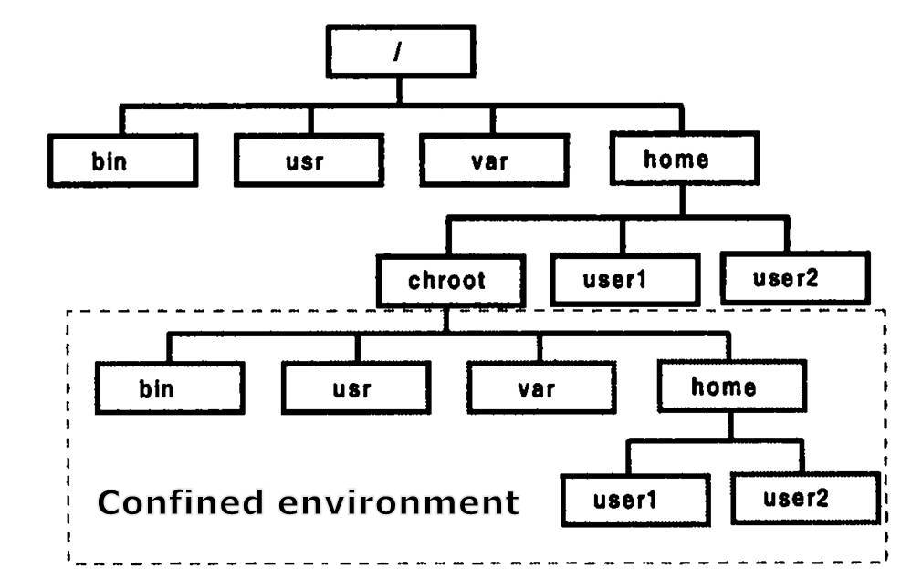

chroot: Sandboxing
Changing Root: chroot()
  Confinement at filesystem level
    A chroot is an operation that changes the apparent root directory for the current running process and their children.
  Oldest Unix isolation mechanism
  Make a process believe that some subtree is the entire file system
  File outside of this subtree simply don’t exist
What does it mean to escape
chroot'd sandbox?
Raw device access via /dev/* files ?
Notes:
• On Unix, all (non-network) devices have filenames
• Even physical memory has a filename
* Create a physical memory device, open it, and change the kernel data structures to remove the restriction
* Create a disk device, and mount a file system on it. Then chroot() to the real root

Slide 6
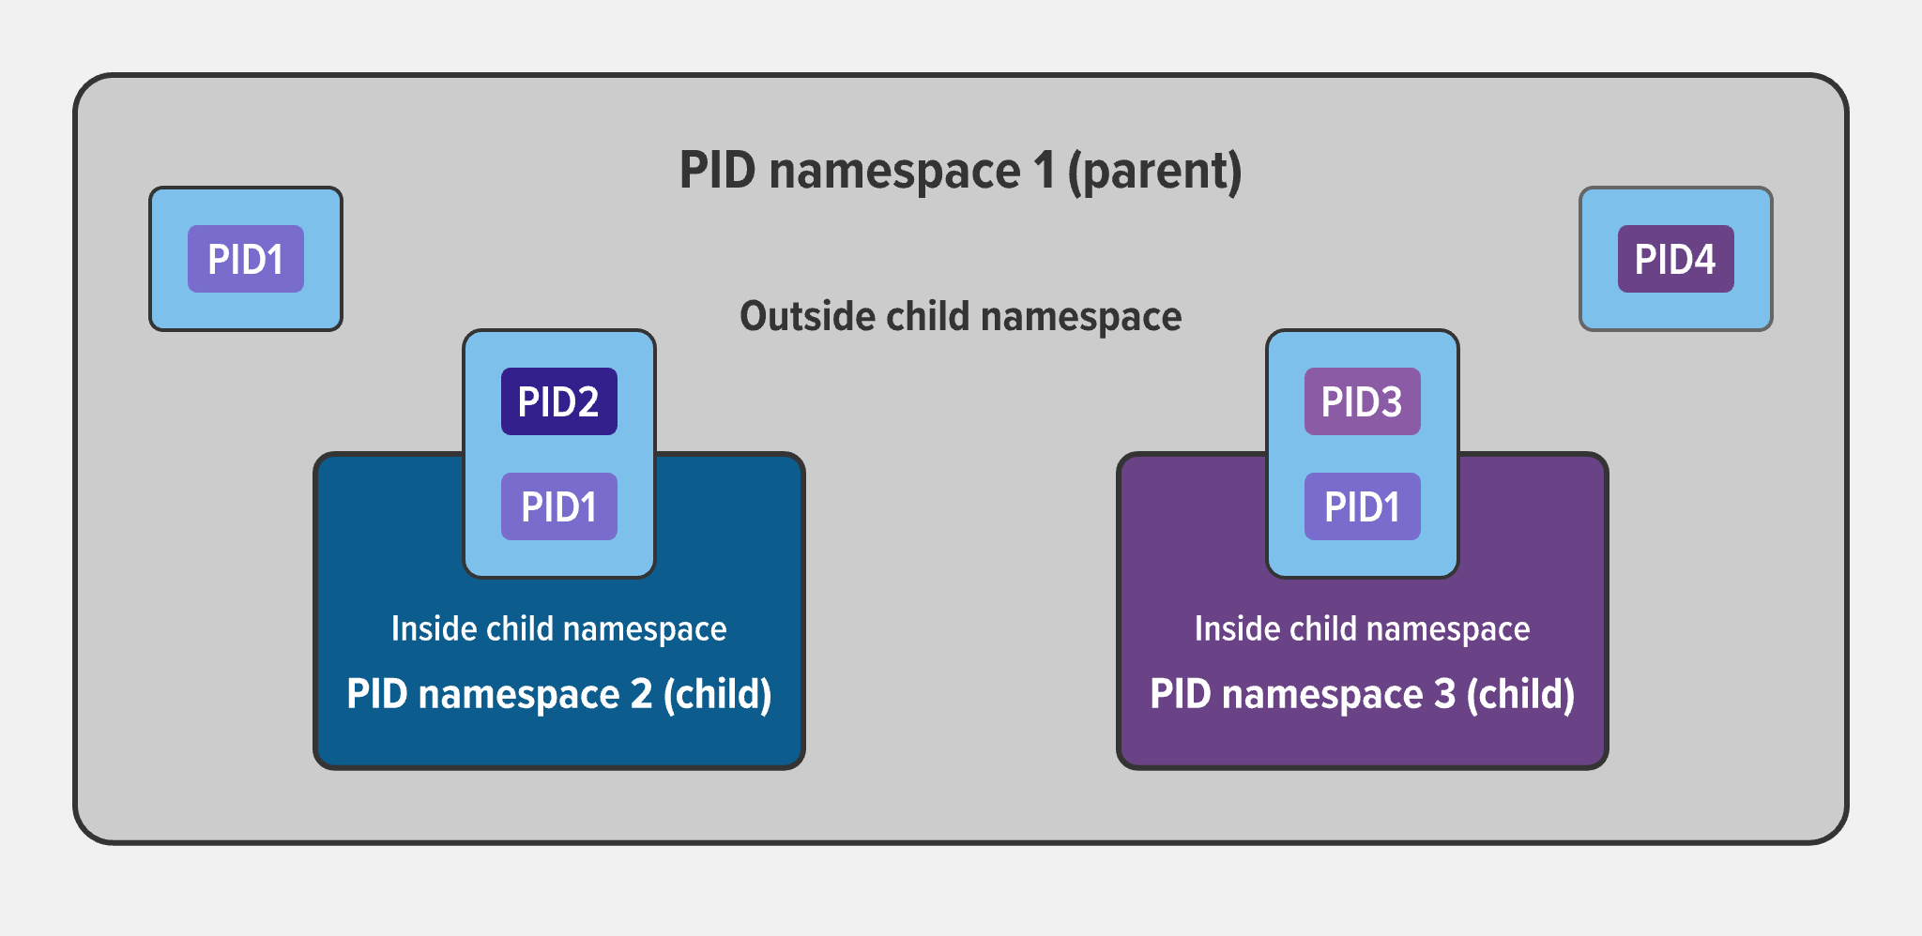
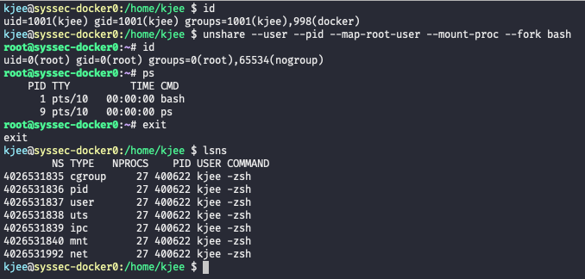
Namespace
Provides processes with their own view of system
  Another way of providing Illusion!
  Extended version of chroot()
    Filesystem and more
Namespace support for
  PID, Net, Mounts, Unix Time Sharing, User, IPC
  E.g., MySQL namespace, Apache namespace …
Explore namespace
  lsns, unshare, nsneter
Notes:
nable each container to have it's own mount points, network interfaces, user identifiers, process identifiers, etc.

Slide 7
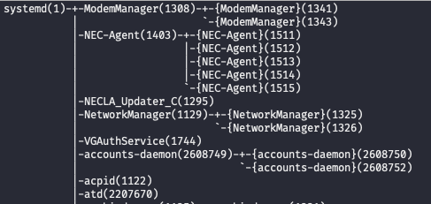
Control groups (cgroup)
Linux features for accounting and limiting system resources
  Memory, CPU, Block I/O, Network
  Device node (/dev/*) access control
cgroup is officially merged into mainline Linux Kernel since 2006
  Redesigned to embrace Namespace support in 2013
Now backbone of Linux system
  systemd
'namespace' supports isolation.
'cgroup' supports fine-grained resource accounting and control.
pstree –a

Slide 8
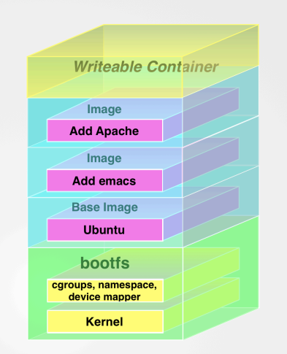
Union-cable FS (OverlayFS)
Union mounting combines multiple directories into one combined contents
  Read-only lower layers + Read-Write upper directory
    lowerdir=$ LAYER1:$SLAYER2(Read-only)
    upperdir=$CHROOT/upper
    workdir=$CHROOT/work
    ➔ $CHROOT/root
Notes:
The lower directory can be read-only or could be an overlay itself.
The upper directory is normally writable.
The workdir is used to prepare files as they are switched between the layers.
The lower directory can actually be a list of directories separated by :, all changes in the merged directory are still reflected in upper.
# ps.: `work` (passed as argument to `workdir`) is required for # overlayfs to be able to perform atomic actions.
The WORKDIR command is used to define the working directory of a Docker container at any given time. The command is specified in the Dockerfile.
Any RUN, CMD, ADD, COPY, or ENTRYPOINT command will be executed in the specified working directory.

Slide 9
Three Technical Pillars
Sandboxing with namespace isolation
  Prevent the user / program from accessing context outside the container (or sandbox)
  chroot() + many more
Resource control and accounting with control group (cgroup)
  Translation of the host resources and map to the container
  Accounting and auditing for fairness guarantee
Overlay filesystem: UnionFS
  Support for layered/versioning container images

Slide 10
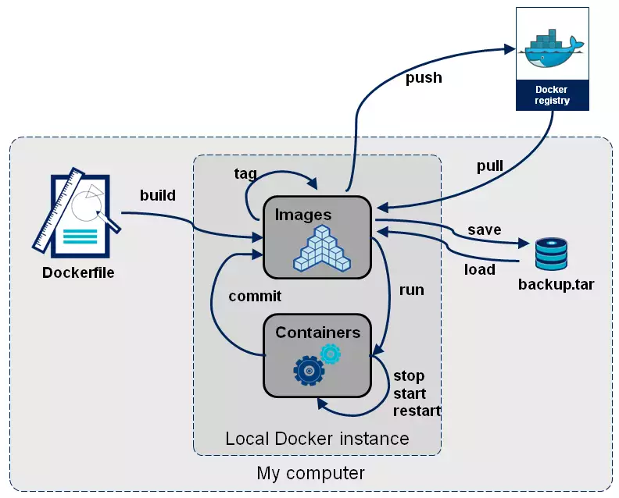
Container (docker) operation
Dockerfile
FROM syssecutd/zsh:v0.1
RUN mkdir -p /usr/lib/jvm/
COPY res/jdk1.8-amd64.tar.gz /tmp/
RUN cd /usr/lib/jvm
RUN tar xvzf /tmp/jdk1.8-amd64.tar.gz -C /usr/lib/jvm/
RUN rm /tmp/jdk1.8-amd64.tar.gz
RUN update-alternatives --install \\
/usr/bin/java java /usr/lib/jvm/jdk1.8.0_261/jre/bin/java 3
WORKDIR /root
CMD ["/usr/bin/zsh"]

Slide 11
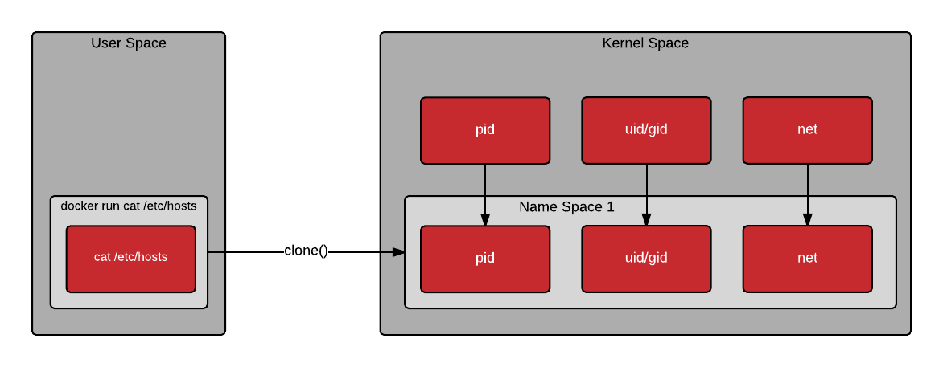
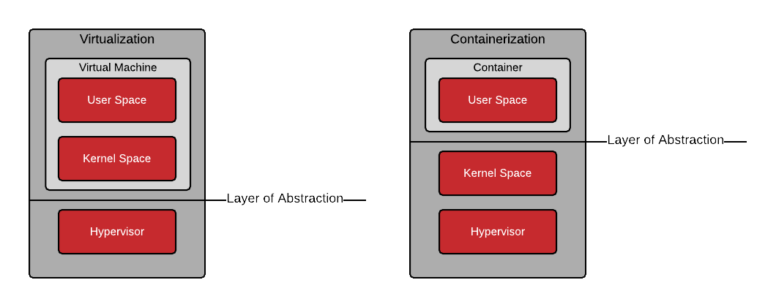
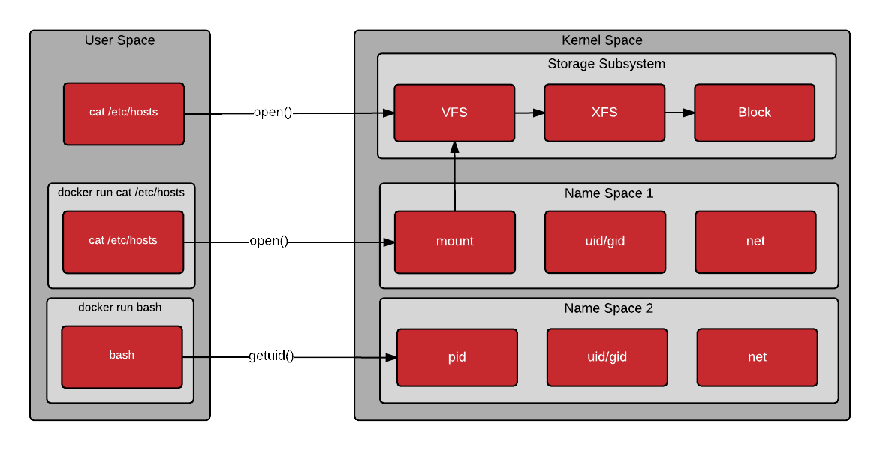
Kernel vs. User space

Slide 12
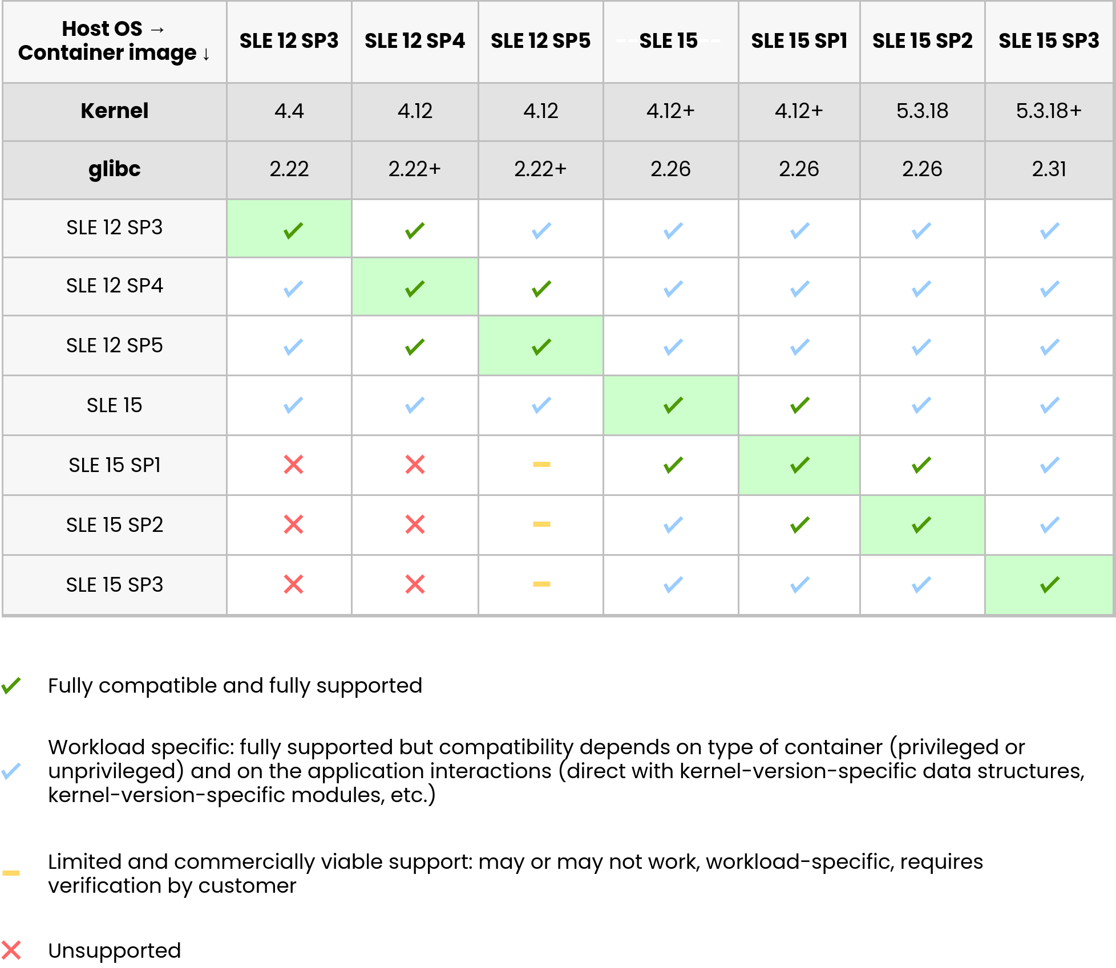
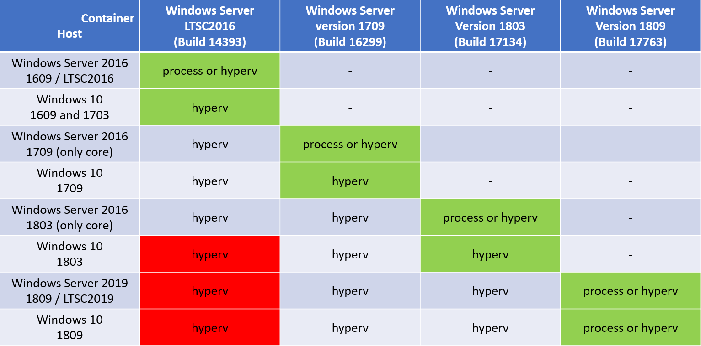
Compatibility Matrix

Slide 13
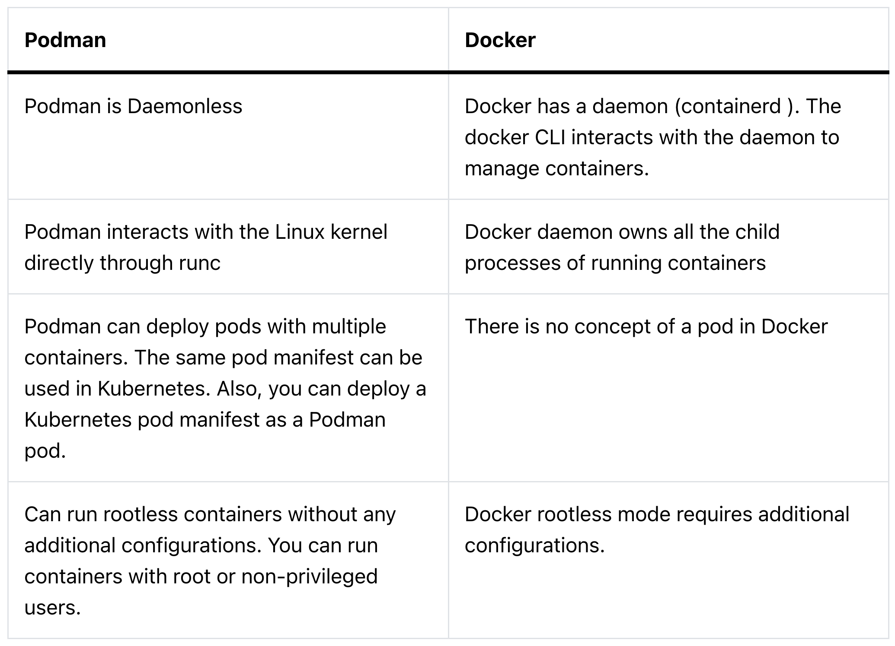
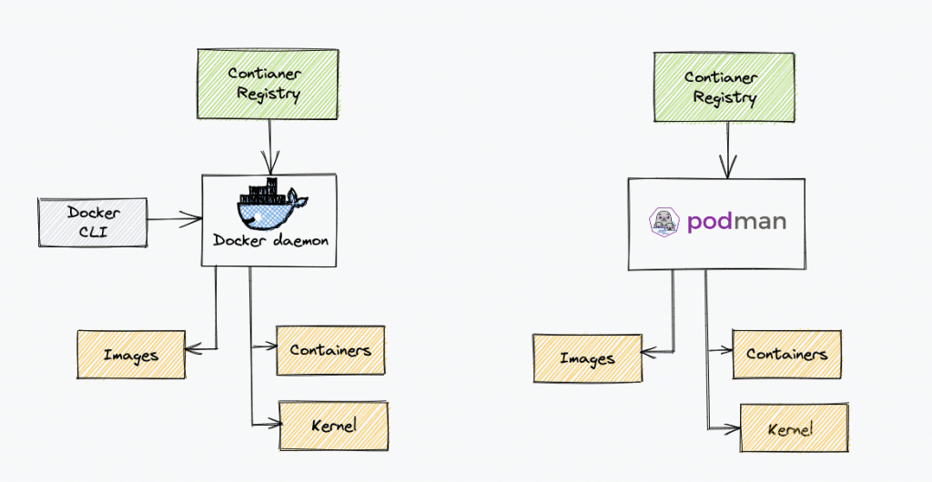
Podman vs. Docker
Notes:
https://devopscube.com/podman-tutorial-beginners/

Slide 14
Container: Tool Support
Registry server
  Fancy file server that to store docker repositories
    E.g., Docker Hub
  Essential in container ecosystem
  Implicit trust on the server and its image
Container orchestration
  Kubernetes, docker swarm, mesos
  scheduling, deployment, scaling, load balancing …

Slide 15
Backup

Slide 16
Container from Scratch
Demo
Notes:
https://ericchiang.github.io/post/containers-from-scratch/
An interesting exercise: https://www.youtube.com/watch?v=Utf-A4rODH8

Slide 17
What is Docker, Docker-Compose, Kubernetes
Docker Registry for version-controlled Docker images
Docker-compose and Kubernetes for microservice orchestration

